Slide 1

Workforce on the move: the case of Luxembourg
Fabienne Becker & Adolfo Sommarribas
LU EMN NCP
26 June 2013 Warsaw, Poland

Slide 2

Presentation outlook
Luxembourgish demography
The structure of the labour market in Luxembourg
Third-country national cross-border workers - LU EMN NCP study - 2012
Luxembourg and the highly qualified workforce - LU EMN NCP study - 2013
Challenges and barriers for highly qualified TCN
Conclusions

Slide 3

1. Luxembourgish demography
537.000 inhabitants (January 2013)

Slide 4
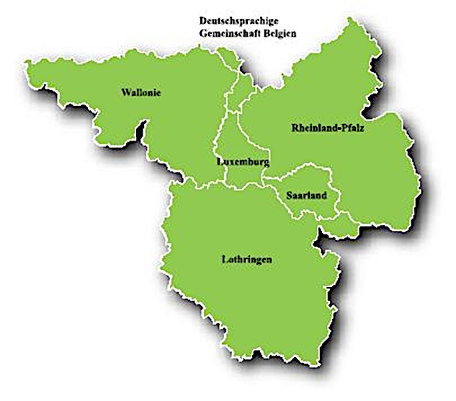
1.1 The Greater Region
Source: Study Individual Profiles and Migration Trajectories of TCN CBW 2012, p.15.
Notes:
The Greater Region is located in the heart of Europe. It covers Saarland and the southwest part of Rhineland-Palatinate in Germany, the Grand Duchy of Luxembourg, the French region of Lorraine and Belgian Wallonia with the French and German-speaking communities in Belgium, covering a total area of 65.401 km2. Luxembourg has 2586 Km2
The Greater Region constitutes the biggest political transnational space in Europe and counts almost 25% of the total number of CBWs in the EU-27 with 213.000 CBWs,

Slide 5
2. The structure of the labour market in Luxembourg (2011)
Total active wage-earner workforce: 347.100
Cross-border workers: 154.200 (44,4%)
Belgium 38.900 (25,2%)
France 76.300 (49,5%)
Germany 38.900 (25,2%)
TCN CBW 1.094 (0,7%)
Notes:
Luxemburgish economy is centered on the tertiary sector: finance and services. Also centered in new technologies (i.e. ICT and biotechnologies)
Migration policy is based on economic and humanitarian considerations
Statec, 2013

Slide 6
3. Third-country national cross-border workers (TCN CBWs) LU EMN NCP study (2012)
TCN CBW – Definition:
Person residing in Belgium, France, Germany
Regularly crossing the border
Carrying out a paid activity
Non-EU citizens
Work permit requirement
Individual Profiles and Migration Trajectories of TCN CBWs

Slide 7
3.1 TCN CBWs by gender

Slide 8
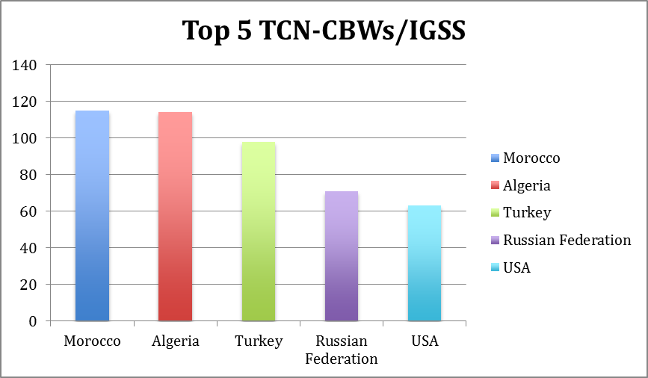
3.2 Top five nationalities of TCN CBWs

Slide 9
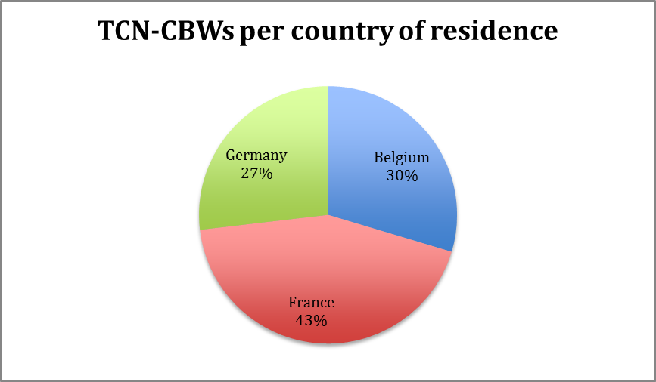
3.3 TCN CBWs by country of residence

Slide 10
3.4 Profile of TCN CBWs
Labour characteristics
Permanent work contract 87,6%
Dole beneficiaries 0,7%
Wage earners 94,5%
Full-time work contract 80,0%
Working in large companies 35,0%
Educational background
University degree/higher education diploma 51,8%
Notes:
→TNC CBW tend to belong to the highly qualified workers category
→ there is a certain level of stability in the professional status of TCN CBW

Slide 11
3.5 Migration and work reasons
Motivation to migrate to the EU
Family reasons
Studies
Work reasons
Motivation to work in LU
Salary
Possibilities for career development
Job opportunities in Luxembourg
International working context
Professional network
Notes:
Comparitive advantages
Labour market:
offers job opportunities
higher salaries
better social benefits
Neighbouring frontier regions:
much lower living costs
less job opportunities
children education

Slide 12
3.6 Challenges and barriers for TCN CBWs
Administrative barriers
Commuting time
Difficulties to change legal status
Recognition of qualifications
Integration in Luxembourg
Notes:
Most people feel integrated in their country of residence

Slide 13
4. Luxembourg and the highly qualified workforce LU EMN NCP study (2013)
Labour migration → demand-driven (low and highly qualified)
Traditionally the source of workforce → the Greater Region
Recent developments of the economy → beyond the Greater Region
Notes:
-It solves the needs of the labour market
-Demographic and educational deficit
-Economy is based on highly-added value sectors
-Government programme 2009 – 2014: Migration has to be adapted to the needs of the Luxemburgish economy
-Search worldwide
-Most TCN HQ workers come from developed or developing countries (USA, Canada, Japan, Brazil, Russia, India, etc.)

Slide 14
4.1 Legal framework
Luxembourg has anticipated the Blue Card Directive (2009/50/EC) and introduced the «highly qualified worker» residence permit in article 45 of the Law of 29 August 2008 before the enactment of the Blue Card Directive
Blue Card Directive was transposed by Law of 8 December 2011 and entered into force on 3 February 2012
European Blue Card replaced the «highly qualified worker» category

Slide 15
4.2 Requirements of the authorisation of stay
Position in ISCO/08: categories 1 and 2
Vacant position
Work contract valid for at least 1 year
Certificate of professional qualifications
Higher education diploma or 5 years work experience
Salary threshold
Notes:
For the activity or sector mentioned in the contract
Experience: In case a person does not have a higher education diploma s/he can apply if s/he proves having a professional experience of minimum 5 years equivalent to a higher education diploma and which is pertinent for the profession or the economic sector indicated in the work contract

Slide 16
4.3 Characteristics of the European Blue Card
Issuance by the Directorate of Immigration
Valid up to two years
Residence permit indicates conditions of access to labour market
Limited access to the labour market for the first two years
Renewable
Notes:
Once the authorisation of stay is approved by the Minister and the person can prove that s/he has adequate housing, the Directorate of Immigration issues the “European Blue Card”.
First two years holder will have limited access to the labour market, namely only for the activities for which s/he has been engaged in but to any employer
with equal conditions as a national, with the exception of the jobs that are directly or indirectly related to the exercise of public authority. Equal access to highly qualified positions as a national after renewal (exception: public authority)
Residence permit is renewed if the conditions are fulfilled

Slide 17
4.4 Advantages of the European Blue Card in comparison to the «Wage-earner» permit
No labour market test
Automatically family reunification right
Fast-track procedure
Facilitation for obtaining long-term residence status
No negative consequences in case of unemployment
Tax incentives
Notes:
Minister has to answer in a delay of 90 days after the complete application is filed.
Time spent in another Member State as a HQ worker will be taken into account for obtaining long-term

Slide 18
4.5 Top five nationalities of European Blue Card holders (in absolute numbers, 2012)
Source: Directorate of Immigration, 2013

Slide 19
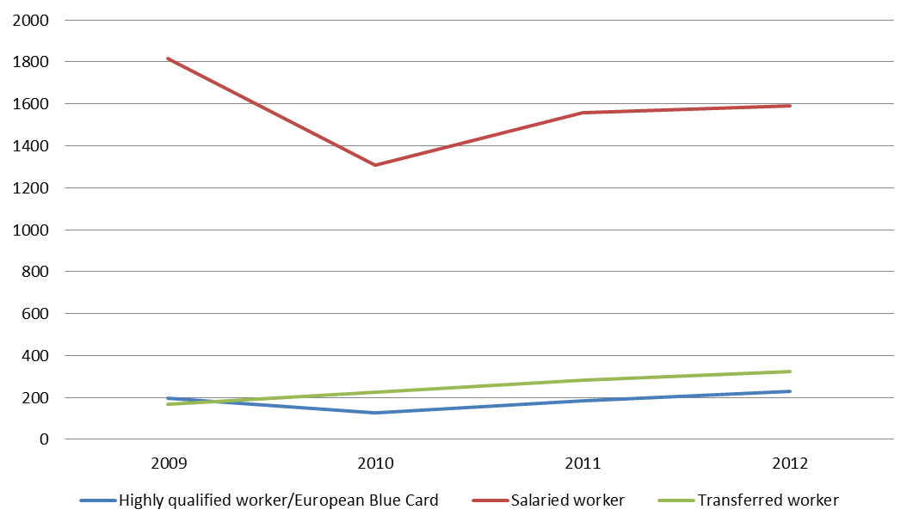
4.6 Evolution of wage-earner residence permits by category (2009 - 2012)

Slide 20
5. Challenges and barriers for highly qualified TCN
Overly restrictive definition of “highly qualified”
Language barriers
Schooling
Housing
Bureaucracy
Lack of information
Notes:
Official documents and government websites are mostly in French
-Integration into the Luxembourgish society is difficult partly due to language barriers
-Different official languages enable different angles of integration
-The accompanying spouse might have difficulties finding a job, or even integrating in the society
-Courses in public schools are thaught in Luxembourgish, French and German
-Only 6 private schools
-High fees
-Capacity is a major issue
-International bacchalaureate diploma is only provided at the secondary level and an admissions test has to be passed which takes place only once a year
Housing:
-Finding an accommodation can be difficult in Luxembourg as there are more demands than offers on the Luxembourgish real estate market.
Administrative procedures hinder the workflow of the business
Problems that occur when highly qualified workers are applying for a work permit in Luxembourg:
-Difficulties to reach administrative facilities via phone
-Files are not transferred when functionaries are out of office
-Applicants may not have receipts confirming when their files have arrived
-Processing of files lacks transparency
-There are often delays that can lead to complicated situations for the applicant.
-Prevalent lack of information for foreigners coming to Luxembourg
-The situation is different for TCN, who will work for major companies that hand out ‘welcome packages’ to new employees
-Language barrier
Drive to improve this situation:
-The Luxembourgish Reception and Integration Office promotes orientation and information activities
-The AMCHAM published a brochure called ‘Working in Luxembourg’
-Some existing websites for international communities in Luxembourg

Slide 21
6. Conclusions
In Luxembourg, migration is characterized by EU mobility, especially by cross-border workers coming from the Greater Region
Third-country nationals represent only 6,1% of the population living in Luxembourg
Government policy is focused on high qualified workers and researchers

Slide 22
6. Conclusions
TCN CBWs tend to be highly qualified and to have a certain level of stability in their professional status
As part of the migratory process TCN CBWs often acquire the nationality of an EU Member State
There is a higher level of integration in the country of residence of TCN CBWs
Barriers for highly qualified TCNs are often language based

Slide 23
Thank you
for your attention!

