Slide 1
GEOTHERMAL ENERGY
FOR
BREATHING CITIES
2020

Slide 2
Arctic Green Energy
50 | million m² geothermal district heating capacity
60 | cities with AGE´s operation
7,500,000 | tons of CO₂ saved
4.1 | GW_{th} generated in 2019
15 | MW_{e} generated in 2019
>50 | patents registered
520 | wells drilled
399 | heat centrals

Slide 3











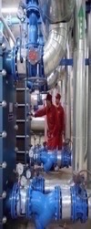

The Global Energy Transition & Heat
The Problem
Heating cities with fossil fuels has created massive pollution, environmental damage, and deteriorating public health
The Solution
GeoDH & GeoDC for heating and cooling cities with co-generation from other renewables
The Team to Deliver
Exceptional track record as pioneer in large scale profitable geoDH

