Slide 1
Polish regulatory framework related to licensing of nuclear facilities

Slide 2
Presentation plan
Regulatory framework in Poland
Licensing process
General opinion of the PAA President

Slide 3
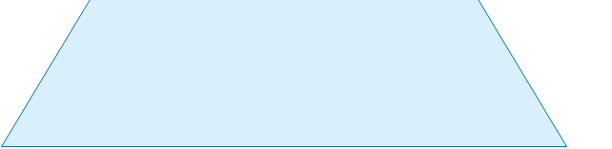
Regulatory framework
Constitution
Legally binding
Act – Atomic Law
Regulations
PAA President's Recommendations
Non-binding

Slide 4
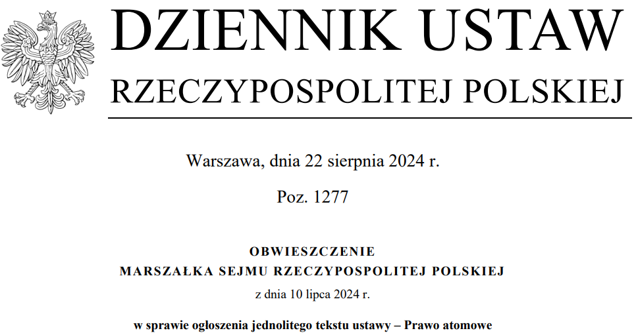
Regulatory framework
Act of 29 November 2000 – Atomic Law
Introduces a unified system to ensure nuclear safety and radiological protection for workers and the general public in Poland.
The Act regulates all types of activities involving exposure to ionizing radiation.
Its most relevant provisions cover:
The issuance of permits / licenses for these activities.
The responsibilities of the heads of organizational units conducting activities.
The supervisory power of the PAA President to oversee these activities.

Slide 5
Regulatory framework
Regulations
Examples:
Regulation on nuclear safety and radiological protection requirements which must be fulfilled by a nuclear facility design.
Regulation on the scope and method for the performance of safety analyses prior to the submission of an application requesting the issue of a license for the construction of a nuclear facility and the scope of the preliminary safety report for a nuclear facility.
Regulation on detailed scope of assessment with regard to land intended for the location of a nuclear facility, cases excluding land to be considered eligible for the location of a nuclear facility and on requirements concerning location report for a nuclear facility.
Regulation on documents required when submitting an application for the issuance of a license to perform an activity related to exposure to ionizing radiation.

Slide 6
Regulatory framework
PAA President's Recommendations
The President of the PAA issues technical and organizational recommendations in matters of nuclear safety and radiological protection, which may serve as guidelines.
The PAA President issued the following recommendations related to nuclear facilities:
Recommendations for assessing ground seismicity for the location of nuclear facilities.
Recommendations for assessing the tectonic stability of the ground and fault activity for the location of nuclear facilities.
Recommendations for assessing geological-engineering and hydrogeological conditions for the location of nuclear facilities.
Recommendations for defining Emergency Planning Zones and Extended Planning Distance around an organizational unit performing activities classified as Category I or II hazards.

Slide 7
Presentation plan
Regulatory framework in Poland
Licensing process
General opinion of the PAA President

Slide 8
Licensing Process of nuclear power plants
Construction
Commissioning
Operation
Deommissioning
License to construct
License to operate
24 months
5 mln PLN
6 months
1,9 mln PLN
License to commission
License to decommission
9 months
1,9 mln PLN
9 months
2 mln PLN

Slide 9
Presentation plan
Regulatory framework in Poland
Licensing process
General opinion of the PAA President

Slide 10
Dialogue tools – opinions of PAA President
One of the voluntary forms of dialogue between investors and the Polish nuclear regulatory authority are the opinions of PAA President. These can generally be divided into:
general opinions of PAA President concerning planned organizational and technical solutions in future activities and draft documents,
preliminary opinions of PAA President concerning the planned location of a nuclear facility or specific aspects of the location of a nuclear facility, submitted before the application for a construction license for a nuclear facility,
opinions of PAA President in the field of nuclear safety and radiation protection regarding the preliminary site report.

Slide 11
General opinion of PAA President
PAA President’s general opinion in the Atomic Act:
Before applying for a licence, the investor may request the PAA to issue a general opinion on:
the planned organisational and technical solutions,
draft versions of documents to be submitted along with the licence application.
The investor shall attach to the application for a general opinion (depending on the scope of the application):
a) documentation of planned organizational and technical solutions, in particular:
description or documentation of the Integrated Management System,
description or documentation of Systems, Structures and Components.

Slide 12
General opinion of PAA President
b) drafts of relevant documents referred to in the Regulation on documents required when submitting an application for the issuance of a license to construct an NPP, e.g.:
Siting report.
Preliminary safety analyses report.
Source reports on PSA of the 1st and 2nd level.
Description and results of the verification of the safety analyses.
Documentation regarding the safety classification.
List and characteristics of the content of design documentation of the nuclear facility.
Documentation describing the Integrated Management System for the construction phase of the nuclear facility.
Nuclear facility decommissioning programme.
Plan of the physical protection system for the nuclear facility and nuclear materials.
Construction schedule.
Environmental radiation monitoring program.
Basic information on the system of managing radiation emergencies.

Slide 13
General opinion of PAA President
  General opinion of the PAA President on the planned organizational and technical solutions or drafts of documents to be submitted along with the licence application.
Opinion is not mandatory – scope is defined by applicant.
The application fee is 350 000 PLN (~82 000 EUR).
The general opinion will be issued within 6 months or in particularly complex cases – within 9 months from the date of submission of the application.
Preparation of application for licence to construct (LTC) by the investor
Regulatory review of the application for LTC
Application for the general opinion
General opinion
of PAA President
Application for the general opinion
General opinion
of PAA President
Application for construction licence

Slide 14
General opinion of PAA President
The PAA President has so far issued the following general opinions:
23 May 2023 at the request of ORLEN Synthos Green Energy – general opinion on selected technical assumptions of BWRX-300 reactor technology.
9 June 2023 at the request of Polskie Elektrownie Jądrowe – general opinion on the description (scope and detail) of the independent verification of safety analyses.
22 December 2023 at the request of KGHM Polska Miedź – general opinion on selected technical assumptions of NuScale reactor technology.
26 April 2024 at the request of KGHM Polska Miedź – general opinion on the safety analysis methods used by technology provider NuScale NPM-20 in the field of basic safety.
30 August 2024 at the request of Polskie Elektrownie Jądrowe – general opinion on safety classification.
28 March 2025 at the request of Polskie Elektrownie Jądrowe – general opinion on the Circulating Water System at a nuclear power plant.
The PAA President's general opinions are available (in Polish) at: https://www.gov.pl/web/paa/wydane-ogolne-opinie-prezesa-paa

Slide 15
Thank you for your attention

