Slide 1
NORCE – Norwegian Research Centre AS
Dr. Kirsti Midttømme
Chief Scientist, Dep. of Technology

Slide 2



This is NORCE
1000
Employees
7
Leading institutes
6
Key areas of research
1,3
Billion NOK
4
University owners
10
Cities
40
Nationalities

Slide 3
Locations
Tromsø
Bardu
BODØ
Bergen
Oslo
Haugesund
Stavanger
Kristiansand
Grimstad

Slide 4



NORCE
Energy
Health
Climate
Environment
Social Sciences
Technology
Notes:
Prototech
A provider of technical solutions, prototype- and product development, manufacturing and test services covering application areas from space to the ocean floor.
GEXCON
Gexcon AS is a world-leading company in the field of safety and risk management and advanced dispersion, explosion and fire modelling. Gexcon’s experience arises from detailed knowledge of explosion phenomena built up throughout years of extensive research projects, carrying out safety assessments, performing accident investigations and performing physical testing at the company's own dedicated facilities on the Norwegian island of Sotra outside Bergen.
Tecom
Tecom AS was established in order to handle commercialization and attend to IPR at former CMR.
Polytec
Polytec contributes, through research and development, to creating value in the region. Our goal is to convert our professional strength into solutions that help your business succeed. We wish to retrieve the whole potential – if it is gas, oil or renewable energy – Polytec aims for effective solutions.
NUBU
The Norwegian Center for Child Behavioral Development (NUBU)
The research conducted here shall be action directed and among other factors linked to implementation and evaluation of methods used to work with behavioral problems.
NIOM
Nordic Institute of Dental Materials (NIOM) works to ensure that dental biomaterials are safe and effective. We undertake research, participate in standardization and provide clinical relevant advice to the dental health services and health authorities in the Nordic countries. NIOM offers research-based consultancy and accredited testing according to international standards. Our independent test laboratory delivers accurate and independent data accepted for third-party evaluations of dental materials and instruments.

Slide 5
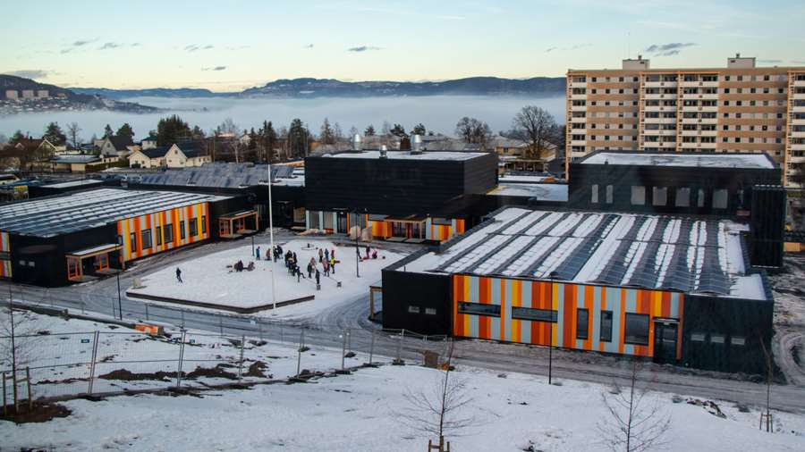
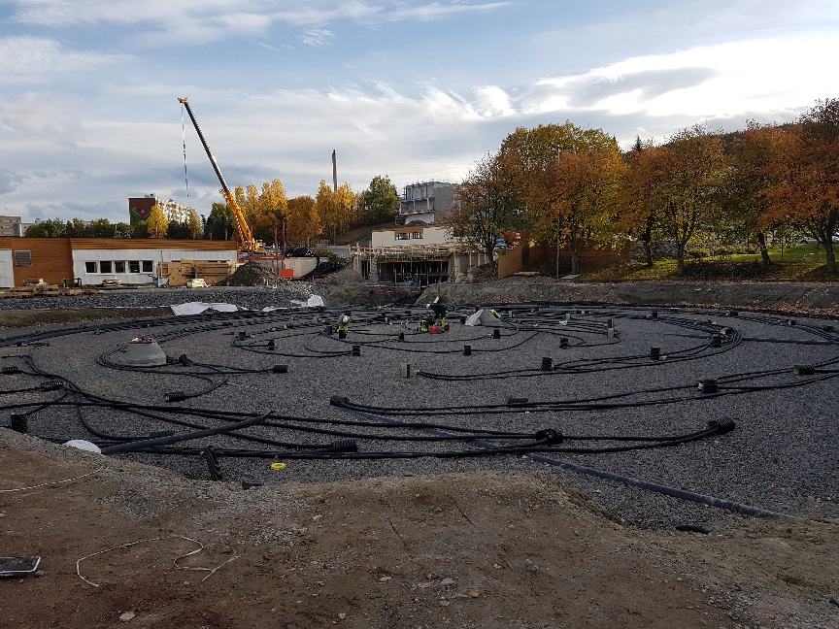
Innovative and energy-efficient school buildings
Fjell school, Drammen
Medium-temperature borehole thermal energy storage (BTES)
100 boreholes of 50 m depth
Solar collectors 150 m²
Photovoltaic (roof 900 m² + wall 100 m² )
CO₂ heat pump (producing heat from air)
Heat delivery; ca 350 MWh /year
Distribution systems: floor heating (water) and ventilation (air)
Heat power: base load: 80 kW, peak load ca 300 kW
Charging the BTES ca 700 MWh year
Distributed temperature fiber – optic monitoring in 11 boreholes
In operation from april 2020
Owner and operator: Drammen municipality

Slide 6
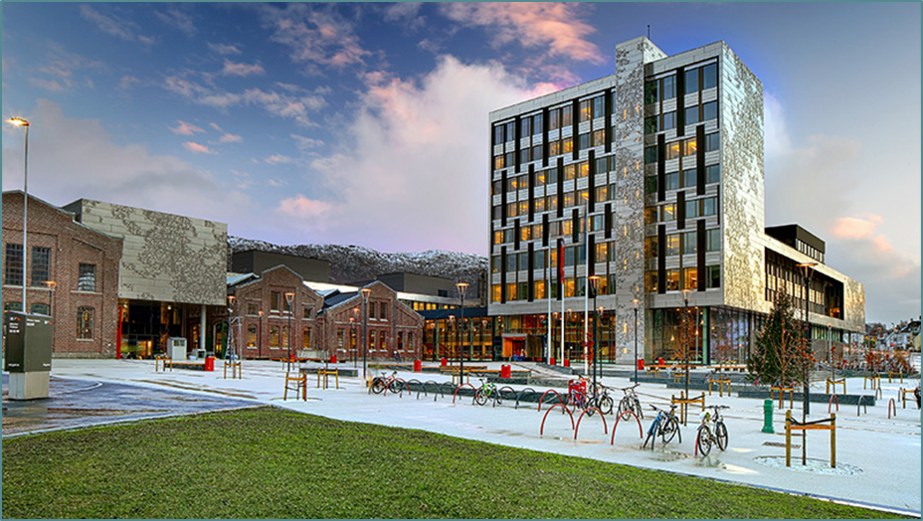
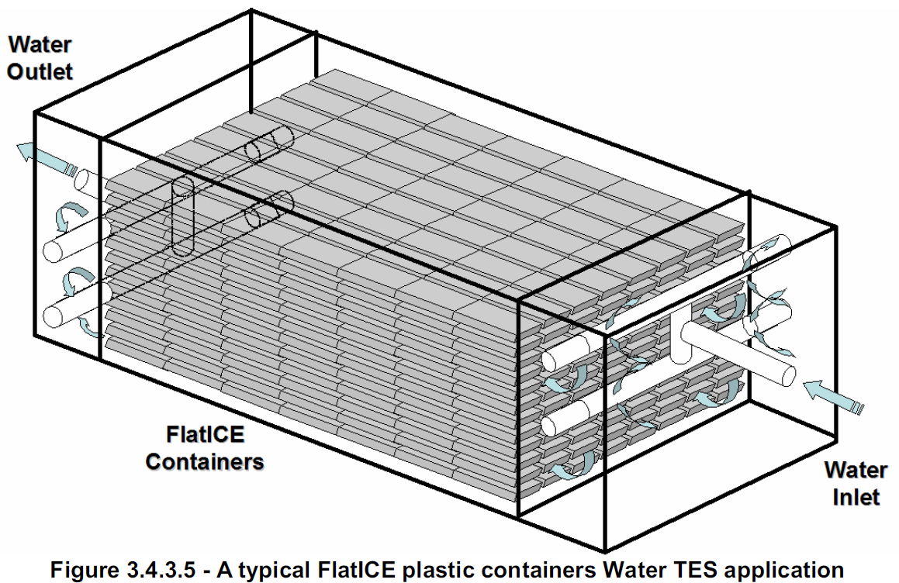
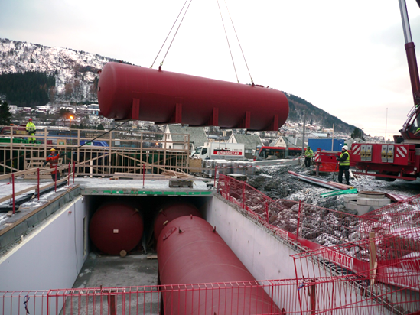
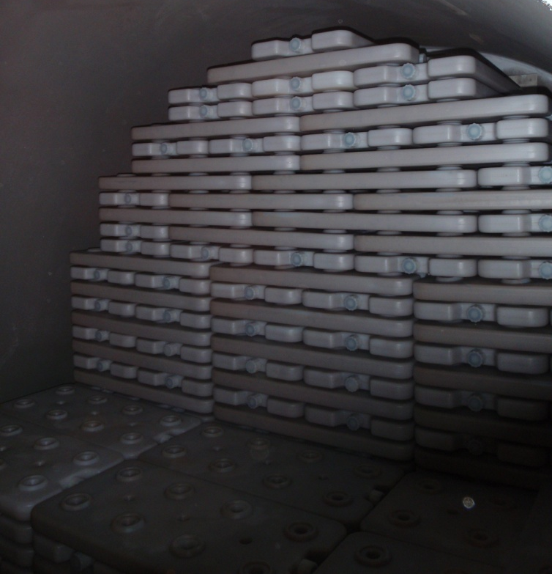
Innovative and energy-efficient school buildings
University Collage of Western Norway, Bergen
Integrated thermal energy storage combining PCM storage and BTES
Gross area 51 000 m2
In operation since 2014
BTES (borehole field) 81 boreholes to 220 m depth
Phase Change Material (PCM) for short-term thermal storage
  4 tanks a 70 m3 containing 12 700 Flat-ice elements
  Cooling capacity 11 200 kWh

Slide 7
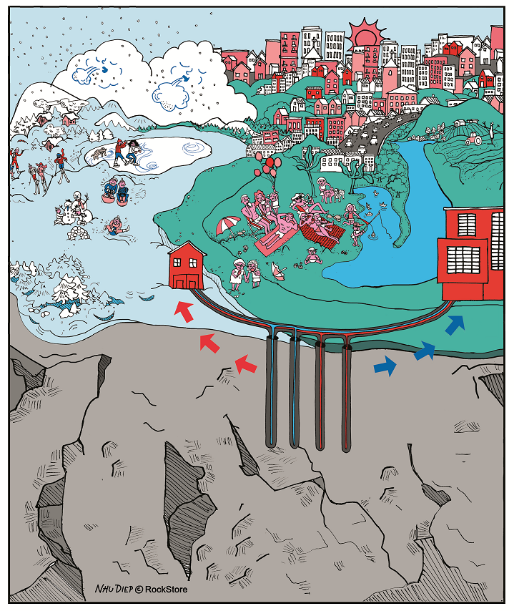



Construction/modernization of municipal heating systems and elimination of indvidual heat sources
Partner in ongoing and new projects
Horizon 2020
Robinson Smart integRation Of local energy sources and innovative storage for flexiBle, secure and cost efficIent eNergy Supply ON industrialized islands
EEA Regional Cooperation
Improving the energy efficiency of geothermal energy utilisation by adjusting the user characteristics (Poland, Hungary, Slovakia, Iceland, Norway
Research Council of Norway
Integrated Renawable Resources and Storage: Operation and Management (India – Norway collaboration)
Develop, demonstrate and monitor the next generation borehole thermal energy storage (BTES) systems

Slide 8
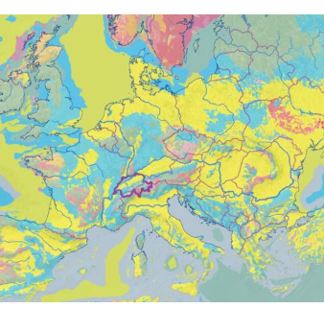
Geothermal energy production
Exploiting oil and gas North Sea → exploiting geothermal in Poland
Exploration
Production
  Thermal Monitoring
    Flow monitoring sensor and fiber-optic measurement technology
  Reservoir / resource state
    Isotope Geochemistry
Fluid and thermal modelling
Drilling and well planning
  Stability, cost, targeting, drilling at high temp, drilling underbalanced
Reservoir modelling
  Multiphase aqueous
Integrated energy systems
Geological map of Europe

Slide 9
Thanks for your attention
Kirsti Midttømme
kimi@norceresearch.no
www.norceresearch.no
@NORCEresearch

