Slide 1
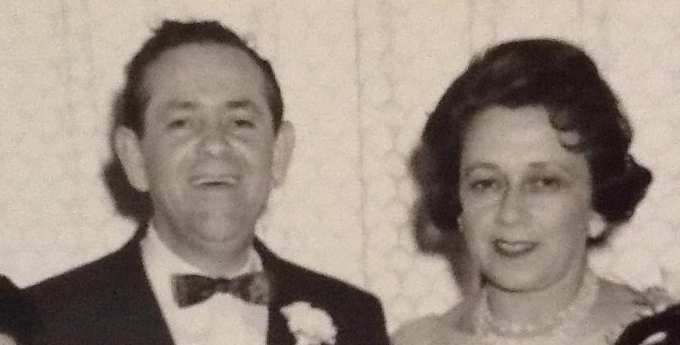
The Holocaust Journey and Survival of my Parents, Samuel Hornung & Ella (Zaks) Hornung

Slide 2
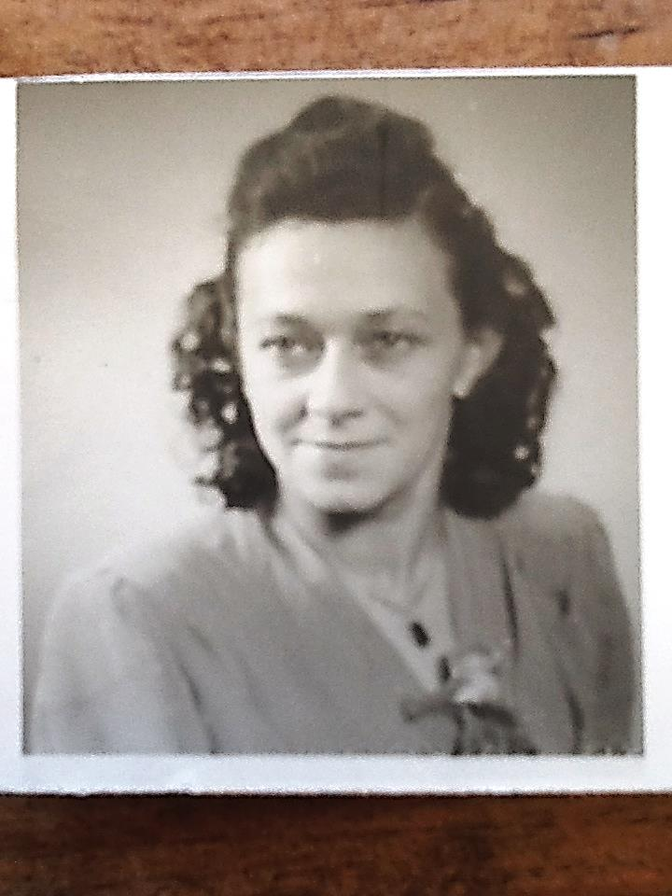
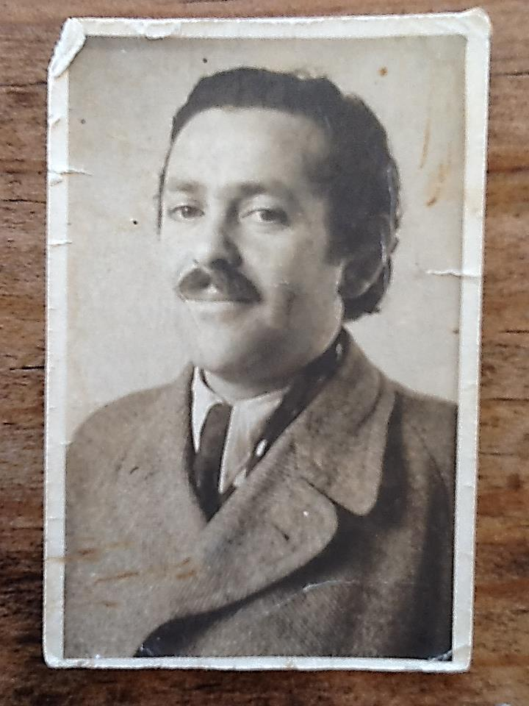
Ella Zaks Samuel Hornung
Both my Parents were Jewish Polish citizens
Ella (Mom) born 1917 in Radomsko
Sam (Dad) born 1911 in Oswiecim…

Slide 3
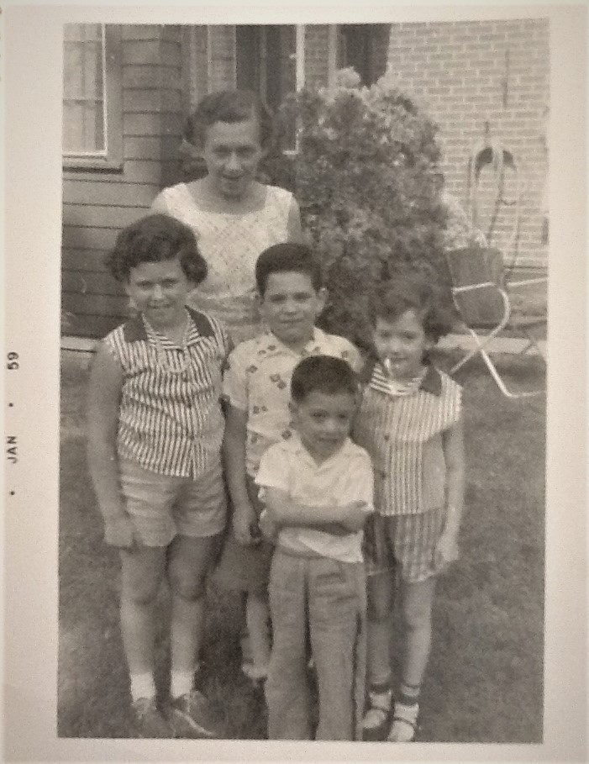
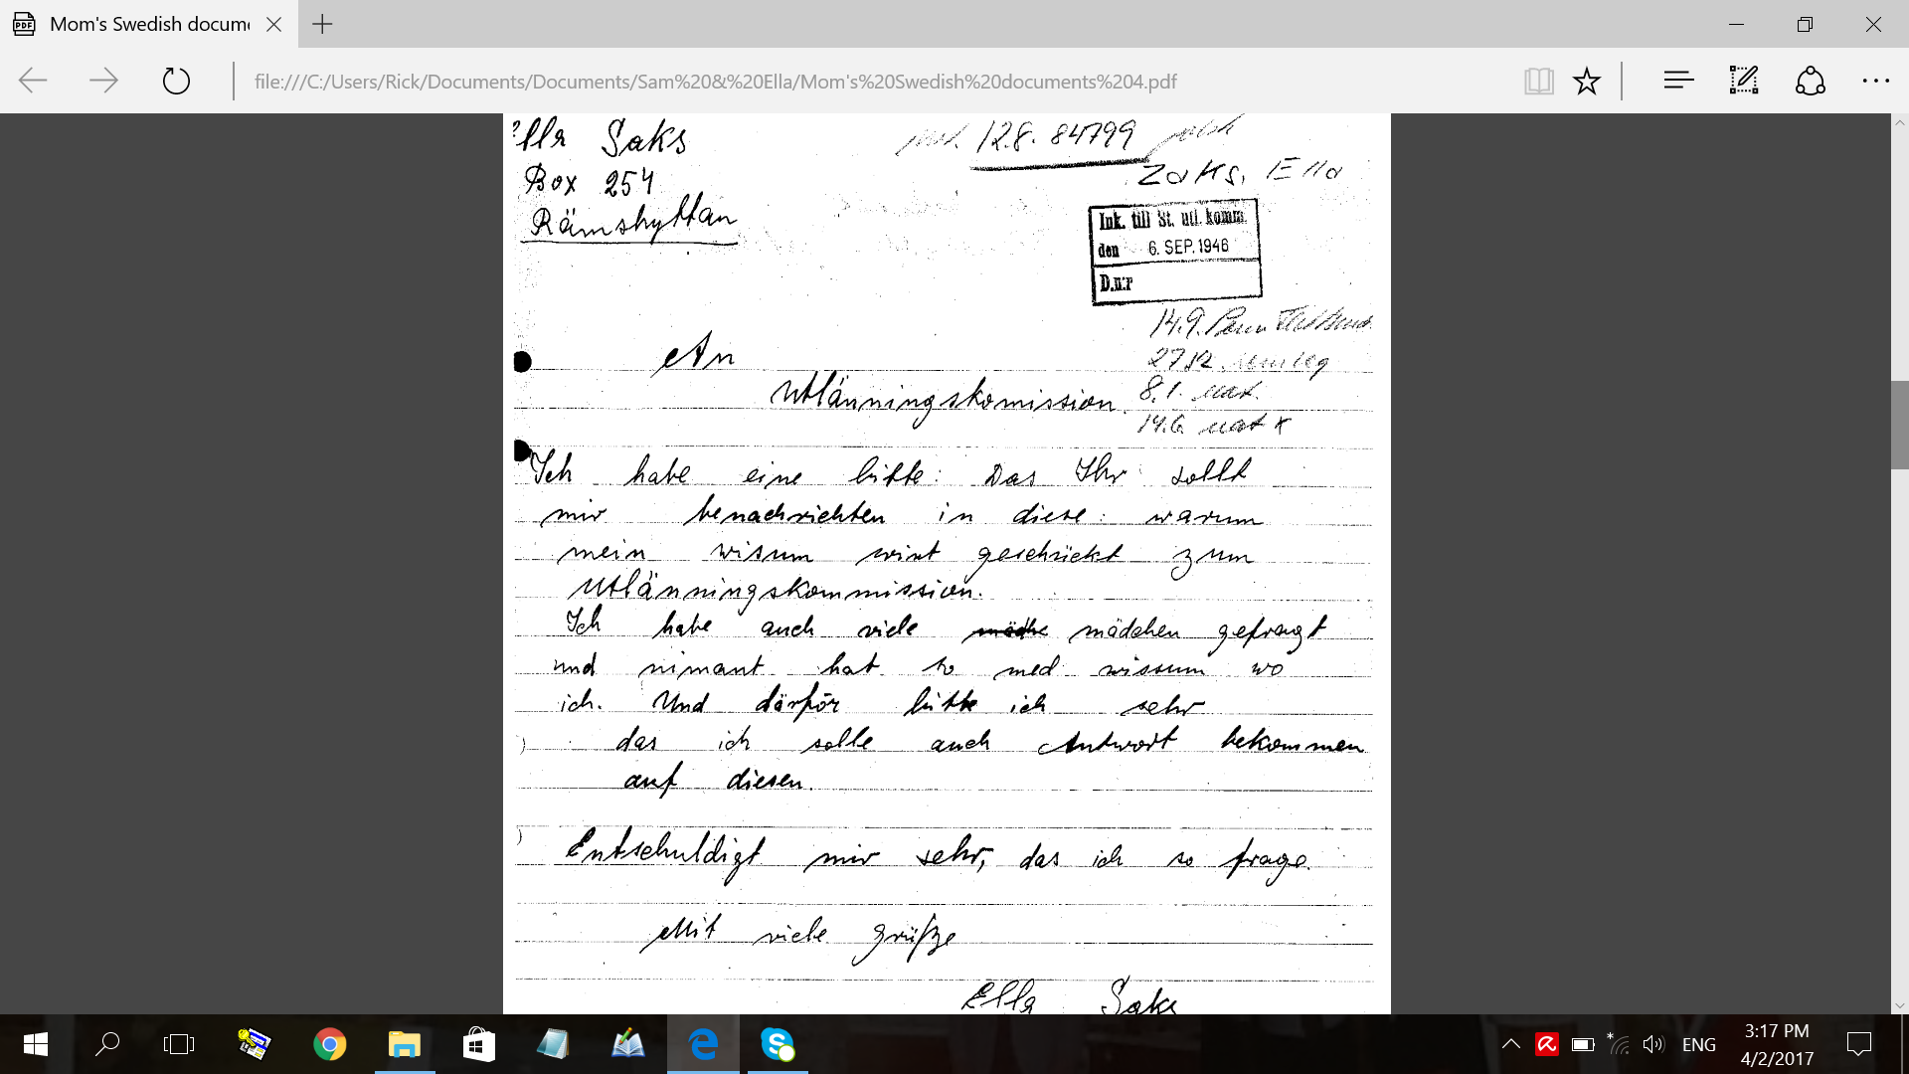
An early memory of growing up in Detroit…
Mom
Here is an example of my Mom’s handwriting on a letter she wrote…
Me

Slide 4
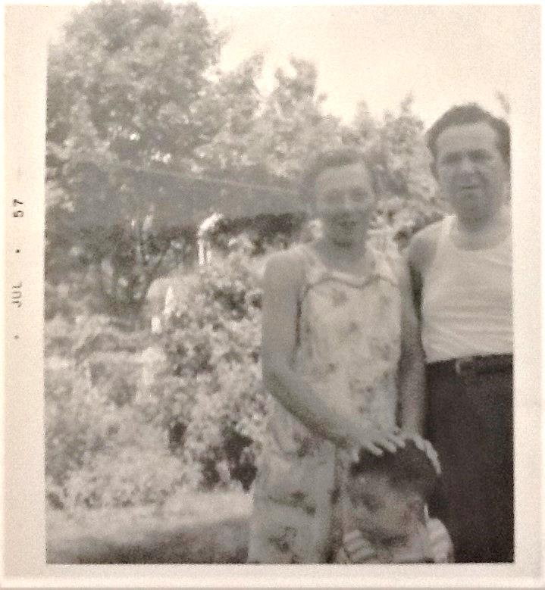
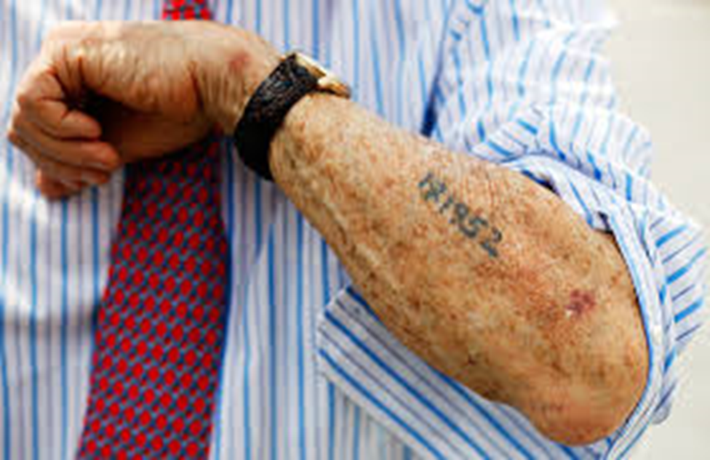
An early memory of growing up in Detroit…
Dad
Me, again
Similar tattooed numbers to those on Dad’s arm, 177395

Slide 5
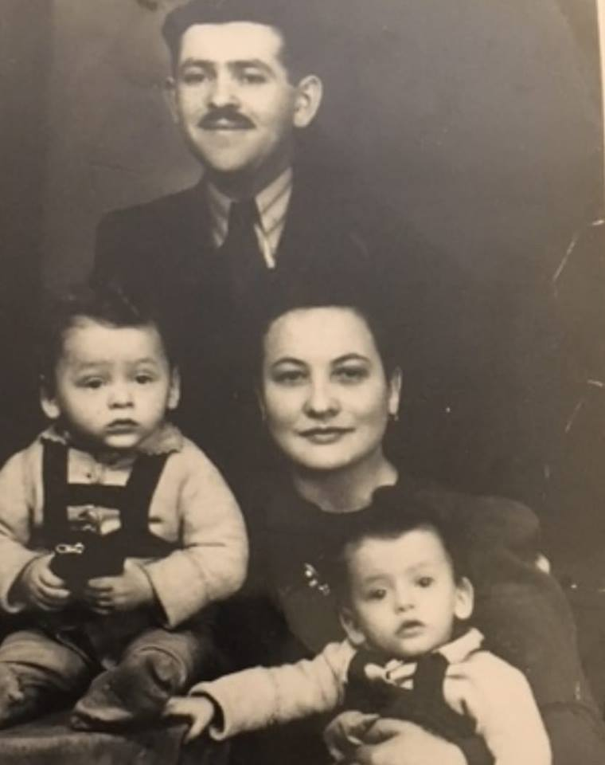
Before World War 2, my Dad was married to Regina. Their twin sons, Henryk and Szaja Wigdor were born 31 Jan 1940.
On 29 March 1941, they were forced out of their home to live in Sosnowiec Ghetto.
Then on 1 April 1944 Dad and his family were sent to Auschwitz Death Camp...

Slide 6
In April 1941, Mom was forced by the Nazis to live at Czestochowa Ghetto.
From Oct 1942, for the next two years, she was a slave labourer at the Hanag munitions factory.
In Dec 1944, Mom was sent to Ravensbrueck Concentration Camp to do hard labour…

Slide 7
How did they survive the Holocaust?
Where and how did they meet?
Here are their stories, of Resilience and Rescue

Slide 8
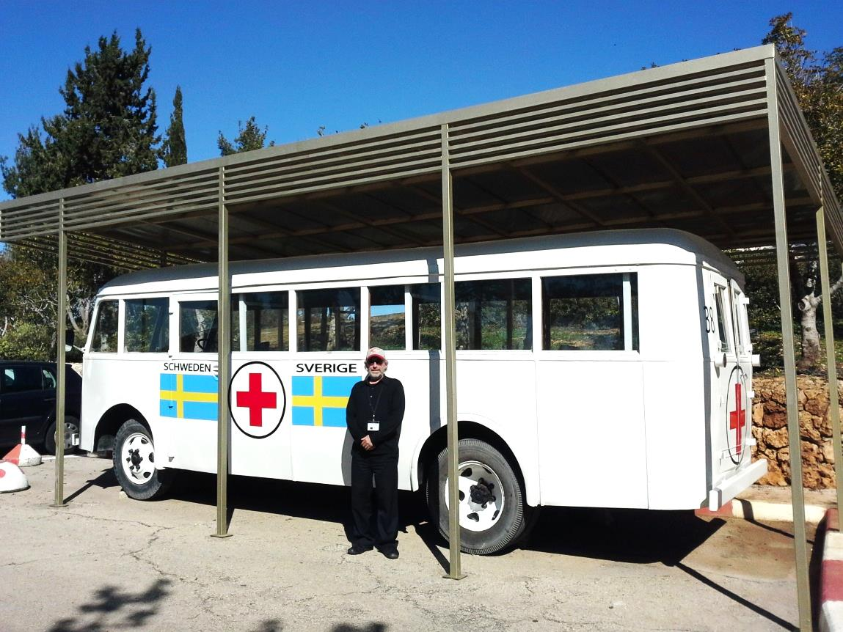
Rescue
Mom was rescued from Ravensbrueck Concentration Camp on 28 April, 1945 by the Swedish Red Cross, during the largest rescue operation of Concentration Camp Prisoners known as “The White Buses”.
Initiated by Folke Bernadotte, the Swedish Vice President, who negotiated the release of about 31,000 prisoners.
That’s me next to a “White Bus” on display at the Yad Vashem Holocaust Memorial Museum in Jerusalem…

Slide 9
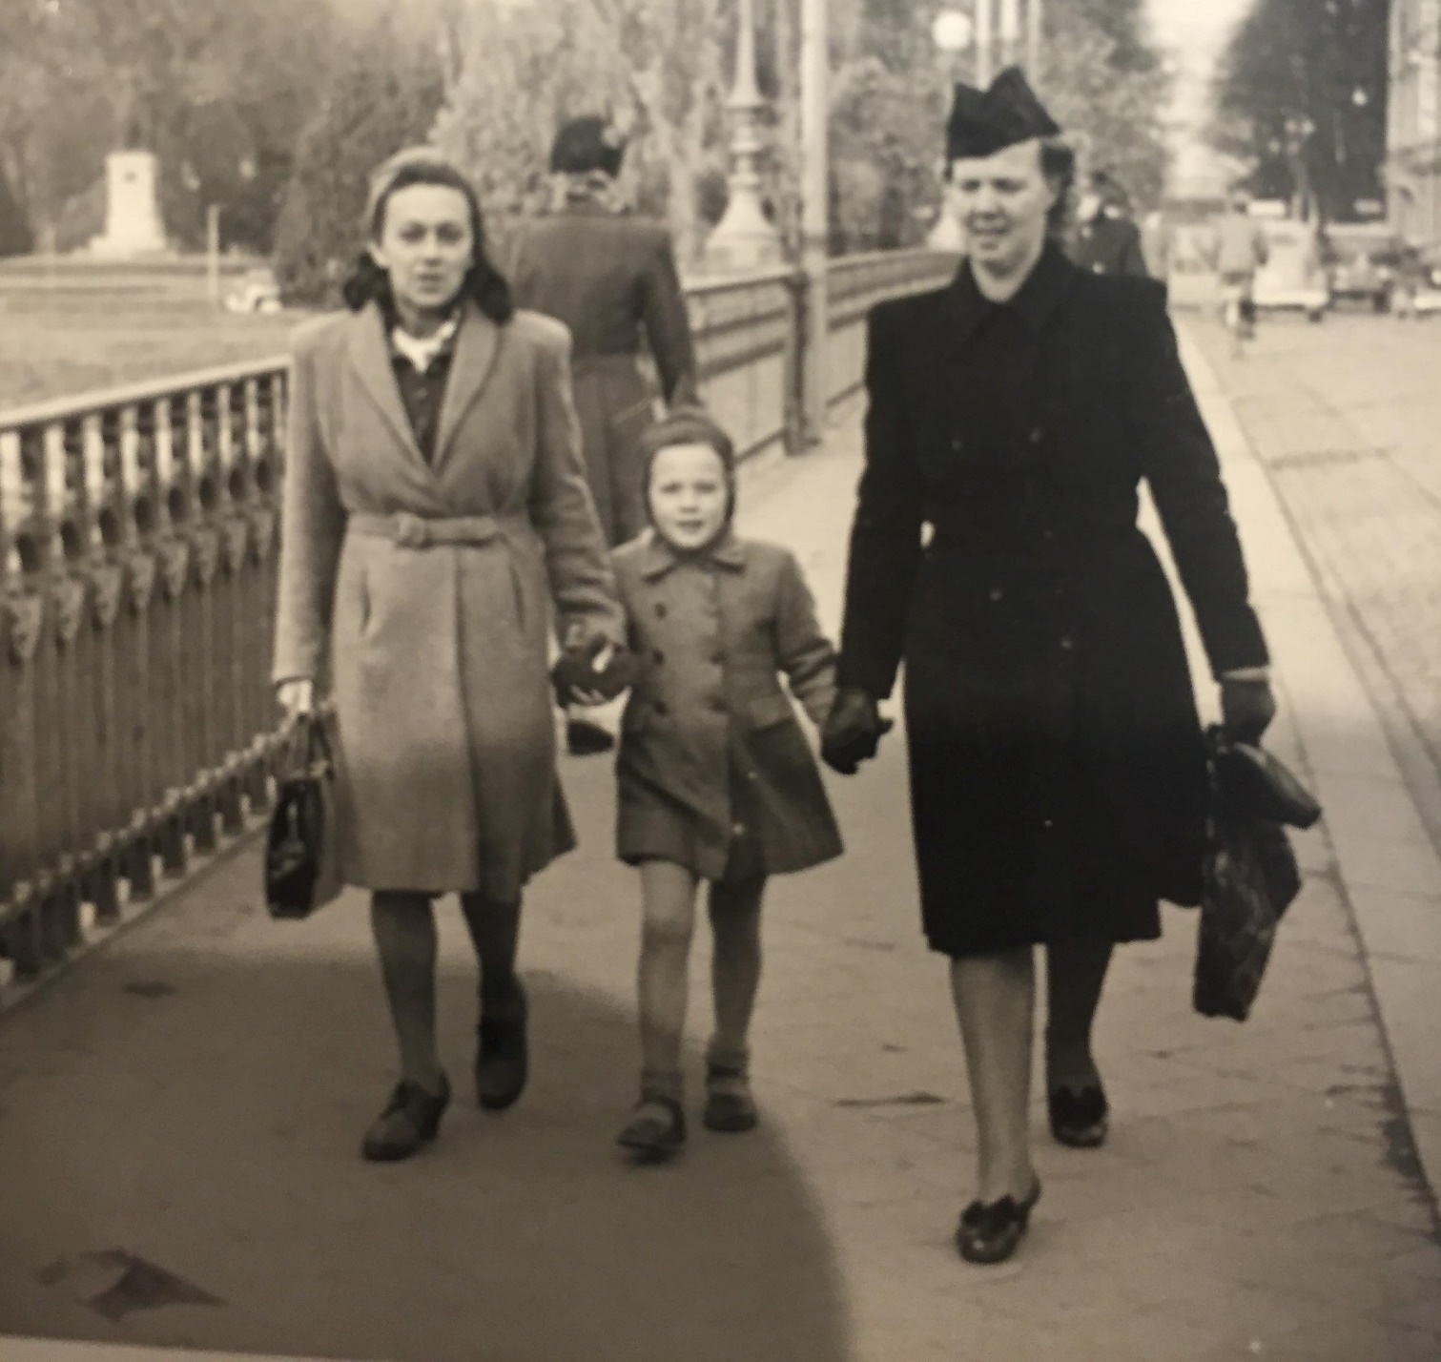
Resilience
Mom arrived in Sweden on 3 May, 1945 and settled in Norrköping with a “foster family” where she recovered from her ordeal and also worked as a nanny and at a confection factory.
Mom stayed in Sweden for four years as a displaced person, yearning to emigrate and live in USA…

Slide 10
Resilience
Dad was a barber. Back then in Poland, barbers treated people with certain ailments similar to doctors and nurses today.
Dad also spoke German. Because he was a barber and spoke German Dad was saved from the gas chamber and given work at Auschwitz that required his specific skills.

Slide 11
Rescue
Dad was liberated from Auschwitz by the invading Soviet forces on 27 April 1945.
My Dad was involved as a witness at the war trials held at Auschwitz.
He told me that he only spoke the truth at the trials, that he would not lie or embellish the truth to punish the Nazi guards and collaborators more than they deserved, the way others did…

Slide 12
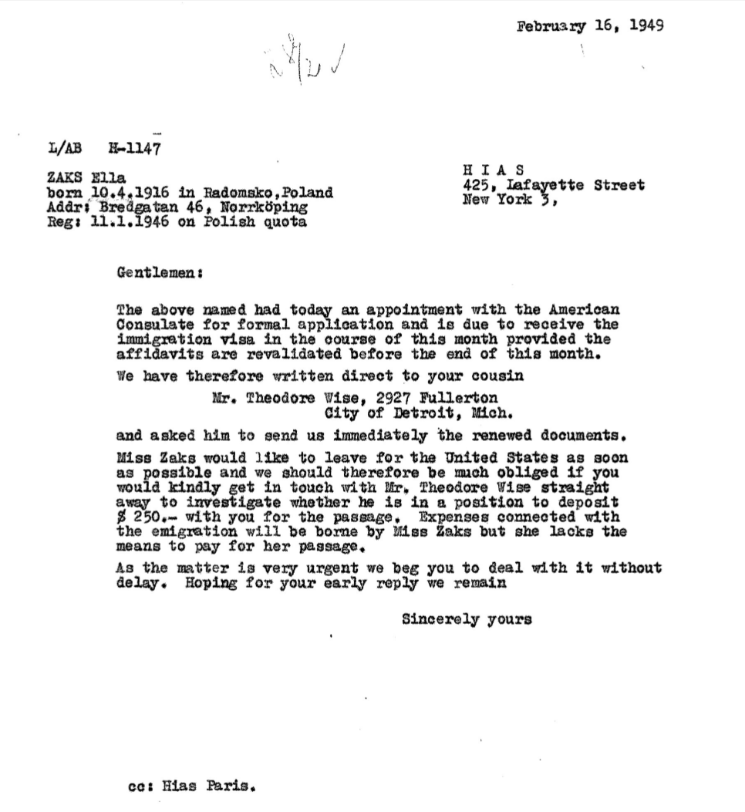
Mom was told that the quota for Polish refugees to USA was “oversubscribed”.
HIAS Relief Agency looked for an American Sponsor so Mom could be allowed to emigrate to USA.
Theodore Wise, a distant cousin, was found in Detroit and paid for her visa and travel costs…

Slide 13
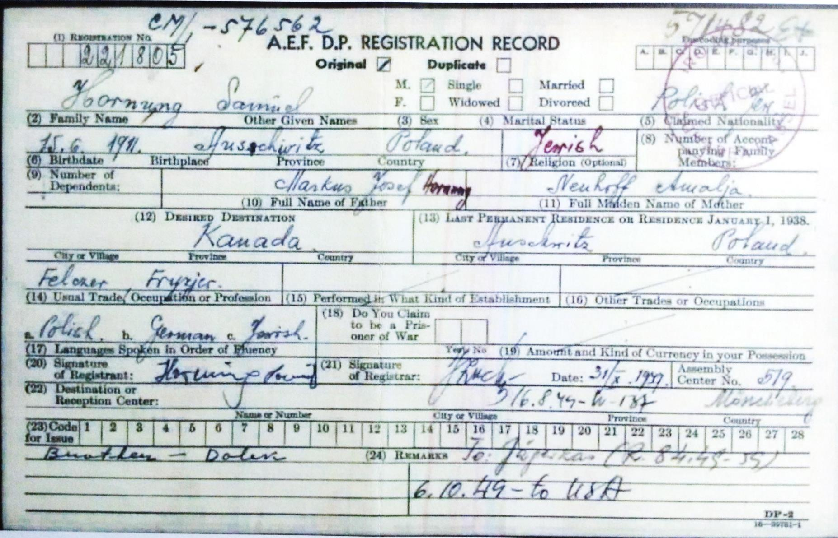
And after four years as a Displaced Person, my Dad was accepted to go to the USA. His Sister-in-Law, Hanka Fisk, was now married and living in Detroit, offered to be his Sponsor…
Hanka was Regina’s sister, Dad’s wife and mother of their two boys.
APPROVED! Dad is on his way to Detroit!

Slide 14
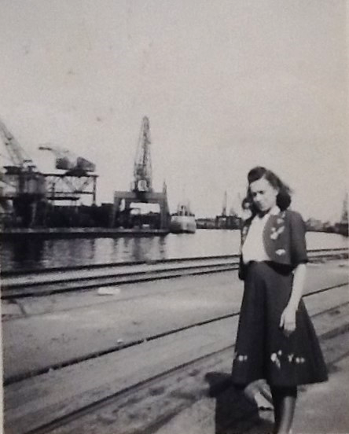
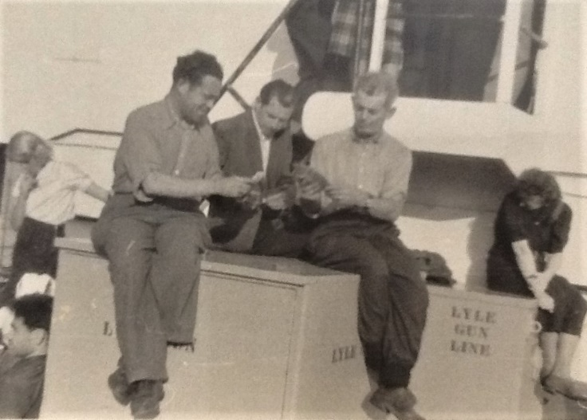
Mom left Sweden for Detroit on 21 June 1949 traveled on the Swedish-American Ship Line's, the "Gripsholm"
Mom arrived in the Detroit on 1 July 1949...
Here’s Dad playing cards on the deck of the USA ship, the “General Stewart”. He sailed on
2 Oct 1949 out of Bremmerhaven, Germany.

Slide 15
My Dad’s Father’s name was Jozef Mordechai Hornung and his Mother’s name was Amalia Neuhoff. They owned a chicken and fish shop in Oswiecim. Before World War 2 started, my Dad was married to Regina. Their twin sons, enryk and Wigdor were born on 31 Jan 1940. On 29 March 1941, Dad and his family were forced to go live in Sosnowiec Ghetto. Their family home and business were stolen by the Nazis. Dad was a Barber and his Barber Shop was also stolen by the Nazis. …on 1 April 1944 my Dad and his family were sent to Auschwitz Death Camp.
My Mom’s Father’s name was Jozef Zaks and her Mother’s name was Bejla Moszkowicz. They owned a tins-smith shop in nearby Piotrkow. Mom also had a brother called Tuvia, who was 12 years older than her. My Mom had 7 years of Polish public school education then trained to become a dressmaker… In April 1941, the family home and business were stolen by the Nazis. Mom was forced to live at Czestochowa Ghetto. Mom was forced to give up her chosen profession and work at the local munitions factory for the Nazis. In April 1944, my Mom was sent to Ravensbrueck Concentration Camp and forced to do hard labour.
Dad lost his Parents, brothers, his wife and their two boys…
Mom lost her Parents and her only brother…
Their lives were changed forever…
Here’s what happened next…

Slide 16
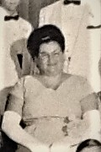
This is where Hanka enters the picture…

Slide 17
Sammy, go say “hello”…

Slide 18
‘cause you are going to marry her!

Slide 19
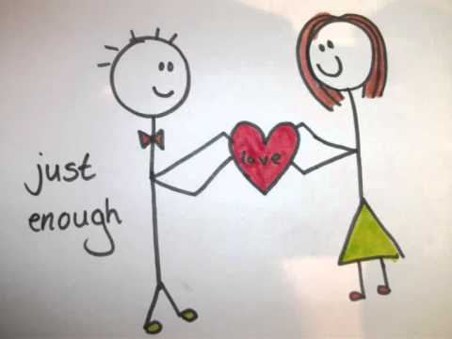

Slide 20
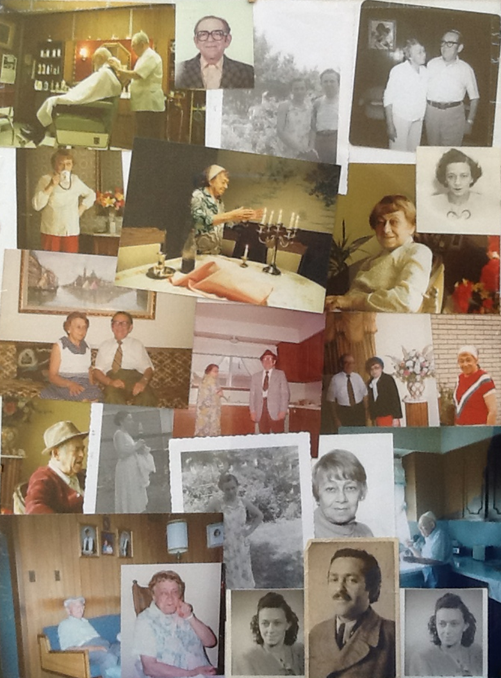
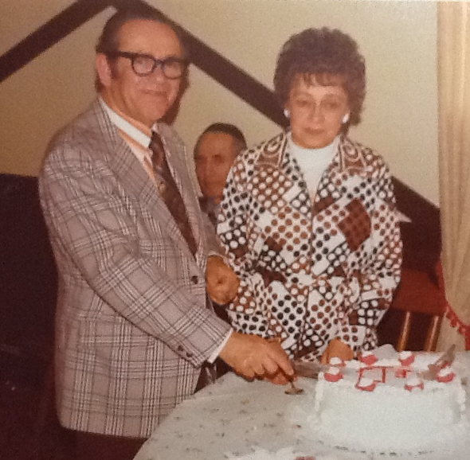
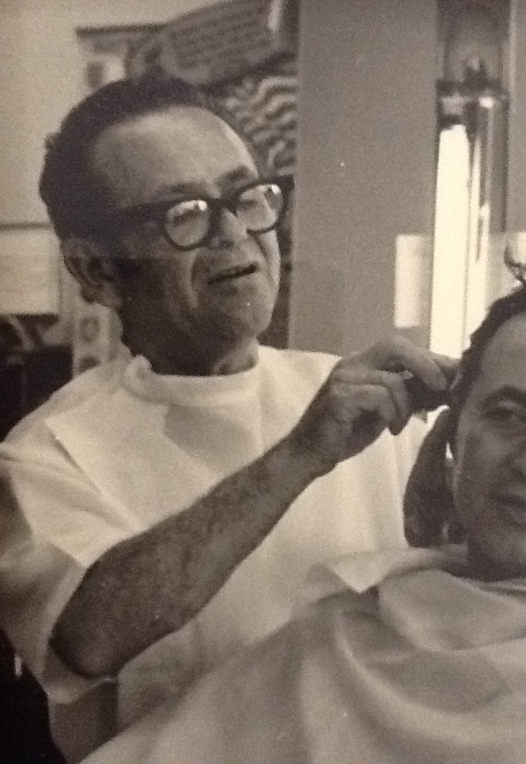
…they started new lives and a family together.
My Parents hardly ever spoke about their Survival, focussing on raising four kids in a Jewish home.
Though they lived as free people, protected by laws, having the same rights as others, they were different to even other Holocaust Survivors...

Slide 21
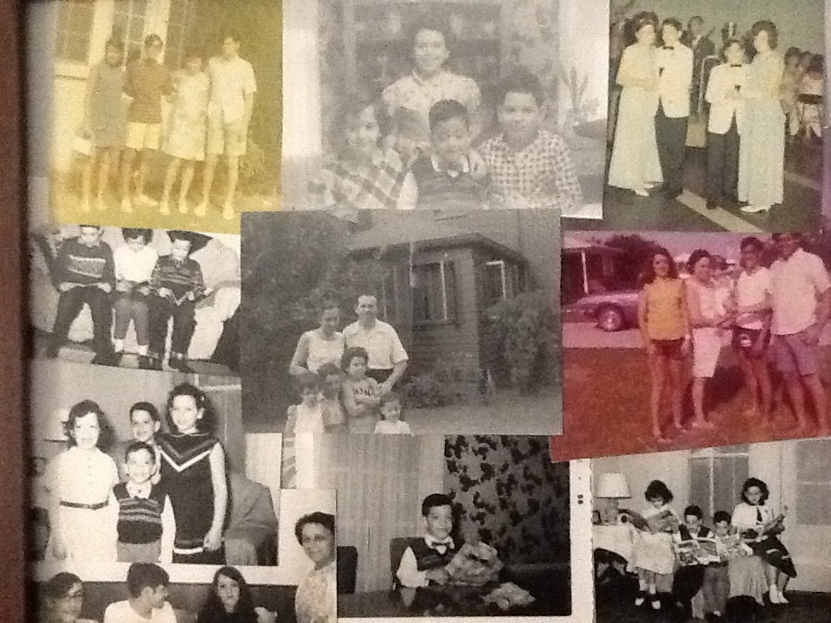
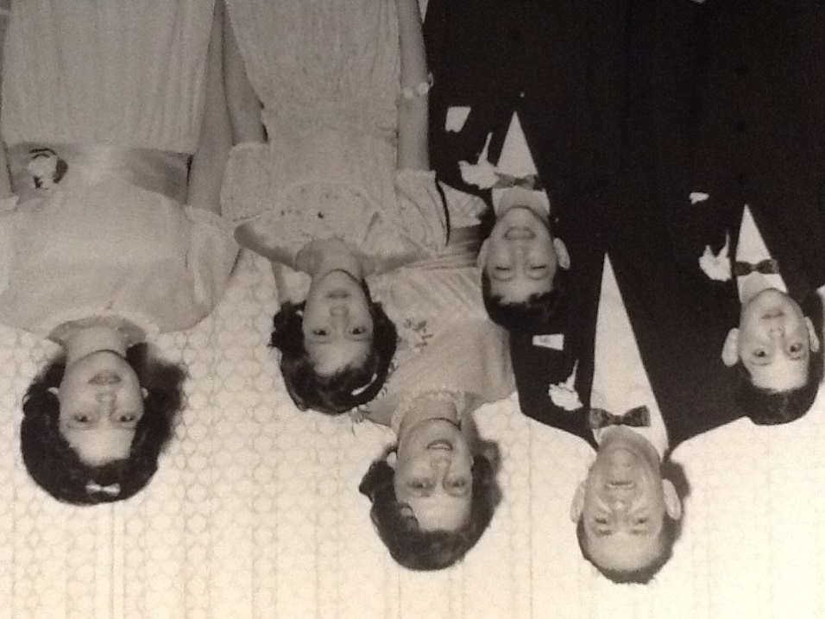
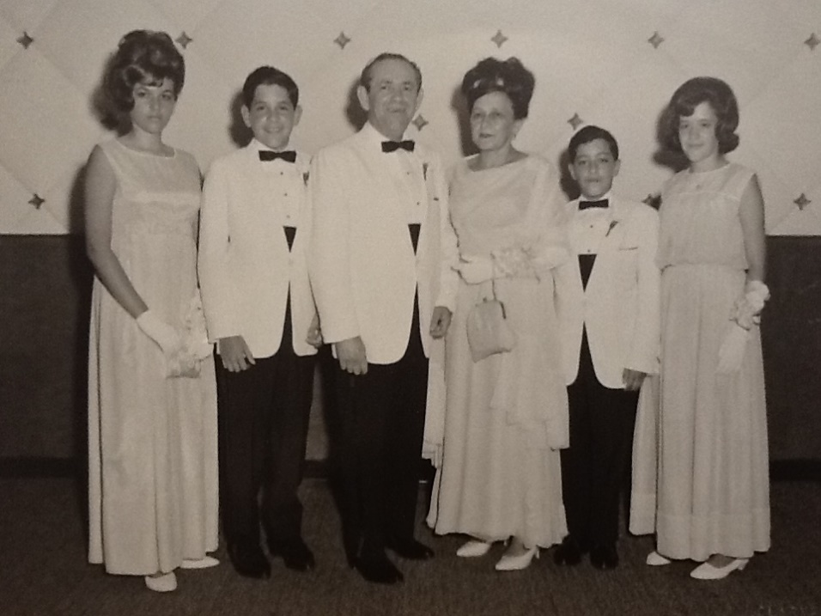
Mom and Dad’s New Family, in Detroit, USA

Slide 22
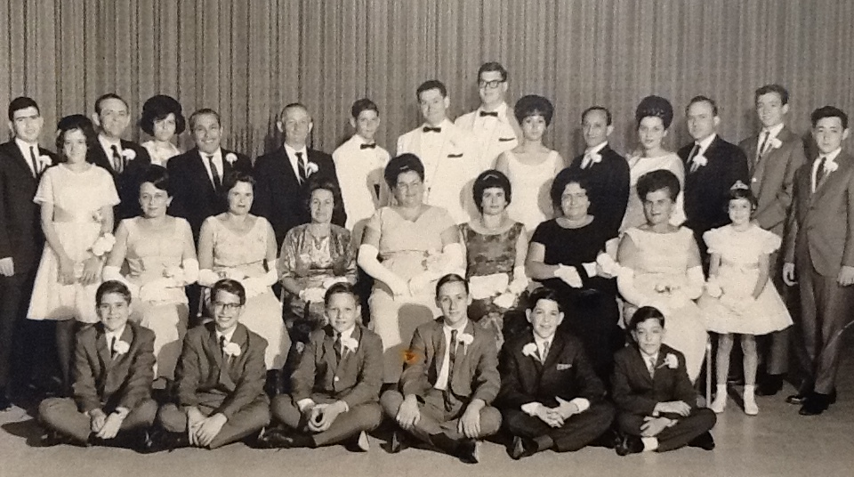
Here we are, a few Survivors and their children, thanks to Theodore Wise, Hanka Fisk and her husband Ben’s support.
Sammy, go say “hello”…!

Slide 23
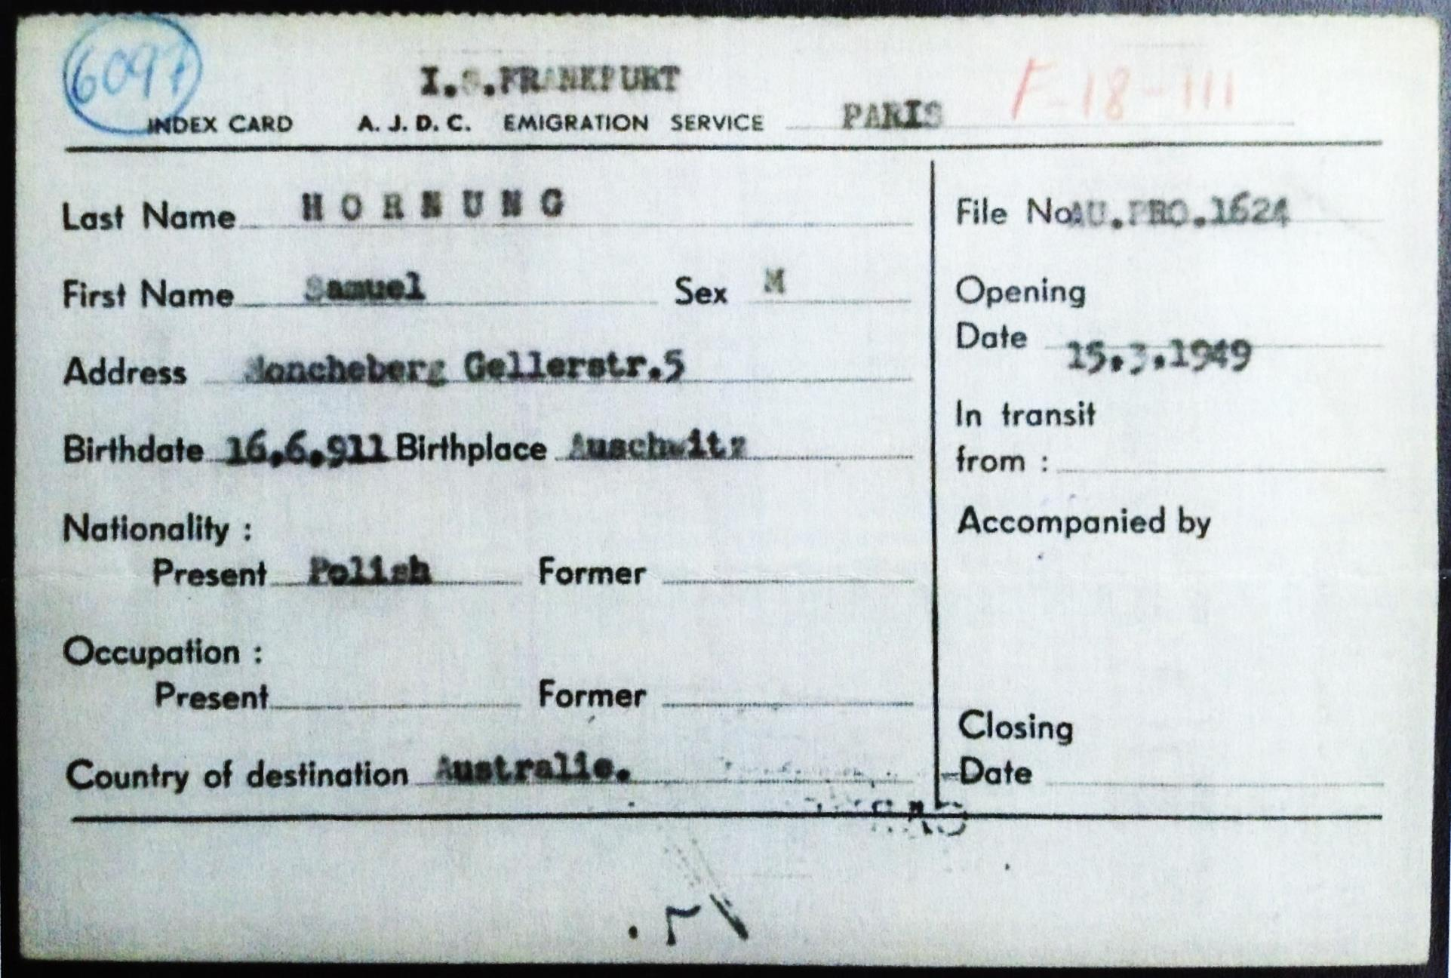
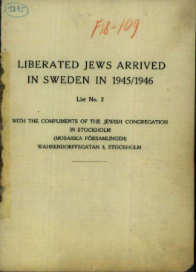
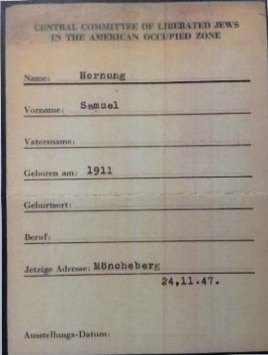
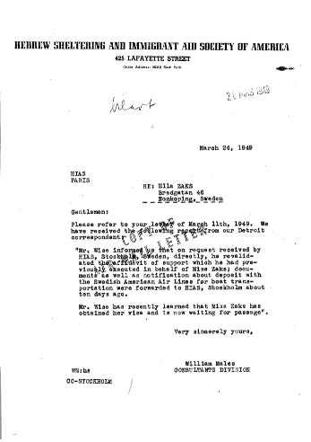
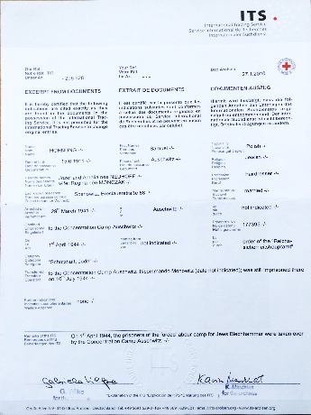
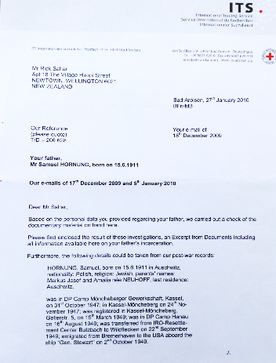
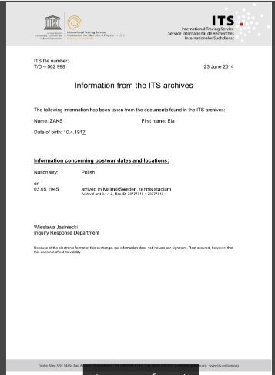
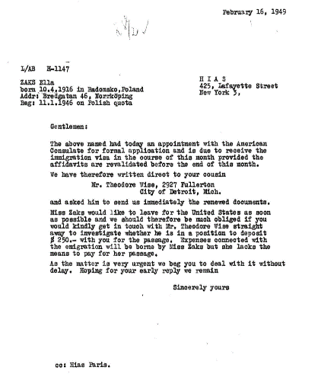
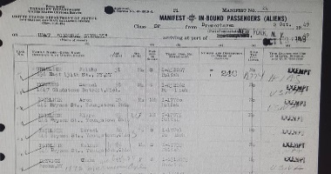
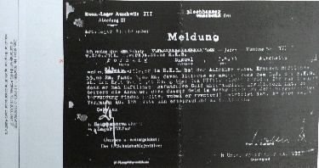
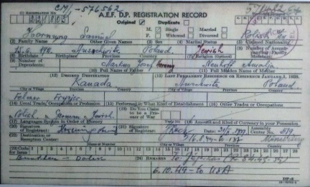
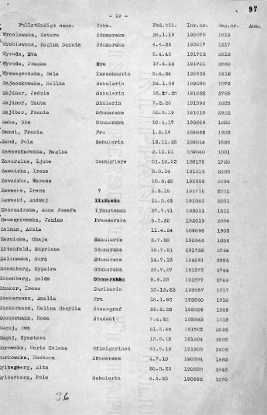
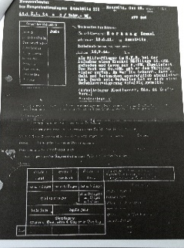
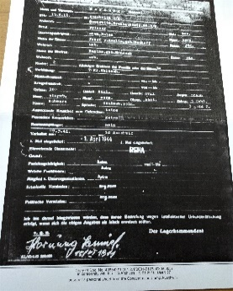
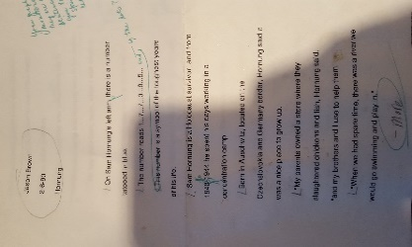
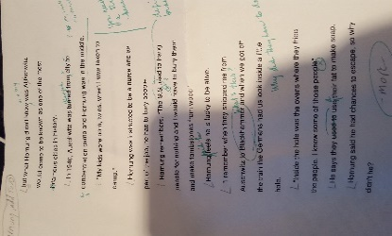
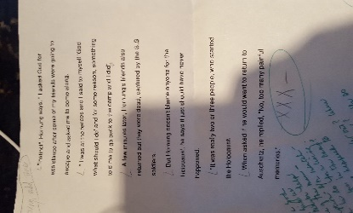
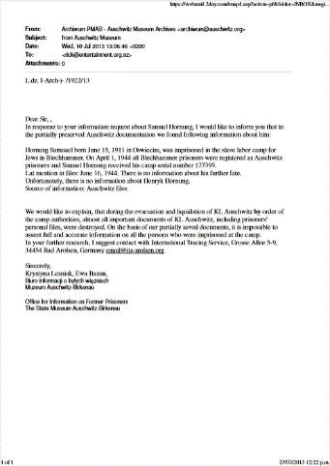
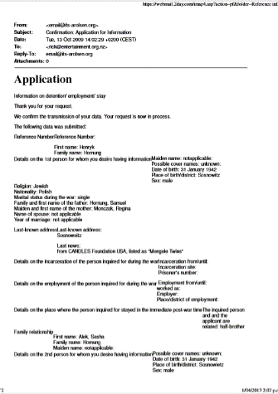
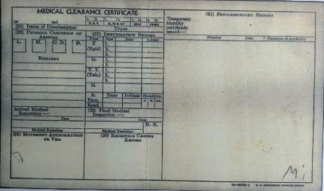
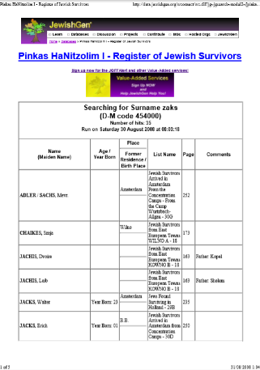
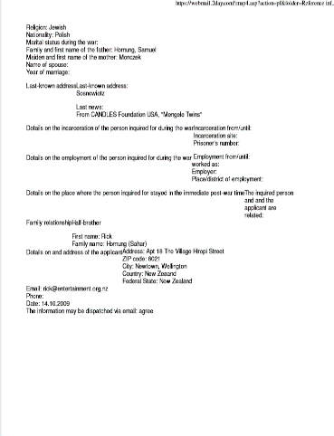
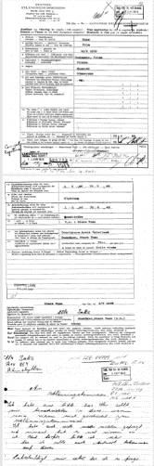
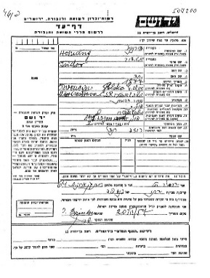
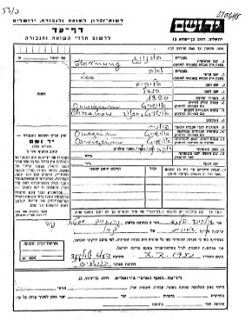
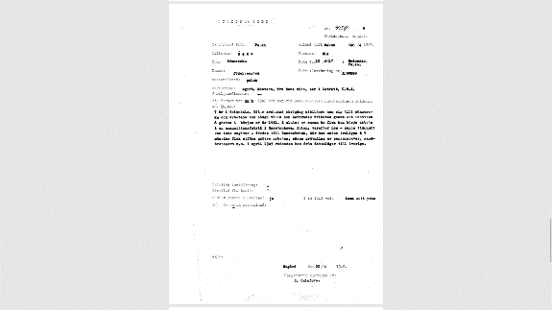
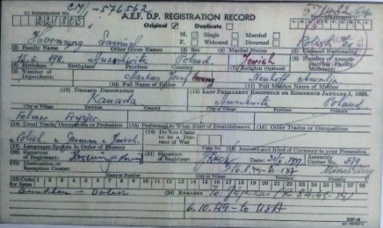


I have over 200 documents verifying my Parents’ Holocaust experience was real and cannot be denied.

Slide 24


Protecting our Freedom now, and into the Future
Universal Declaration of Human Rights of 1948 was adopted by the United Nations in response to the Holocaust. The Declaration states that all people are equally entitled to these rights, that no one can take away your rights....
THANK YOU for joining us today in remembering the Holocaust and honouring the Survivor stories told here today.
Your attendance reflects your personal commitment to protect peoples’ rights for a more just and tolerant future for all.
www.holocaustcentre.org.nz

