Slide 1
3rd Health Programme 2014-2020
Participating in the
Annual Work Programme 2019
Luxembourg, 08 May 2019
Dirk Meusel, DrPH
Call Coordinator
European Commission
Consumers, Health, Agricuture and Food Executive Agency (Chafea)
Health and Food Safety Unit

Slide 2
Overview
Where to find?
Financial mechanisms
Who can participate?
Timeline
Overview open opportunities
Dissemination

Slide 3
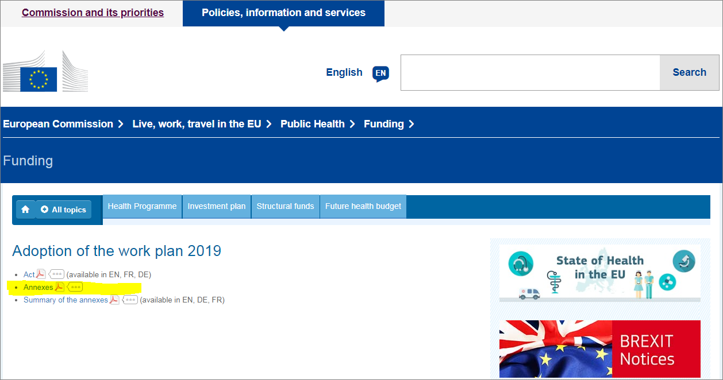
Annual Work Programme 2019
DG SANTE website:
https://ec.europa.eu/health/funding/adoption_workplan_2019_en

Slide 4
Financial mechanisms
Project Grants
Joint Action co-financed with Member State Competent Authorities (Direct Grants)
Operating Grants (Grants to Framework Partnership Agreement holders)
Procurement for Service Contracts
Direct Grants with International Organisations

Slide 5
Who can participate?
Country eligibility, Types of organisations, Additional criteria

Slide 6
Who can participate?
- Project Grants
Country eligibility
To receive EU financial support for a project, i.e. to be a coordinator or other beneficiary, the organisation needs to be legally established in:
EU Member States;
Iceland, Norway;
Serbia, Bosnia and Herzegovina, and Moldova. Those countries which have a bilateral agreement with the European Union in accordance with Article 6 of Regulation (EU) No 282/2014 on the establishment of a third Health Programme.
Applicants participating in a project proposal must have different legal entities (i.e. be independent from each other) and be from at least three countries participating in the Health Programme. Proposals which involve fewer applicants and/or cover fewer countries will be rejected.

Slide 7
Who can participate?
- Project Grants
Types of organisation
Grants can be awarded to legally established public, non-governmental or private bodies including public authorities, public sector bodies, in particular research and health institutions, universities and higher education establishments.

Slide 8
Who can participate?
- Project Grants
Additional eligibility criterion for the project Rare disease registries for the European Reference Networks (PJ-01-2019)
Only approved ERNs not having received grants for registries under the related call of the AWP 2016 are eligible for co-funding.
Applicants participating in a project proposal must have different legal entities (i.e. be independent from each other) and may be from less than three countries participating in the Health Programme.

Slide 9
Who can participate?
- Joint Actions
Authorities of Member States and of other countries participating in the programme will be invited to nominate one competent authority responsible for the implementation of the action on their behalf.
‘Competent authority’ means the authority of a Member State or a country participating in the programme responsible for health or for a specific health topic or any other authority to which that competence has been conferred.
The nomination should confirm that:
the nominated entity is a competent authority;
and
the nominated entity and the entities affiliated to it are eligible to participate on behalf of the respective country and under its responsibility in the relevant action.
The competent authorities should also identify and select the civil society organisations active at EU level that can make the most valuable contribution to the action. These organisations will then be invited to join the action as collaborating partners and/or participate in advisory structures.

Slide 10
Who can participate?
- Operating grants
Non-governmental bodies holding a Framework Partnership Agreement (FPA) for the period 2018-2021.
FPA recipients being eligible for a specific grant agreement (SGA) (‘operating grant’) will be invited to submit an application for an SGA to cover their operating costs for 2020. This will include the annual work programme and the budget.

Slide 11
Who can participate?
- UK Applicants
Please note that until the United Kingdom leaves the EU, nothing changes with regard to the participation in EU programmes.
Please be aware however that the eligibility criteria must be complied with for the entire duration of our framework partnerships/grants.
If the United Kingdom withdraws from the EU during that period (without an agreement ensuring eligibility for UK beneficiaries), you will cease to receive EU funding or be required to leave the project on the basis of the contractual provisions on termination.

Slide 12
Who can participate?
- Procurement
Participation in this procurement procedure is open on equal terms to all natural and legal persons coming within the scope of the Treaties (EU Member States), as well as to international organisations.
It is also open to all natural and legal persons established in a third country which has a special agreement with the European Union in the field of public procurement on the conditions laid down in that agreement. In specific, procurement procedures launched by the Executive Agency are open to the EEA countries and countries under the Stabilisation and Association Agreements.
Procurement procedures launched by Chafea are not open to countries that are parties to the Agreement on Government Procurement.

Slide 13
TIMEline
Country eligibility, Types of organisations, Additional criteria

Slide 14
Tentative Timeline
- Project Grants
Call publication: | 14 May 2019
Opening of submission | 21 May 2019
Deadline for applications: | 10 September – 17:00 CET
Evaluation: | September - October 2019
Information on evaluation result: | October to November 2019
Grant agreement signature: | January to February 2020
Starting date: | March 2020

Slide 15
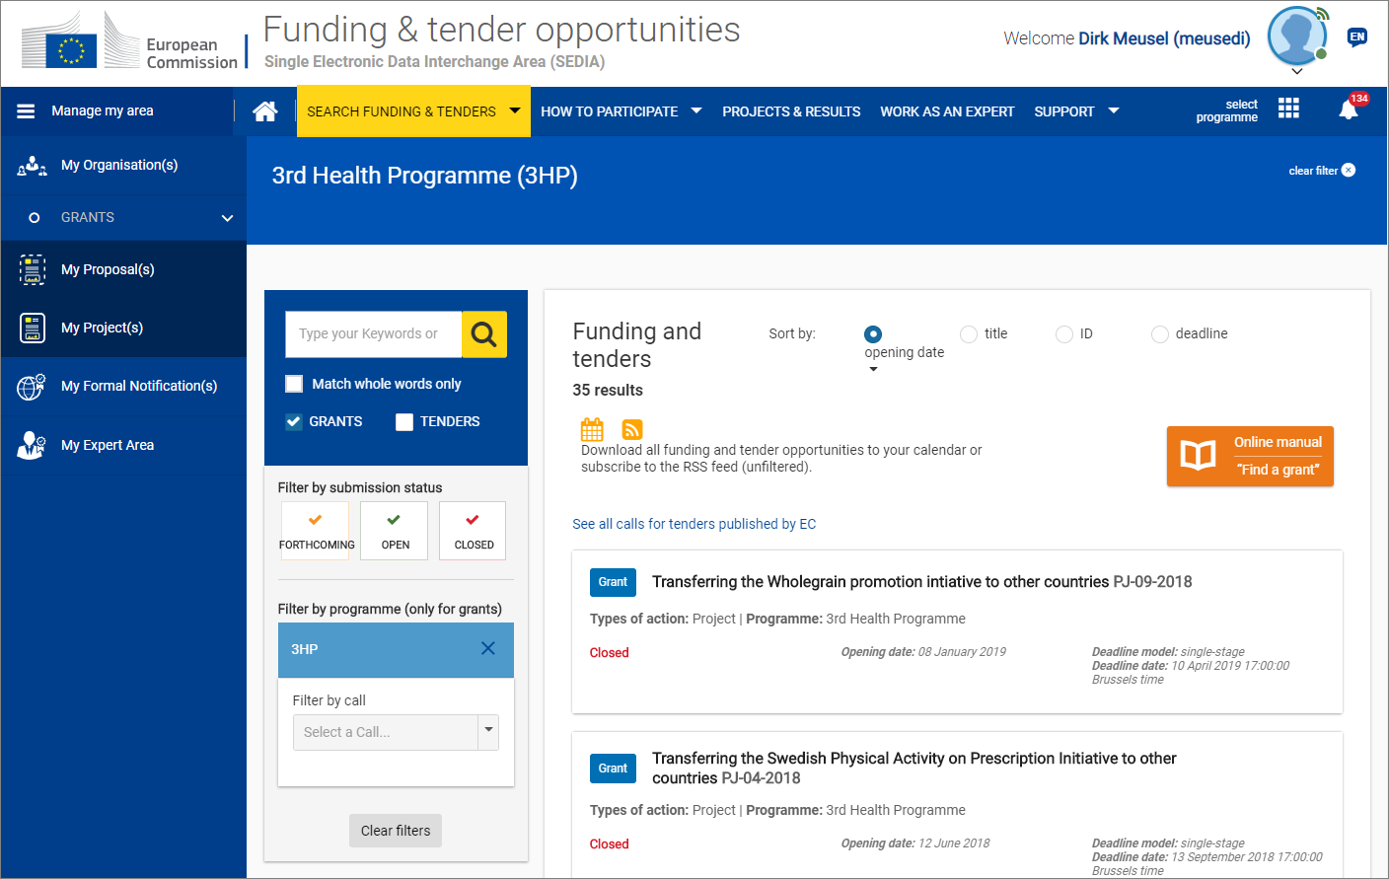
EC Funding and Tenders Portal:
https://ec.europa.eu/info/funding-tenders/opportunities/portal/screen/home

Slide 16
Participant Portal became EC Funding and Tenders Portal
Single entry point for finding and managing EU grants and procurement contracts,
… by covering all centrally managed programmes by the start of the next EU multiannual programme period in 2021
Since 27 September, 2018

Slide 17
Whats new?
The new portal includes
a new layout and graphic design,
an improved keyword search function with new features and search behaviour,
it reflects its multi-programme coverage and
integrates the calls for tenders.
The new Portal provides all the functions available under the previous Participant Portal

Slide 18
Tentative Timeline
- Joint Actions
Invitation to nominate | May 2019
Opening of submission | June/July 2019
Deadline for applications: | September 2019
Evaluation: | September – November 2019
Information on evaluation result: | November 2019
Grant agreement signature: | February-March 2020
Starting date: | April 2020

Slide 19
Tentative Timeline
- Operating Grants
Invitation: | 25 April 2019
Opening of submission | 25 April 2019
Deadline for applications: | 11 June 2019 – 17:00 CET
Evaluation: | June/July 2019
Information on evaluation result: | September 2019
Grant agreement signature: | November 2019
Starting date: | 01 January 2020

Slide 20
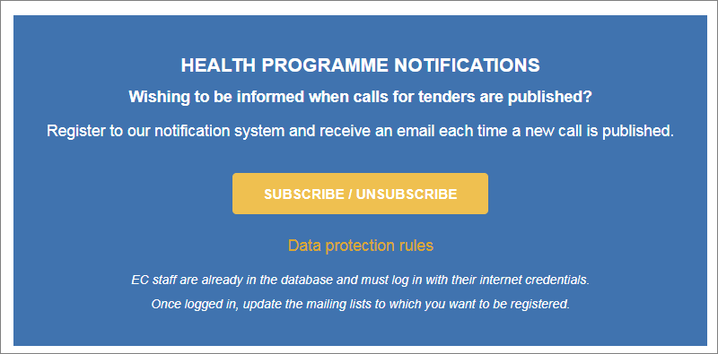
Tentative Timeline
- Procurement
Seperate Calls for Tender (1 per service contract)
CHAFEA > Funding - Calls for tenders:
http://ec.europa.eu/chafea/health/funding/calls-for-tenders/index_en.htm

Slide 21
open opportunities
Overview

Slide 22
Open opportunities
- Project Grants
PJ-01-2019: Rare disease registries for the European Reference Networks (Heading 2.1 of the AWP 2019)
PJ-02-2019: Stakeholder actions to implement the EU guidelines on prudent use of antimicrobials in human health (Heading 2.2 of the AWP 2019)

Slide 23
Open opportunities
- Joint Actions
JA-01-2019:Joint Action on implementation of validated best practices (Heading 3.1 of the AWP 2019)
JA-02-2019: Joint Action to strengthen health preparedness and response to biological and chemical terror attacks (Heading 3.2 of the AWP 2019)
JA-03-2019: Joint Action on implementation of digitally enabled integrated person-centred care (Heading 3.3 of the AWP 2019)

Slide 24
Open opportunities
- Joint Actions
Specific Webinar on 21 May 2019
By invitation

Slide 25
Open opportunities
- Procurement
Several topics
Seperate Presentation

Slide 26
Dissemination
EU Funding Reference, Disclaimer, Public Deliverables, Project Database

Slide 27

22.1.2 Information on EU funding — Obligation and right to use of the EU emblem
Any communication activity related to the action (including at conferences, seminars, in information material, such as brochures, leaflets, posters, presentations, etc., in electronic form, via social media, etc.) shall state:
This [insert appropriate description, e.g. report, publication, conference, infrastructure, equipment, insert type of result, etc.] is part of the project / joint action ‘Project Number, Acronym’ which has received funding from the European Union’s Health Programme (2014-2020).
https://europa.eu/european-union/about-eu/symbols/flag_en

Slide 28
22.1.3 Disclaimer excluding Agency/Commission responsibility
Any communication activity related to the action must indicate the following disclaimer:
“The content of this [insert appropriate description, e.g. report, publication, conference, etc.] represents the views of the author only and is his/her sole responsibility; it can not be considered to reflect the views of the European Commission and/or the Consumers, Health, Agriculture and Food Executive Agency or any other body of the European Union. The European Commission and the Agency do not accept any responsibility for use that may be made of the information it contains.”

Slide 29
Public Deliverables
Will be published in the Project Database
"Stand-Alone" Character
Title Page (Title of Project and Deliverable), Executive Summary, Background to the project
Visual Identity of the beneficiary/consortium
Language adapted to the target group(s)
Non-public deliverables should have a publicly available short version

Slide 30
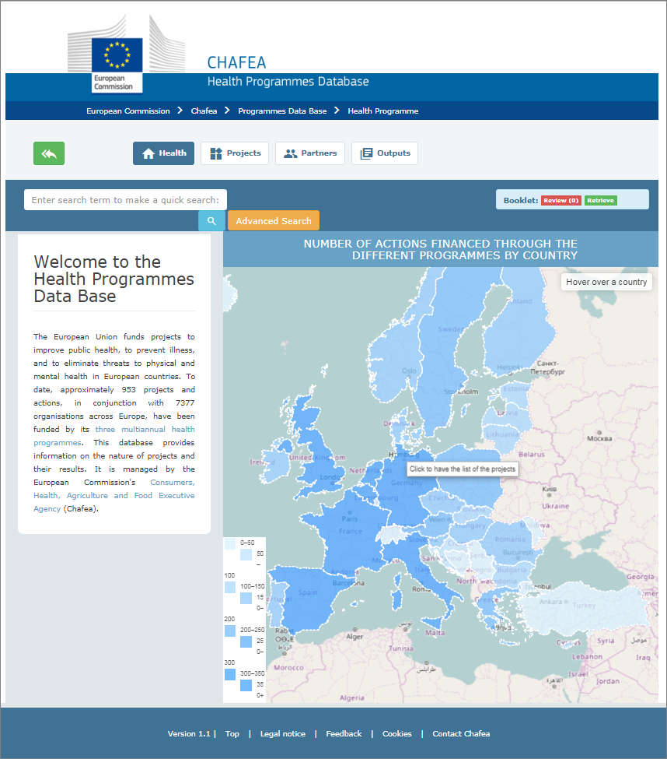
Project
Database
Grants since 2003
1st, 2nd, 3rd Health Programme
Summary, Consortium, Public Deliverables
https://webgate.ec.europa.eu/chafea_pdb/health/

Slide 31
Further Information

Slide 32
Further Information
Helpdesks:
  CHAFEA-HP-CALLS@ec.europa.eu
  CHAFEA-HP-TENDERS@ec.europa.eu
Chafea website:
  http://ec.europa.eu/chafea/health/funding/index_en.htm
Publication of open Call for projects, including FAQ:
  https://ec.europa.eu/info/funding-tenders/opportunities/portal/screen/programmes/3hp
Publication of open Call for tenders, including FAQ:
  https://etendering.ted.europa.eu/general/page.html?name=home

Slide 33
National Focal Points
http://ec.europa.eu/chafea/health/national-focal-points/index_en.htm

Slide 34
National Information Days - 2019
Bosnia Herzegovina | 14 May 2019, from 10:00 to 15:00 | Sarajevo, in the Building of the Parliamentary Assembly of Bosnia and Herzegovina
Ireland | 13 June 2019 | Dublin
Malta | 26 June 2019 | Valetta
Poland | 28 May 2019 | Warsaw

Slide 35
Thank you for your attention!
Dirk Meusel,
DrPH, PM2 cert.
European Commission
Consumers, Health, Agriculture and Food Executive Agency (Chafea)
Health and Food Safety Unit

