Slide 1
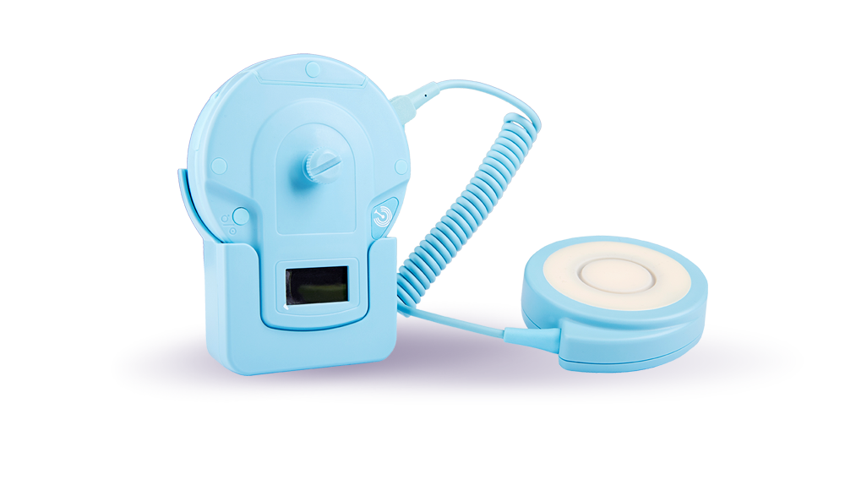


CTG Sigmafon System
The world's first fully digital, wireless CTG with CE certification for telemedical monitoring of pregnant women integrated with the Obstetric Surveillance Systems

Slide 2

Every journey needs a map.
In every journey, especially the first and the most important one, each parent dreams of their child arriving healthy to this world. Childbirth is the meta of a journey, but also the beginning of a new one. We do not know what future path your child will take. Maybe they will become a physicist, astronaut, maybe a teacher. But we want them to have a choice.
The CTG Sigmafon system can lead them by the hand to the first door.

Slide 3
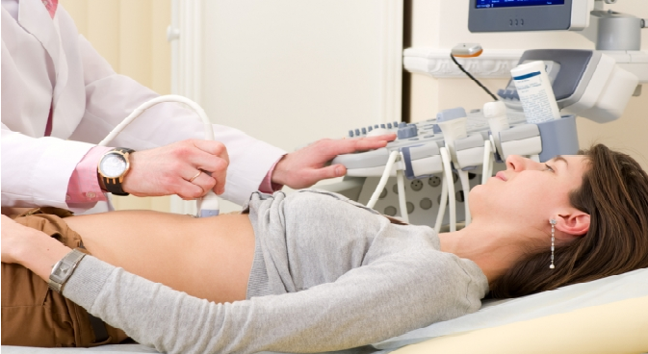
Until now, a thorough examination of the unborn child's condition was available only in gynecological clinics and selected surgeries. Portable devices present on the market were not sufficiently precise or technologically advanced to fully follow the most important vital functions (they were not based on the analysis of ultrasound signals which are THE ONLY STANDARD in cardiotocography). The vast majority are gadgets, not medical devices of the highest quality.
Creation of the KTG Sigmafon System is a response to the requests of the medical community as well as the patients themselves to create a mobile KTG device, which is not inferior to the best clinical devices.

Slide 4

Breakthrough in obstetric research
The CTG Sigmafon system is a revolution in obstetrics. It is wireless, the size of a telephone, has accuracy comparable to stationary CTG and using the smartphone, transfers the collected data to the Med Systems Obstetrics Monitoring Center (OMC), where the CTG examination entry is interpreted online by a computer obstetric supervision system and authorized by experienced OMC medical personnel.
The patient and doctor providing prenatal care receive an interpreted and authorized result, even within a few minutes from the end of recording.
Professional home CTG - digital revolution in obstetrics!

Slide 5
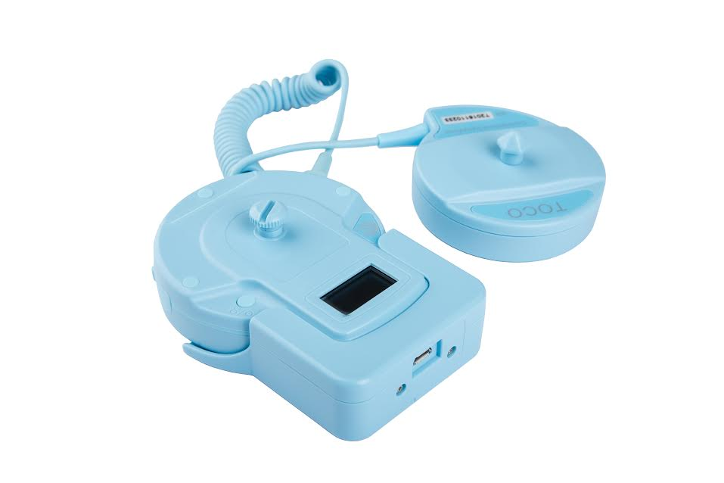
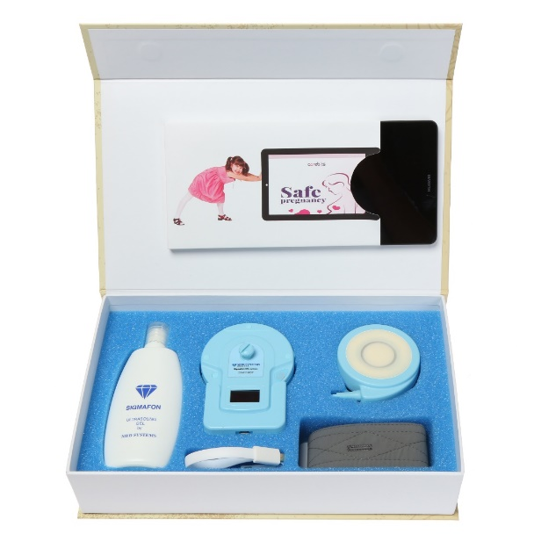
CTG Sigmafon System
CTG Sigmafon is a high-class innovative cardiotocograph, a device used for long-term fetal heart monitoring (FHR), uterine contracting function (TOCO) and fetal movements (FMOV). The device is intended for use at home by pregnant women, but it can also be used in clinics, hospitals or gynecological surgeries.
CTG Sigmafon is the result of over 8 years of work of our R&D department (the company was founded in 2015 to commercialize research).
The Med Systems team was guided by one goal. In the era of today's development of technology, pregnant women should gain the right to reliable information on the well-being of the fetus and their health regardless of their own limitations such as; place of residence, technical skills, lack of time and many more. All this so that pregnant women are not, as they are at present, exposed to constant anxiety in between medical appointments - CTG monitoring guarantees them a clinical quality result whenever they need it.

Slide 6

CTG Sigmafon System
In addition, CTG Sigmafon is integrated with the certified Obstetrical Obstetrics System, which allows for immediate interpretation of results. It is possible to also integrate the Sigmafon CTG System with other Obstetric Surveillance Systems.
So far, similar solutions have been available only at the best gynecological-obstetrics clinics.

Slide 7
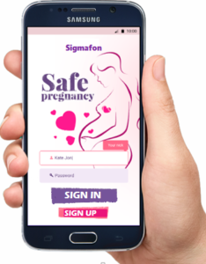
How is our CTG Sigmafon System different?
The world's first fully digital, wireless CTG camera.
A unique solution due to the possibility of controlling the CTG camera directly from a standard computer, laptop, tablet, smartphone, etc.
Very high accuracy of measurement (digital probes + preanalysis algorithms) that allows the device to be used also in clinical settings. The quality of tests is comparable or higher than tests performed using "classic, hospital" CTG which includes a camera and probes.
Small size of the device and ease of attachment (150 grams and elastic bands).
Simplicity of self-use - it does not require training of patients.

Slide 8
How is our CTG Sigmafon System different?
An innovative and unique system of immediate automatic analysis of the test record - during monitoring of cardiotocograph signals, you can connect with the remote Mother and Fetus Monitoring Platform (Obstetric Observation Center) and transmit current data to her in the form of temporary values: FHR, TOCO and recorded fetal motor activity. Full data can be read on an ongoing basis by the doctor providing prenatal care - the highest quality, extended and real round the clock online medical care with a certified Obstetrics Surveillance System.
Battery supply. The charger is an integral part of the KTM Sigmafon System. For safety reasons, it was developed in such a way as to enable performing tests when charging with a USB cable - battery capacity is enough for several hours of continuous operation.

Slide 9











Diagram of information flow
Patient
Smartphone/Tablet
transmission
Computer Obstetrical Surveillance System
Doctor providing prenatal care
OK. Results are good.
NOT OK – implementation of the appropriate medical procedure (e.g., re-examination, emergency call)
24/7 Obstetrics Monitoring Center (OMC)

Slide 10
Simplified information flow - description*
The patient performs examination herself or with the help of the doctor providing prenatal care in accordance with the instructions. During entire examination in accurate positioning of the device, she supports the Carebits software that the client installs on her smartphone. After examination, the CTG record is automatically sent to the Obstetrical Obstetrics System**. Remember to stay within the range of cellular network. It is possible to send data via the Internet.
The Obstetric Obstetrics System (about 2-3 minutes after receipt of the CTG record) sends a detailed interpreted study by e-mail and text message to 2a) patient, 2b) doctor providing assistance during pregnancy, 3c) Obstetric Obstetrics Monitoring Center according to the distribution list.
The Obstetric Obstetrics Center (on average, 2-10 minutes after receipt of the CTG record) sends a record of the study, authorized by the experienced CMP medical personnel, along with a commentary according to the distribution list as above. In the case of detecting alarming symptoms or doubts, the appropriate (standard) medical procedure is implemented - CMP medical staff recommends further examination or asks for an emergency call; the patient receives information via e-mail, via the application, text message and additionally by phone**.
*The detailed flow of information may vary depending on the market or requirements of the buyer.
**The indicated information flow scheme is the first implementation of this type in the world.

Slide 11

Our device also guarantees additional benefits for doctors, midwives and patients
Benefits for doctors and midwives:
Improved work ergonomics, simple operation without cables, transferring or carrying equipment with a cart
Optimized working time of the doctor and midwife (automatic analysis)
Possibility of receiving a much larger number of patients thanks to remote monitoring while maintaining the highest quality of services guaranteed by the certified Obstetrics Surveillance System
Access to online historical data, ability to track trends, etc.
Better control of pregnancies in particular with problems and/or pathologies
Increasing competitiveness against the background of doctors and midwives who do not use professional home CTG
No need to instruct or train patients in use of the camera.

Slide 12

Benefits for doctors and midwives:
The solution allows to monitor the patient between visits at the doctor providing assistance in pregnancy
Full responsibility of specialists from the Obstetrics Monitoring Center (created, among others, in cooperation with the most renowned national and foreign institutes)
Very low operating costs; no need to print out (file available in many formats, e.g., in PDF), low power consumption, low consumption of ultrasound gel
The CTG Sigmafon system works with standard smartphones on Android system, tablets and computers. This reduces the costs of service and maintenance
Possibility of 24-hour care for the pregnant woman (carried out in a 24/7 mode by the Obstetric Obstetrician Center)

Slide 13

Additional benefits for patients:
No stress associated with commuting and queues to the doctor - the patient is tested alone at home
The pregnant woman takes positions convenient for her during the test - digital probes ensure excellent quality;
Immediate transmission of the diagram and interpretation of CTG examination record to the doctor providing assistance during pregnancy;
Access to online historical data, ability to track trends, etc., listening to the child's heartbeat even after years.

Slide 14

Additional benefits for patients:
Reduction of costs of travel to the hospital, enormous time savings and reduction of the number of hospitalizations;
Possibility of ongoing monitoring of the fetus’s welfare is of great value for the patient's mental calmness;
Rapid reaction of medical staff of the Med System Obstetrics Monitoring Center in a situation when the results indicate a threat, warning or alarm conditions;
24-hour care for pregnant women 7 days a week;
Very small device that weighs 150 g and elastic bands - it will fit even into a women's clutch bag.

Slide 15
Additional benefits for patients:
Very simple intuitive operation;
The test uses only one integrated probe (FHR - fetal heart rate and FMOV - fetal movements) and if necessary, a smaller TOCO probe (uterine contraction - usually used only at the end of pregnancy);
Probes are attached to the pregnant belly or with elastic bands without the use of troublesome suction cups;
Special software installed on the patient's smartphone helps in proper operation of the device - it is intuitively easy.
Caution: In case of any doubts regarding the result of monitoring, you should immediately contact a medical center without waiting for a doctor's reply.

Slide 16



Register address: 16-400 Suwałki, ul. Kościuszki 82/5, Poland/Polska
Address for correspondence: 00-511 Warszawa, ul. Nowogrodzka 31/204A, Poland/Polska
Phone numbers:
Management:
+48 888 065 534
Research and development
+48 514 951 077
Contact for Investors / Finance:
+48 577 778 776
e-mail: zarzad@med-systems.pl
http://med-systems.pl
Domestic CTG - clinical quality

