Slide 1


Specialized consulting on development and operation of renewable energy resources

Slide 2
COMPANY PROFILE
Private Icelandic consulting firm
Founded in 1982
Nearly 40 years experience in Iceland and around the globe
Diverse team of 12 specialists
5 PhD, 7 MSc
Wide range of academic backgrounds within physical and environmental sciences, engineering and computer programming
Specialized consultancy utilizing models of natural and man-made environments
Addressing issues relating to renewable energy, resource management, urban planning, industrial processes, climate change and the environment
Clients from the energy sector, public utilities, private industry and government
Collaboration experience, including…
Consulting on international renewable energy projects (Europe, Africa, Asia, North and Central America)
Advisory role at University of Iceland and the United Nations University Geothermal Training Programme (UNU-GTP)
Training in numerical modelling (open courses and specifically designed programs for clients)
Software development (Finsterle GeoConsulting and Lawrence Berkeley National Laboratory)

Slide 3
SERVICE SECTORS
RENEWABLE ENERGY
Hydropower
Geothermal
Sustainable District Energy
Wind, Solar and Ocean
INFRASTRUCTURE AND UTILITIES
Water Supply
Wastewater
Urban Development
ENVIRONMENT AND CLIMATE
Environmental Quality and Impact Assessment
Climate Change Adaption and Mitigation
INDUSTRIAL PROCESSES AND DESIGN
Computational Fluid Dynamics (CFD)
Multi-phase flows and Thermodynamics
Full Value-Chain Modelling
Further information at our website: www.vatnaskil.is

Slide 4
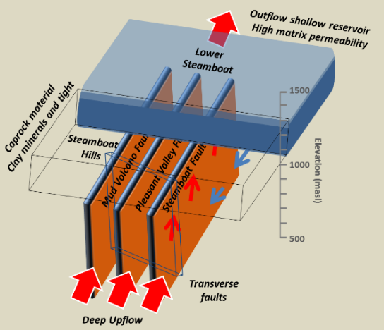
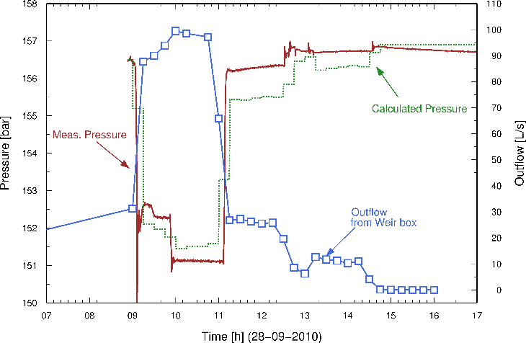
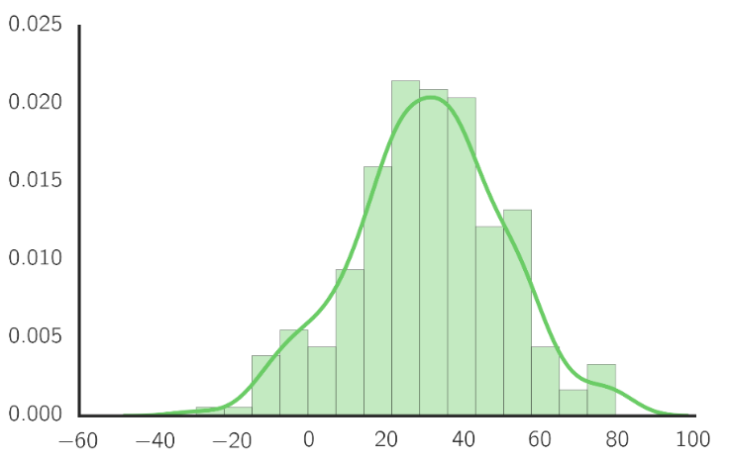
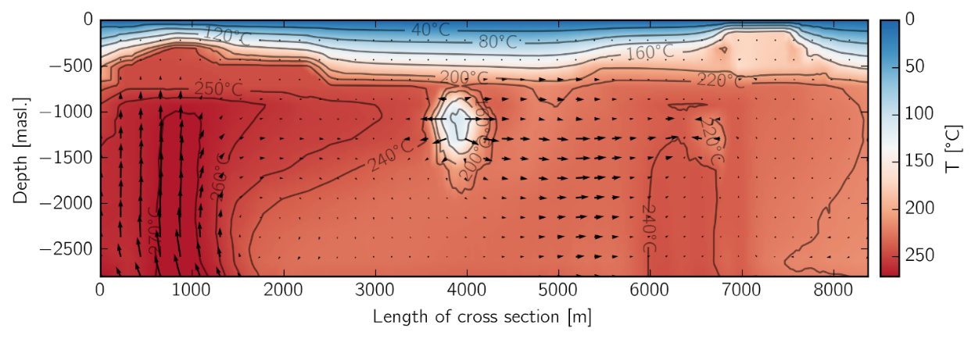
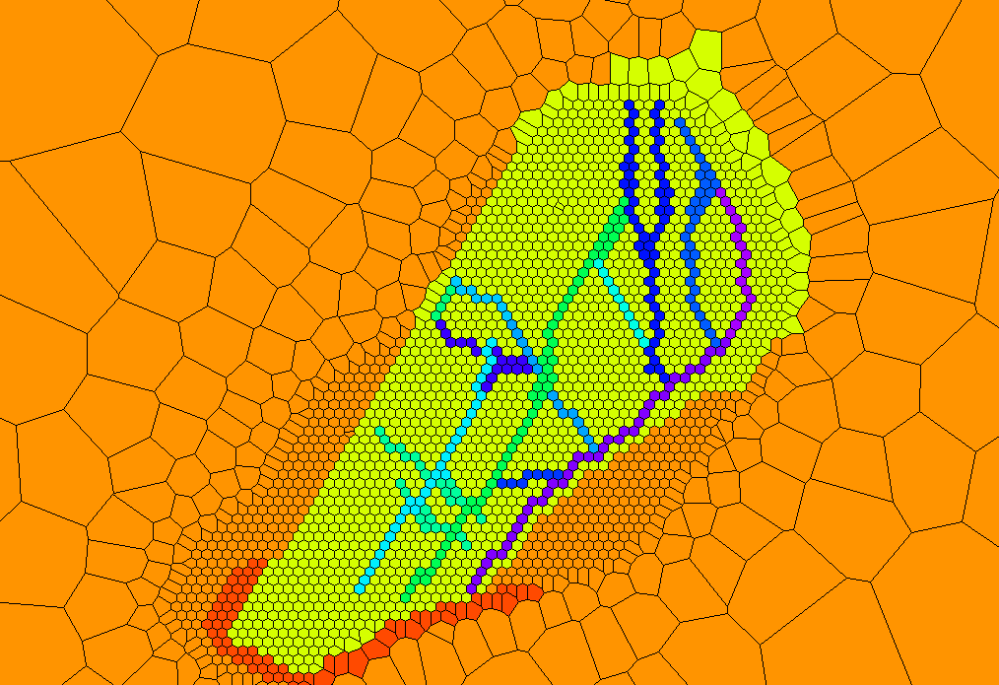
GEOTHERMAL SERVICES
Conceptual model design
Well test analysis
Value-chain modelling
Feasibility
Design
Operation
Pre-design
Production/injection strategies
Robust numerical modelling

Slide 5
GEOTHERMAL SERVICES
Feasibility
Data analysis
Pre-design
Well test design/analysis
Design
Well siting
Feed-zone targeting
Production/injection strategies
Energy budget
Operation
Resource management
Operational decision-making
Sustainability analysis
Robust numerical model
Full value-chain model
Wellbore modeling
Preliminary numerical model
Conceptual model design
Resource capacity assessment
Resource classification
Probability of success

Slide 6
Integrated geothermal district heating network
Mass flow Heat flow
Pressure drop
Thermal energy
Reservoir model
Network model
Operational model
Profit
Pumping capacity
New boreholes
Reinjection
Changes in demand
New distribution areas
Notes:
Above diagram shows the basic setup of an integrated geothermal district heating network model consisting of three different models, a reservoir model, network model and a operational model. These models interact together, flow and heat are calculated in the reservoir model and supply input directly into the network model, which simulates distribution to the customers. The operation of the network model depends on the demand of customers and the sales and operation of the utility company, all of which are taken into account in the operational model. Changes in demand are then fed backwards to the network model from the operational model. The reservoir model takes into account these changes as well as other factors like new boreholes and reinjection schemes.

Slide 7
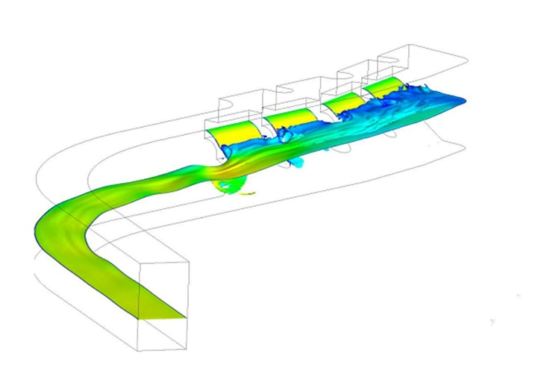
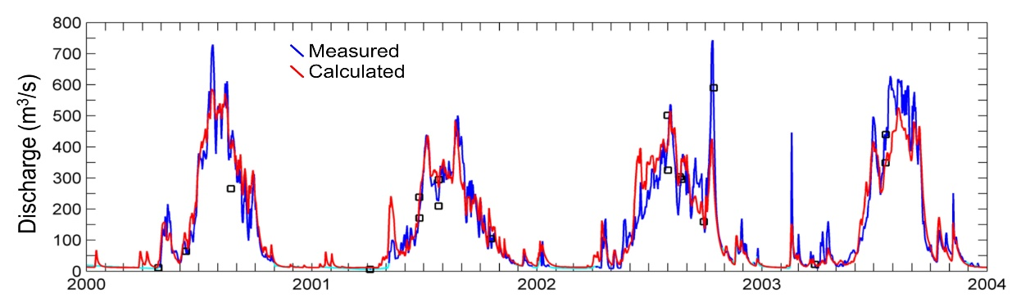
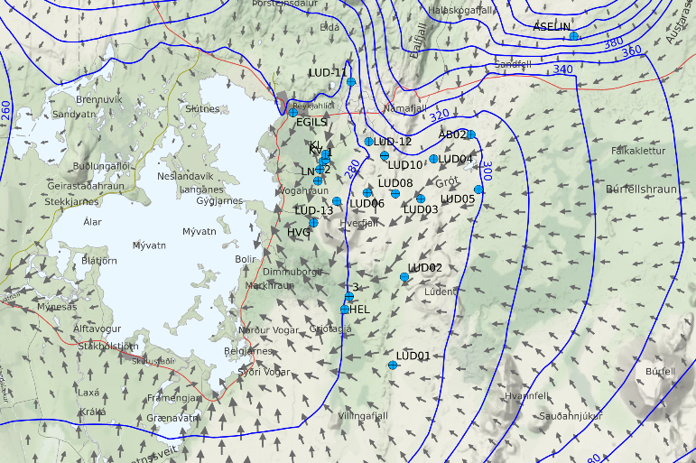
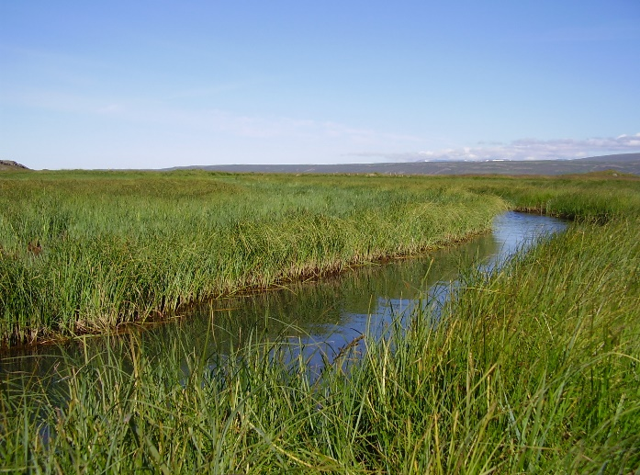
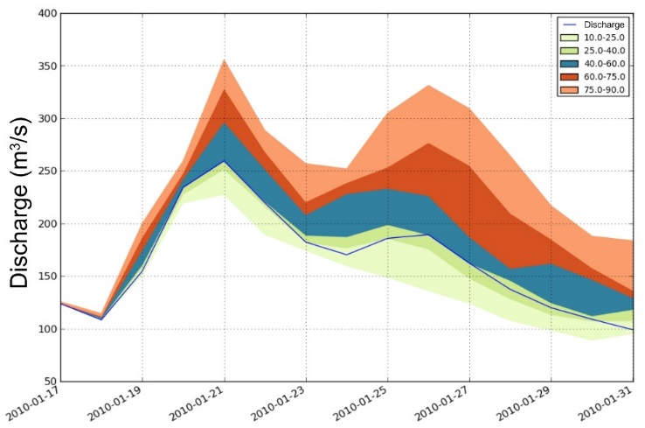
HYDROPOWER SERVICES
Hydrodynamics of structures
Calibration of historic reservoir inflow
Feasibility
Design
Operation
Pre-design
Groundwater modelling
Environmental impacts
Reservoir inflow forecasting

Slide 8
HYDROPOWER SERVICES
Feasibility
Hydro potential mapping
Long term inflow series
Pre-design
Watershed modeling with infrastructure
Environmental effects
Watershed research management
Groundwater modeling
Design
Watershed modeling
Hydrodynamics of structures and reservoirs
Sedimentation
Operation
Short and long term inflow forecasts
Refurbishment design parameters
Operational decision-making
Reservoir leakage

Slide 9
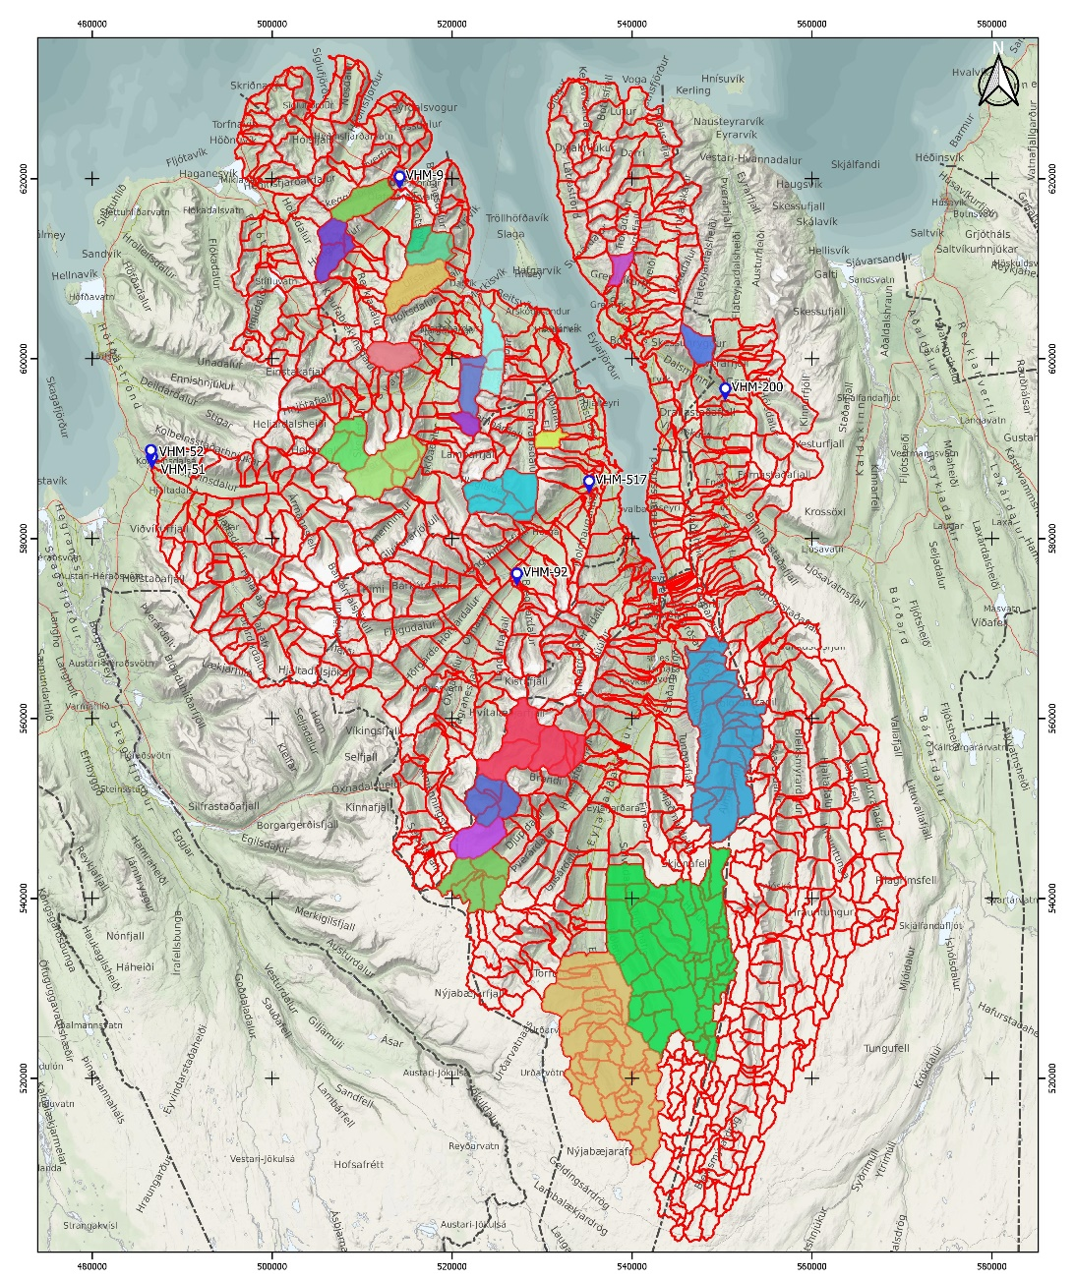
Small-hydro services
Hydro potential mapping with geographical analysis methods
Long-term inflow series with runoff models
Duration curves and other planning and design support tools
Tailor made solutions to each project, taking into account available data and specific needs of client
Methodology primarily developed in Iceland and Greenland but transferable to other parts of the world where suitable meteorological input data can be produced

Slide 10

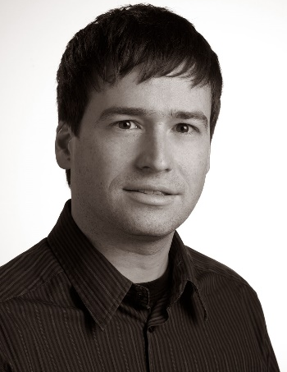
Programme Area: ENERGY
Renewable energy, energy efficiency, energy security
  Improved energy efficiency in school buildings
  Development of high-efficiency industrial and professional cogeneration
  Construction/modernization of municipal heating systems and elimination of individual heat sources
  Geothermal energy production
  Increasing the efficiency of energy generation in existing small hydropower plants (up to 2MW)
Current call
for proposals
Contact information:
Eric M. Myer, M.Sc.
Marketing manager
Senior Hydrogeologist
eric@vatnaskil.is
Further information at our website: www.vatnaskil.is

