Slide 1



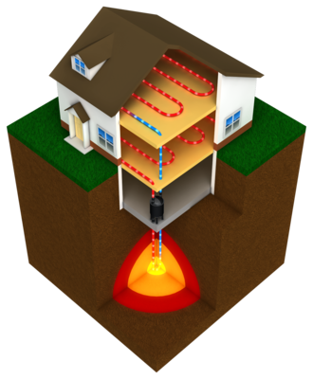
Drilling and geothermal utilization, our expertize.!
Friðfinnur K. Daníelsson.
Michal Czekanski.
alvarr@alvarr.is

Slide 2
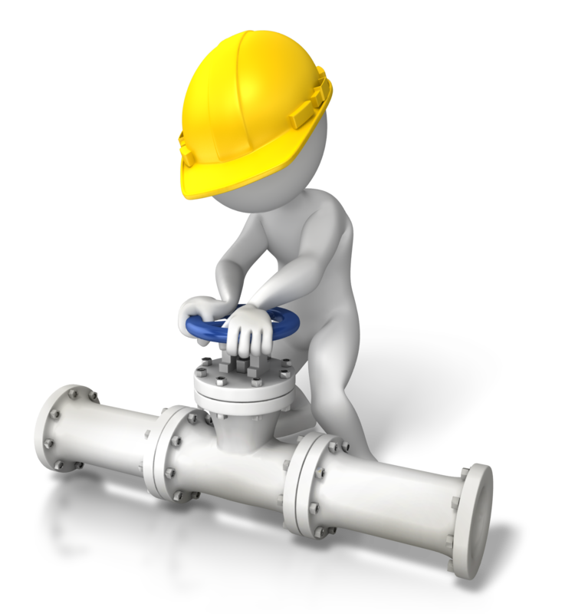
We have vast experience with:
Drilling and related activity such as well
logging and testing
Utilization of low temp geothermal together
with heat pumps.
Design and building of heat pumps.
We would be happy to team up with some
Polish companies within the above fields.
Thank you.!
s. 4/5

