Slide 1

Immigration of foreign students to the European Union – the case of Sweden
EMN Conference 2012
Immigration of International Students to the EU
6 December 2012
Warsaw Poland
Kjell Ekfeldt
Swedish Migration Board, Norrköping
National EMN contact point

Slide 2
Background: Number of third country national students coming to Sweden
Source: Swedish Migration Board; Figures include residence permits issued for studies at universities (2011: 73%), other studies (7%) and family members of students (20%)
Figures for 2012 (Jan – Nov) was 6000.
Main reason for decline 2011: Introduction of student fees for third-country national students

Slide 3
Introduction of student fees (2011)
Tradition of free higher education in Sweden
However: Universities should compete internationally for attracting students on the basis of high quality education, not on the basis of offering free studies
  (Government Bill 2009/10:65)
Since 2011, third country nationals who wish to study in Sweden have to pay tuition fees
  Exceptions: students that take part in exchange programmes, doctoral students, persons who already have a residence permit
Introduction of new scholarship programmes
The fee is decided by each University
(approx 11 000-16 000 €/year)

Slide 4
Examples of required support
Study period | You must have at least
12 months | 10 x 7 300 = 73 000 SEK
24 months | 20 x 7 300 = 146 000 SEK

Slide 5
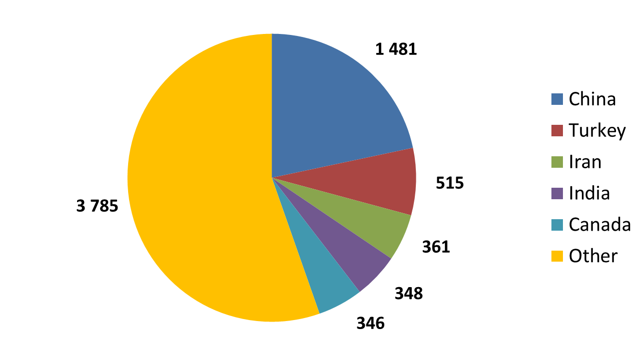
Trends: Countries of origin 2011
Source: Swedish Migration Board

Slide 6
Trends: Popular study courses
Most third country national students chose shorter study courses, such as master programmes (60%) or Swedish Magister programmes (23%)
Share of international students in vocational (1%) and bachelor programmes (8%) is smaller
Studies within the areas of technology and manufacturing (34%) and natural sciences, mathematics and computer science (15%) are among the most popular study subjects
Source: Högskoleverket / Swedish National Agency for Higher Education

Slide 7
Marketing and recruitment strategies, information provision
Website www.studyinsweden.se serves as a portal and hub for information regarding studies in Sweden
Marketing for Sweden as a study destination by the Swedish Institute, Swedish missions abroad and individual higher education institutions (such as through agents, education fairs, international offices and cooperation with foreign universities)

Slide 8
Legal aspects: Residence permits, application procedures
As a general rule, in Sweden, residence permits for study reasons must be applied for from abroad
Universities notify the Migration Board when payment of registration and student fees have been made
Visas are only used for short-term stays and in exceptional circumstances
Since 2011, biometric identifiers must be given in person at a Swedish mission abroad
Visa free students have the possibility to leave their biometric identifiers after entering Sweden
Time from application to decision shall be as short as possible (government objective: three months)
No fast-tracking for special groups, but processing can be fast when applications are complete from the beginning
Possibility of applying for a residence permit via the internet for nationals of almost all countries

Slide 9
Legal bases for entry and stay of students from third countries
Duration of stay:
  At least one year or for the period of studies concerned, if this period is shorter
Extension of stay:
  At least one year (or for the period of studies concerned, if shorter).
  Conditions as above must be satisfied, but extension can be applied for from within Sweden.
  Student must also have made progress in studies (minimum 15 university credits during first year, 22.5 during second year, and 30 during third and subsequent years)

Slide 10
Legal aspects: Access to labour market during and after studies
International students have full access to the Swedish labour market
Change of status from student permit to residence permit for work is only possible when the applicant has a job (or job offer) before the student permit expires
Number of work permits issued to former students is increasing

Slide 11
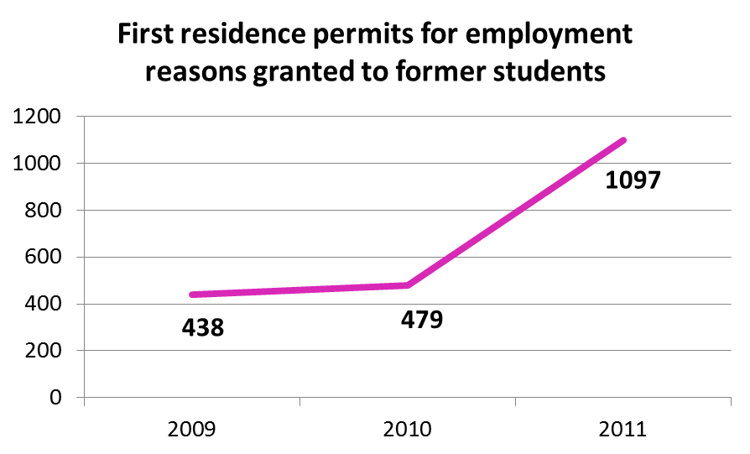
Trends: Change of status study → work
Background: International students represent an important recruitment base for the education system, research and the labour market (Government Bill 2009/10:65)

Slide 12
Legal aspects: Conditions for students’ dependents
International students can be accompanied by spouses/partners and children.
20% of all residence permits for study reasons were granted to dependents in 2011
However: Applicants must prove that they are in possession of sufficient means to support their families; dependents are not allowed to work.

Slide 13
Welcoming international students in Sweden
+
Higher education institutions invest into more welcoming structures (such as “welcome days”, guaranteed housing)
More and more education offered in English
New scholarship schemes introduced in 2011
-
The number of scholarships is considered to be to small to counter-balance the effects of the introduction of tuition fees
Persons staying in Sweden on a short-term basis are not registered in the population registry and are therefore not issued a personal identity number, which can lead to difficulties concerning bank accounts or mobile phones

Slide 14
Inter-agency cooperation
Forum for internationalisation started in 2008
Members: Government ministries, agencies, representatives for higher education institutions, students’ union
Objective: Improve coordination between Swedish authorities and organizations dealing with the internationalization of higher education institutions
Forum has identified and addressed a range of problems, such as problems pertaining to intra-EU mobility of third country national students

Slide 15
Conclusions and future options
Despite the new tuition fees, Sweden can be seen as an attractive destination
However, several improvements could be envisaged:
  Introduction of a residence permit for graduates to look for work after completion of studies
  Work permit for students‘ dependents
  Efforts to further speed up the application process for residence permits
  Eradicate barriers to intra-EU mobility of third-country national students
  Further regional integration efforts and promotion and facilitation of contacts between international students and employers
  Expansion of exchange and scholarship programmes

Slide 16
Thank you for your attention!
Kjell Ekfeldt
Swedish Migration Board, Norrköping
National EMN contact point
kjell.ekfeldt@migrationsverket.se
+46 - 10 - 485 07 51

