Slide 1
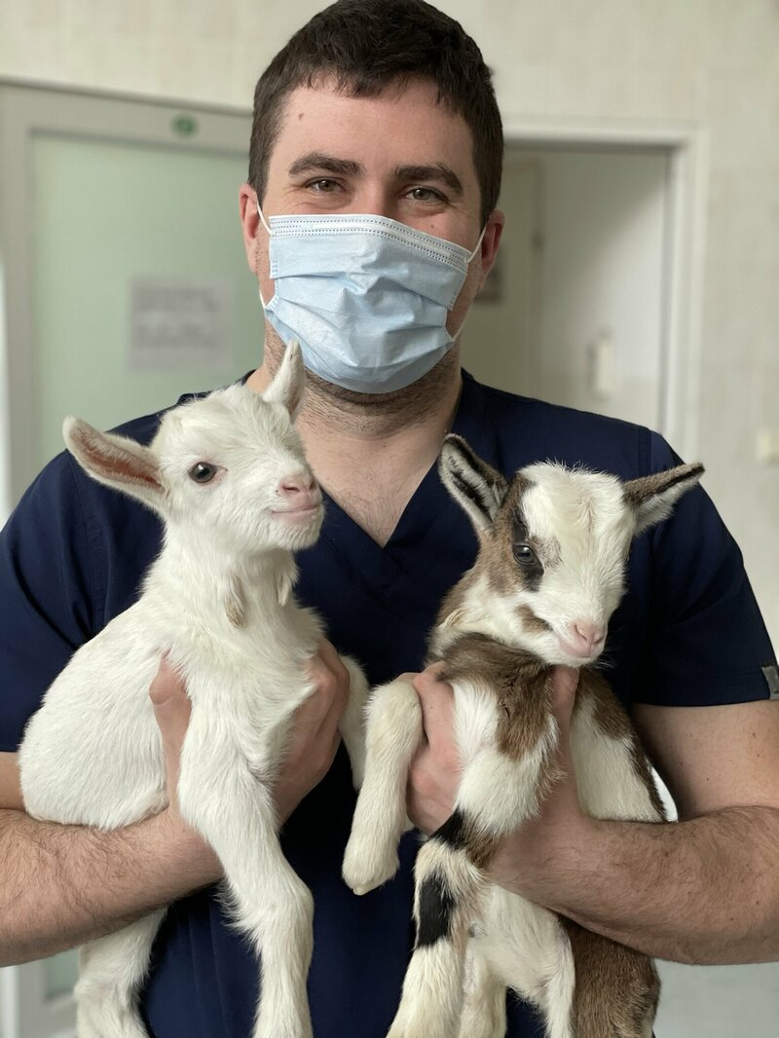
Veterinary Medicine in Wrocław

Slide 2
About us
The Wrocław University of Environmental and Life Sciences:
the best university of environmental and life sciences and 2nd in veterinary medicine in Polish rankings;
placed in the Shanghai Ranking for veterinary sciences and food science and technology
teaching delivered by experts respected both in the academia and in the industry;
international cooperation with universities from all over the world – opportunities for exchanges and internships;
student societies that let you follow your passions!

Slide 3
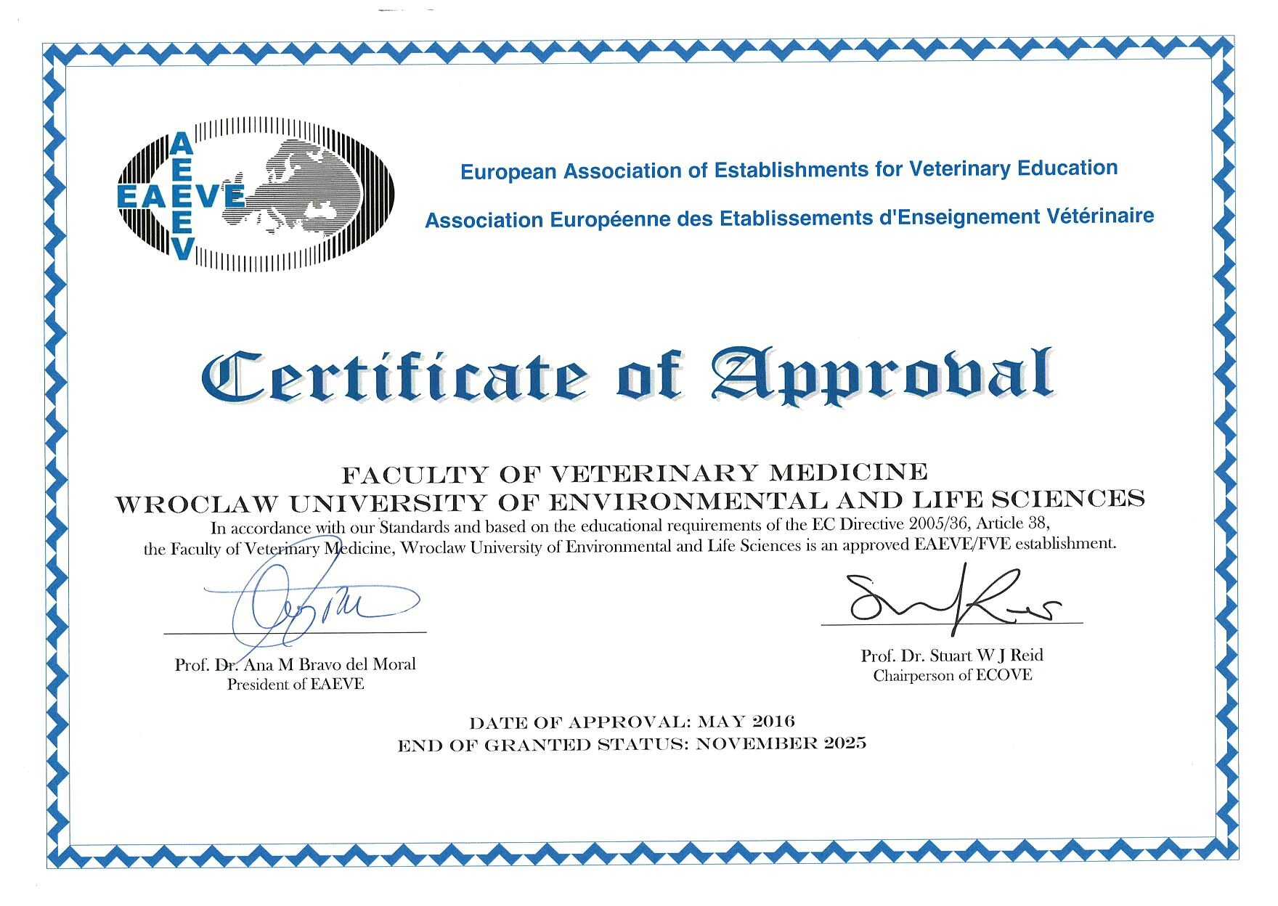
Basic information about the program
fully accredited program
approved by the EAEVE
5,5 years, 11 semesters
vet degree equal to a master’s
certificate of Educational Excellence from the Polish Accreditation Committee

Slide 4
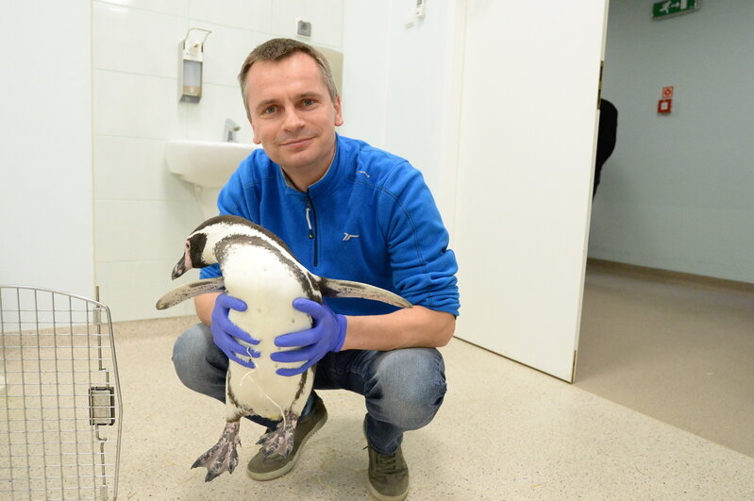
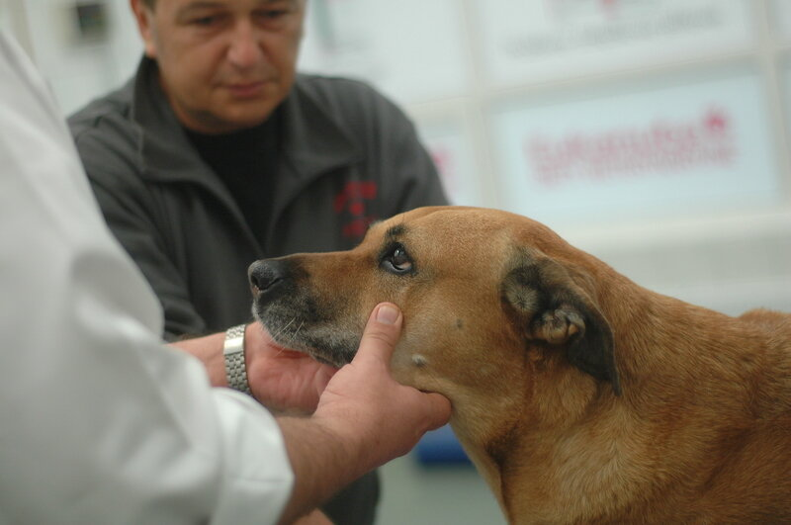
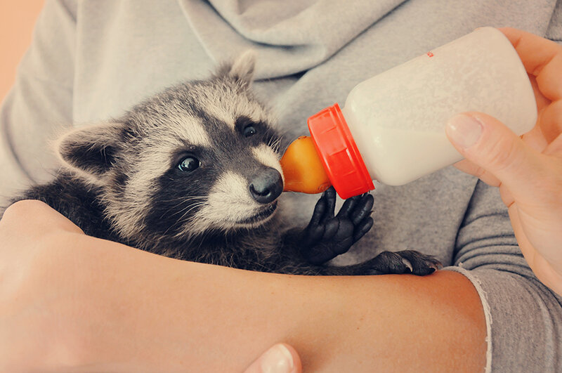
Content
All types of animals
cats, dogs
horses
farm animals
birds
exotic and wild animals
fish
beneficial insects
…and also:
animal behaviour and welfare
basic agriculture
slaughter animals & meat hygiene
milk hygiene
professional ethics
veterinary economy
sports
foreign language

Slide 5
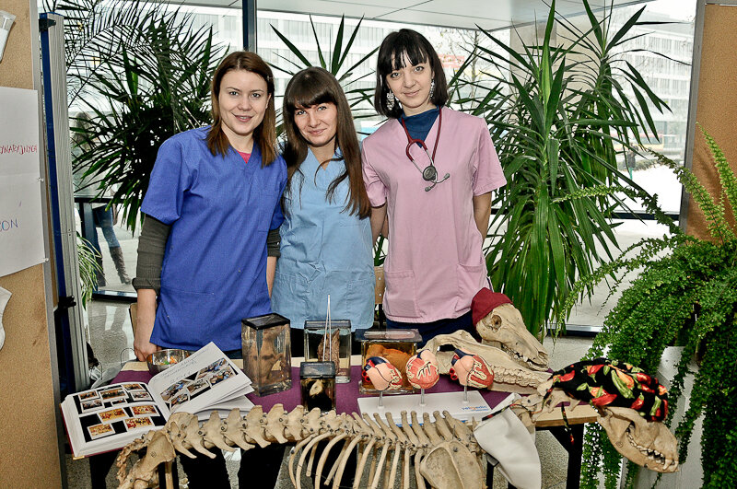
Additional activities
Volunteering at our clinics and farm
Student research clubs
Vet student council
International Veterinary Students Association
Sports
Dance groups
University choir

Slide 6
Wrocław
Facts:
The biggest city in western Poland
ca 700k inhabitants, over 100k of them are students
4 hours drive from some of the biggest cities in Europe, good air and train connections
European City of Culture 2016
European Best Destination 2018
Attractions:
cultural events, film and music festivals
the third biggest zoo in the world by the number of species
dozens of historical landmarks, wild nature reserves and national parks, ski resorts in the mountains, all within two hours drive or less
Wrocław is known as „the Meeting Place,” young, dynamic, diverse, where everyone can feel welcome.

Slide 7
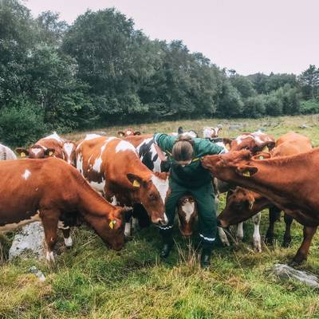
Applications
Steps:
Register in the system https://apply.upwr.edu.pl/
Upload scans of your documents
Submit your application, wait for feedback
Attend the interview
Wait for the results
Congratulations! Remember to pay your fees and submit your paper documents by post or in person
In case of doubt, don't hesitate to ask for advice!

Slide 8
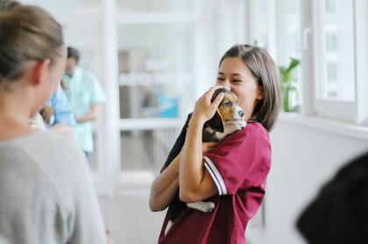
Applications
Step 1: your final high school diploma
-advanced biology and/or chemistry
Biology 1 and Biology 2
Chemistry 1 and Chemistry 2
-English language (level B2)
English 6/7 - grade C
Certificates: IELTS, TOEFL, FCE, CAE, CPE…
Step 2: online interview

Slide 9
Get to know our international students!
Do you want to hear from our international students?
Find them on our YouTube channel and website!

Slide 10
Get in touch!
Phone number: +48 71 320 16 00
Email: admission@upwr.edu.pl
www.upwr.edu.pl

