Slide 1
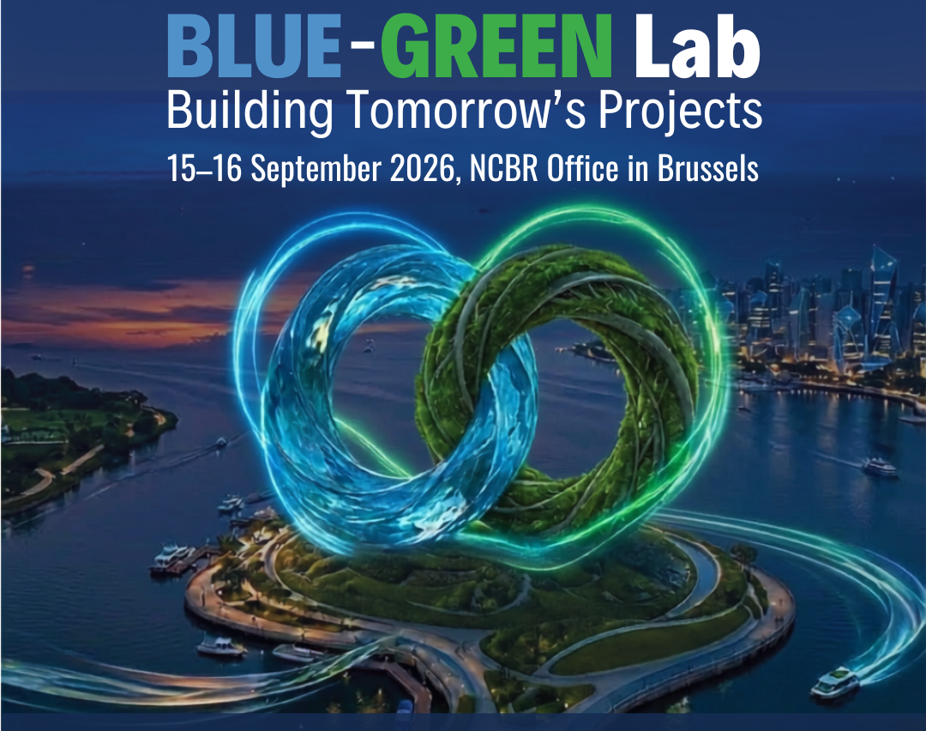

Blue-Green Lab 2026 Agenda
Day 1 | 15 September 2026
Time | Programme
12:00 - 13:00 | Registration & Welcome Coffee and snacks
13:00 - 13:25 | Opening Session: Welcome remarks and event objectives Waldemar Dubaniowski – Director, NCBR Office in Brussels Mirosław Raba – Head of Global Challenges Section, NCBR
13:25 - 14:15 | Keynote & Expert Insights Session John Hanus – Team leader, Mission Ocean and Waters Julie Olivier – Project Management Jülich, SBEP
14:15 - 16:15 | Project Pitching Session
16:15 - 16:30 | Coffee Break
16:30 - 18:00 | Matchmaking Round
18:00 - 19:30 | Networking Dinner

Slide 2
Blue-Green Lab 2026 Agenda
Day 2 | 16 September 2026
Time | Programme
09:00 - 09:30 | Welcome Coffee
09:30 - 9:50 | A Look into the Future - Horizon Europe support to the waterborne transport Agnieszka Zaplatka – Project Advisor, CINEA
09:50 - 10:30 | Interactive Workshop: Building Competitive Horizon Europe Proposals
10:30 - 11:30 | Matchmaking Round I
11:30 - 11:45 | Coffee Break
11:45 - 13:00 | Matchmaking Round II: Consortium Development Session
13:00 - 13:15 | Wrap-Up Session
13:15 - 14:30 | Closing Lunch & Informal Networking

