Slide 1
17th of February 2021
Better communication with the CAF based on the experience of the Kraków City Hall

Slide 2
Benefits of the CAF
Common language: It allows staff and managers to discuss organisational issues together in a constructive way.
People involvement: The self-assessment process is the basis for the systematic involvement of people in the improvement of the organisation.
Common Assesment Framework. The European Model […], p. 6
A short film with representatives of the management of the Kraków City Hall

Slide 3
Improvement projects
in communication with the residents

Slide 4
Simple official language
Diagnosis: downward trend in communication from systematically-conducted customer satisfaction
Improvement area: the language of documents prepared in the course of administrative proceedings
Improvement action:
  guidelines for writing documents in the course of administrative proceedings prepared in co-operation with experts from the University of Wrocław;
  one-day training workshops for officials (the principles of good writing, ways of simplifying texts work on the selection of lexis, clarity, and friendliness of the message).

Slide 5
Kraków taxpayer website
Diagnosis: ineffective information for clients in the field of local taxes based mainly on telephone information and direct visits to the office; tax decisions delivered only in the traditional manner
Improvement area: providing residents with access to up-to-date information on local taxes and their tax liabilities; possibility to make on-line payments

Slide 6
Kraków taxpayer website
Improvement action: developing and launching the internet platform - Kraków taxpayer website
  a communication tool between the residents of the city of Kraków and other persons with the tax authority in the scope of payment local taxes and fees to the budget of the city of Kraków;
  an information platform concerning the amounts due for payment of liabilities, which also offers the possibility to pay them directly on the website;
  a collection of basic information on local taxes and charges, including tax rates.

Slide 7
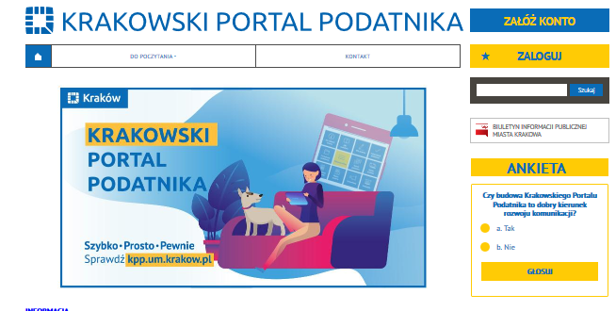
Kraków taxpayer website

Slide 8
Improvement projects
in communication within the City Hall
of Kraków

Slide 9
Staff satisfaction survey
Diagnosis: the low participation of employees in the research, the results are not representative for the entire organisation
Improvement area:
  the quality of feedback on employee satisfaction;
  a uniform methodology for employee satisfaction surveys at the Kraków City Hall;
  the frequency of employee satisfaction surveys,
  to find and analyse the reason for the low participation of employees in the research.
Improvement action: not everything works out …

Slide 10
Modernisation of the internal information service of the Kraków City Hall
modern layout and structure of presentation;
ergonomic and user-friendly;
adapted to the needs of a modern recipient (including the recipient with disabilities);
displayed on all devices (mobile phones, tablets, laptops or desktop computers);
developed in technologies.

Slide 11
Conclusion
Better comunication = increase the quality of services for the residents, latest technological solutions, involvement of employees in the development of the organisation

Slide 12
Anna Sochacka
Head Director of Strategy, Investment Planning and Monitoring Department
City Hall of Kraków
si.umk@um.krakow.pl

