Slide 1

Mineral & Energy Economy Research Institute, Polish Academy of Sciences
(IGSMiE PAN / MEERI PAS)
Beata Kępińska
Match Making Event, EEA FM (online)
Warszawa, 25 June 2020

Slide 2
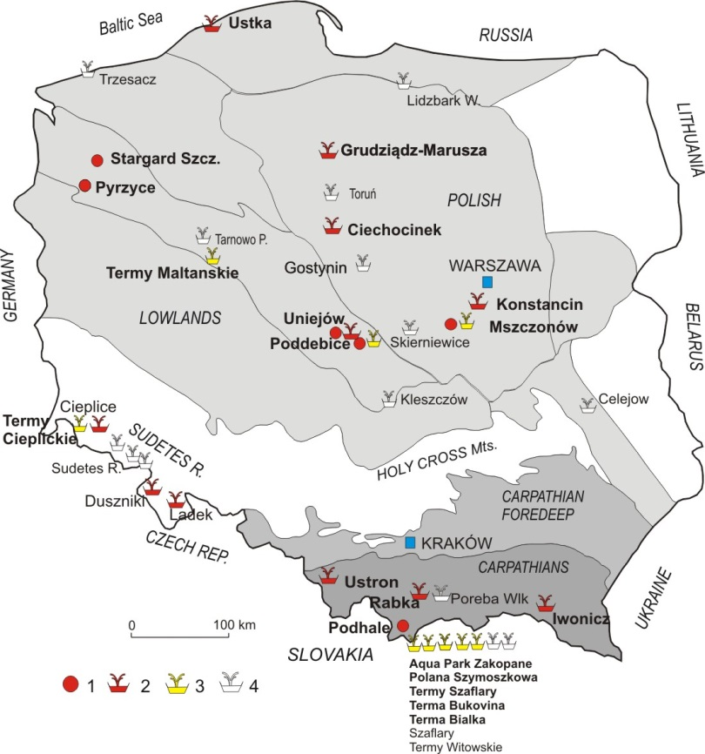
Poland – geothermal energy uses, 2019 -2020
Space heating:
- 6 geothermal district heating systems (geoDH)
- Geo-heat sales: ~800 TJ /2018, 75 MW installed
(12-13th place among European countries)
Balneotherapy, recreation:
12 health resorts, 15 recreation centres
Other single uses: fish farm, wood drying, heating up of a football pitch, food processing, minerals and CO₂ extraction, cosmetics’ production
Shallow geothermal (heat pumps, GSHPs):
> 6 0000 units (high market dynamics in recent yrs)
Extension of existing geoDHs (incl. drilling new wells)
2016-2020: several new exploration wells drilled,
next in progress (for several next geoDHs)
(funded by 2016, 2019 state support programs for geothermal drillings and other geoDH infrastructure)
Space heating - priority for next years
1. District heating, 2. Health resorts,
3. Recreation centers,4. Wood drying,
5. Fish farm, 6. Recreation centers in realisation,
7. Heating system in realisation, 8. Individual heating
(© Kępińska 2020)

Slide 3
The MEERI PAS profile
FIELDS OF R&D EXPERTISE
SCOPE OF RESEARCH
Applied geology and mining
Mineral resources
Mining and resources
Geophysics
Waste management
Renewable energy sources
GEOTHERMAL
Economics of mining and energy
Renewable energy sources
Environ-mental engineering
Statutory research
Mineral resources management
Sustainable development
Information technologies
Economics and law
Chemical technology and materials engineering
Polish energy policy
Fuel & energy management
- Over 100 employees (incl. 50 scientists)
- Over 30 years of activity
- High academic standing (’A’ category)
- Cooperation, projects with >150 Polish
and foreign entities
MEERI PAS – among leading entities in Poland in geothermal R&D, management, various technological aspects, cooperation with LAs, public, private sectors, NGOs, etc.

Slide 4
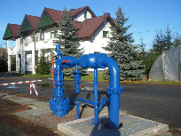
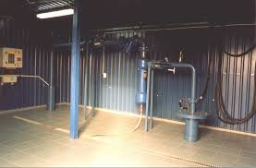
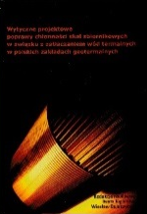
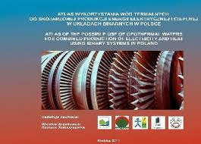
Some geothermal works / projects at a glance
First experimental geothermal plant in Poland (Podhale R.)
First reconstruction of abandoned well for geothermal heating (Mszczonów)
Guidelines on improving reservoir rocks’ injectivity in Polish geothermal plants
Numerical modelling of heat and mass flow in geothermal reservoirs,
modeling of geothermal systems (sustainable exploitation and management)
Geological, thermal, hydrogeological, energy aspects of geothermal systems
Prospects for geothermal CHP binary systems in Poland
(+ cooperation on geothermal atlasses for various regions)
Geothermal feasibility studies, well drilling projects,
pilot and investment projects (wide scopes)
Effective geothermal water uses
Several EU-projects (IGET, GTR-H, GEOCOM, GEODH, GEORISK),
EEA – first for Poland (2016/2017)
Cooperation with local administration units, various investors and entities …

Slide 5
First EEA geothermal projects for Poland, 2016-2017
MEERI PAS – leader of two from three first EEA geothermal projects for Poland:
”Geothermal energy potential in Poland – town Poddebice”
MEERI PAS, AGH, NEA (+ subcontractors), 2016-2017
”Geothermal energy – a basis for low-emission heating, improving leaving
conditions and sustainable development. Preliminary study for selected areas
in Poland”, GeoHeatPol – MEERI PAS, AGH-UST, PWr, NEA, CMR (+subcontractors),2017
In preparation:
”Capacity Building of the Key Stakeholders in the Area of Geothermal Energy”
MEERI PAS – NEA – pre-defined project
Some other project applications submitted in 2019/20

Slide 6
Areas of MEERI PAS interest in cooperation, projects with EEA Donor Countries
Continuation - investment pilot projects’ proposals elaborated for 4 cities
by 2016-2017 EEA Projects (Poddębice, GeoHeatPol), (partners: NEA, ISOR, CMR,
MEERI PAS, AGH-UST, other entities) – joint investment applications (?)
Advanced modeling and simulation of geothermal systems (L-T)
Advanced technologies in drilling, maintenance and management of geothermal wells,
fluids, systems, infrastructure …
Geothermal space heating, CHP and other uses (agriculture, biotechnologies, etc.)
Energy efficiency, reduction of CO₂ (and others pollutants) emission, LCA
Assessement and optimisation of geothermal energy uses
Feasibility studies, pilot projects with Icelandic, Norwegian partners
and various Polish stakeholders (with some MEERI has cooperated,
can lead and facilitate contacts and cooperation aimed at common EEA projects)
Other …

Slide 7

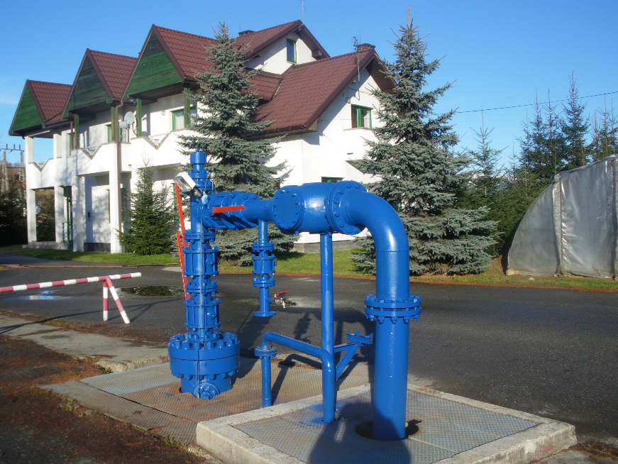
Thank you for the attention
MEERI PAS Geothermal Laboratory:
1st Experimental Geothermal Plant in Poland, end 1980s
(paved the way for geoDH in the Podhale R., other
localities and for various geothermal uses)
Podhale R., Poland
bkepinska@interia.pl
buwi@min-pan.krakow.pl
Mineral and Energy Economy Research Institute
Polish Academy of Sciences
www.min-pan.krakow.pl

