Slide 1
ENFINI AS
Presentation at Webinar organized under the Environment, Energy and Climate Change Programme (PL-CLIMATE)
Reidar Vestby, COO

Slide 2
We install micro hydropower world wide

Slide 4
HydroGo quality and capabilities
5 – 10 m
Produces 5 - 160 kW
80 % efficiency
in energy conversion
Easy & fast
Limited intervention
24/7
Reliable supply
Power Hub

Slide 5
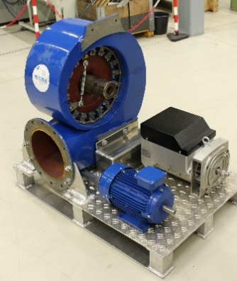
Product
Kaplan turbine new materials 3D printed
HydroGo development has received funding from the European Horizon 2020 research and innovation programme under Grant Agreement NO 832269 and Seal of Excellence

Slide 6
Contact
Astrid Green CEO
Tel: +4748177389
Reidar Vestby COO
Tel: +4740410288
post@enfini.no

