Slide 1
Our project…
Ostrowski Rynek Energetyczny (ORE)
Local energy market in City Ostrów Wielkopolski
organized as an energy cluster
An example of a successful distributed generation implementation project

Slide 2
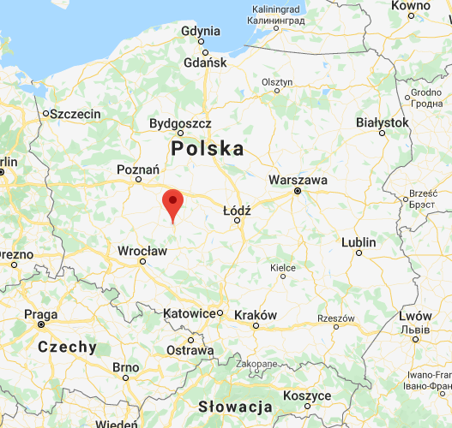
Where…
Ostrów Wielkopolski – city in Greater Poland Pprovince, west-central Poland. A rail junction and industrial town, it produces machine tools and railroad cars, lumber, ceramics, and textiles. The city, which lies in the south of the Great Polish Plain, was first chronicled in the 13th century but received municipal rights only in the 18th. It passed to Prussia in 1793 and was returned to Poland in 1918. Pop. (2011) 72,810.
In the 19th century Ostrow Wielkopolski became an important transport and economic centre. In 1875 a railroad connection with Poznan and Kluczbork was established. The town’s inhabitants were active during the Spring of Nations and the Greater Poland Uprising.
After WW1, there was an economic boom. In 1920s Wagon factory was built here. It was the largest industrial works in the southern Greater Poland.
Electro mechanical industry began to develop. Zaklady Automatyki Przemyslowej (i.e. the facility dealing with industrial automation) and Zakłady Sprzętu Mechanicznego (English: Mechanical Equipment Factory) came into being.
The administrative reform conducted in 1975 lowered the status of Ostrow; however, the forming of self-governments in 1990 opened the door to the city’s development and growth. There were still investments in the industry and transport made but more attention was paid to the culture.
Web ink

Slide 3
What we do…
Our local energy market connects local energy producers with its business, municipal and public consumers. It is a local energy world.
Local production per year:
Consumption per year
36 GWh (co-generation, CHP)
50 companies
22 GWh (wind)
City and citizens
Electro-bus
8 GWh (sun)
E-car loading (estimated)
18 GWh (estmated, biogas)
Our Company:
CRK Energia
- Cluster coordinator
Energy storage (estimated)
80 GWh
80 GWh

Slide 4
Energy cluster organization – members…
CRK Energia Sp. z o. o.
(coordinator)
Ostrów Wielkopolski commune + its municipal units
Municipal Development Center + companies
Entrepreneurs (energy producers and pronsumers)
IT companies
Scientific support
54 entities

Slide 5
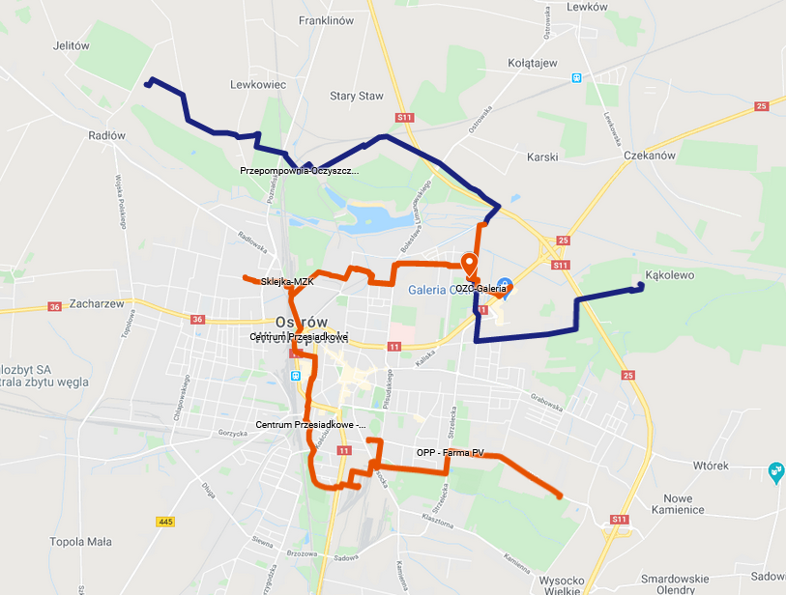
How we do it…
The cluster ORE has and uses its own power grid with a length of over 30 km.

Slide 6
Our goals…
ensuring local energy security and energy self-sufficiency - building own local power infrastructure and independence from the National Energetic System and its threats
fight against low emissions and environmental pollution eliminating from the local area all sources of electricity that do not meet the definition of a Renewable Energy Source
implementation of the circular local economy model - searching for synergies between ORE participants and local economy
improving the competitiveness of the local economy against the background of the national economy - ensuring the access to cheaper local electricity
integrating and stimulating the local community - by encouraging economic participation in the cluster and its development
promoting the concept of prosumer energy - supporting residents and local entrepreneurs in building their own installations and successive placement of PV installations in local government institutions (goal: eliminating the need to purchase energy by municipal institutions in the next 5 years as a result of making them a prosumers)
.

Slide 7
What is CRK Energia?
We are a cluster coordinator. CRK Energia is a municipal company that is part of the capital group of municipal companies, managed by the City and its partners.
.
City
Ostrów Wielkopolski
100%
CRK SA
(mother company)
49%
51%
100%
100%
3
3
29%
25%
33%
OZC SA
(our powerplant, CHP)
CRK Energia
(cluster coordinator)
MZK SA
(public transport)
WODKAN SA
(water supply)
25%
75%
56%
44%
100%
50%
50%
Targowiska Miejskie SA
(city bazaars)
MZGM
(communal flats)
MZO SA
(cleaning and garbage)
CRKZiR
(municipal greenery)

Slide 8
Tasks of the cluster coordinator…
Buying energy from the cluster members who are its producers and resell it to the cluster members who are its consumers,
Adjusting the amounts of energy on both sides on an annual, monthly, daily and hourly basis
The imbalance of energy supply and demand is the subject of trade with the energy market - the coordinator's task is to minimize imbalance
The coordinator acts as the operator of the local mini-energy system
The coordinator animates all initiatives and innovative ideas regarding the development of ORE
The coordinator represents the cluster externally
Visit our web-page: http://www.crkenergia.pl
.

Slide 9
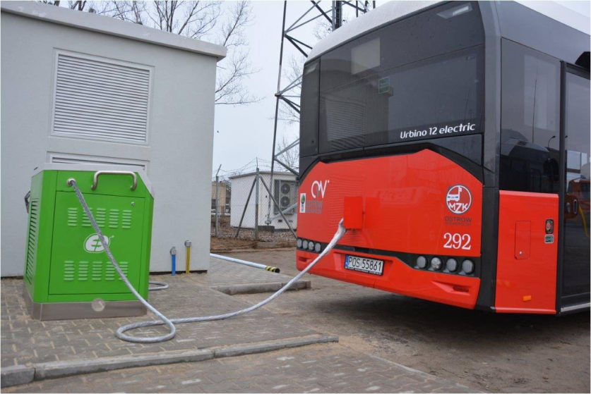
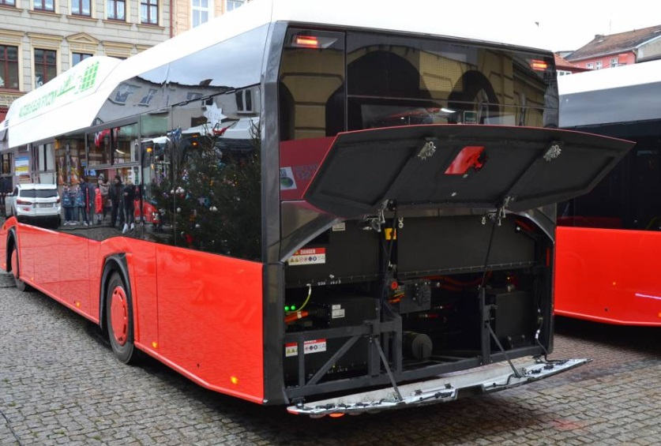
ORE – elektromobility
The strategic decision of town to buy electric buses was far ahead of the cluster’s creation - it was taken in 2014 (the concept rejected other drives: hybrid, gas, etc.)
In order to rationalize costs the concept assumed the purchase of a significant number of buses
the cost of purchase of 10 buses was about 19 million PLN and the co-financing was 85%
10 electric buses account for around 17% of the bus fleet, finally this ratio is expected to reach 30%
The expected lifetime of the e-bus is about 16 years
Selected operating parameters:
range: 130-160 km (with inter-charges - approx. 260 km).
Energy consumption: 1.5 kWh / 1 km. Battery capacity: 200 KWh.
Charging stations: 4 * 50 kW
Wybrane parametry eksploatacyjne:
Zasięg: 130-160 km (z międzydoładowaniami – ok. 260 km). Zużycie energii: 1,5 kWh/1 km. Pojemność baterii: 200 KWh. Stacje ładowania: 4 * 50 kW

Slide 10
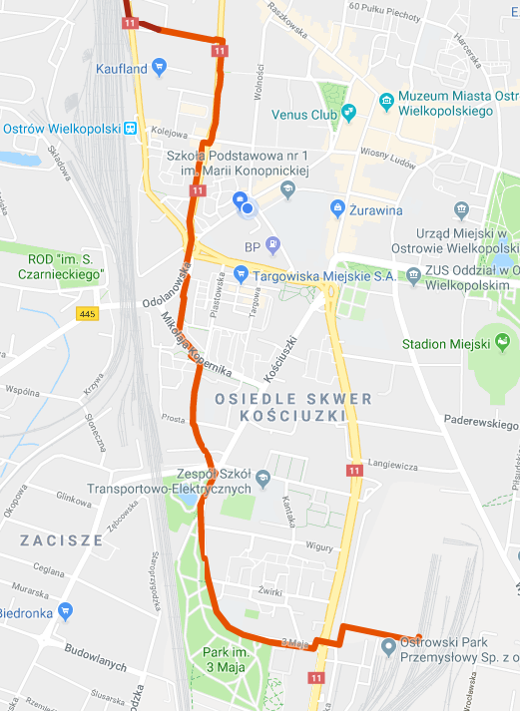
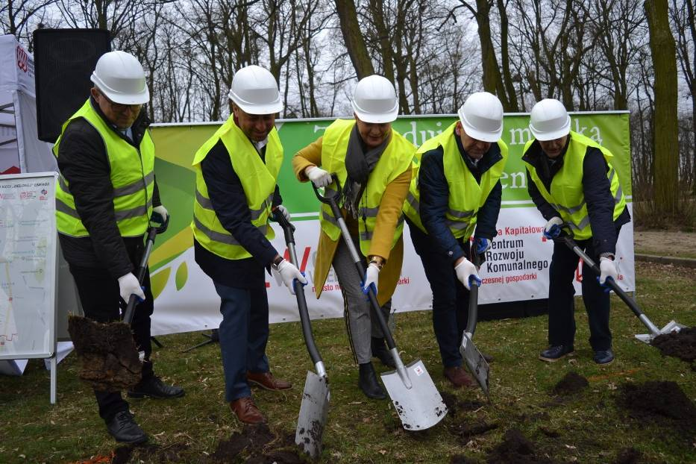
Zielona energia dla Mieszkańców – najnowsza idea
Building of the first municipal ecological energy network in Poland began in 2019.
The first residents and entrepreneurs will receive cheaper electricity in their sockets from July 2020.

Slide 11
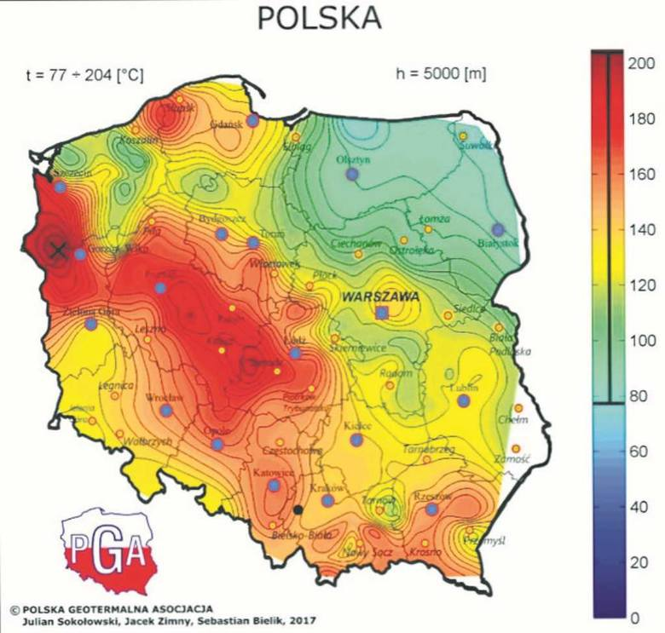
The potential of our region…
City Ostrów Wielkopolski is located in the very center of the warmest geothermal sources in Poland:
.

Slide 12
Our plans and what we need…
We are going to build another own energy sources:
Co-generation (CHP)
Thermal
PV (we have just started a project to build a 3 MW PV farm)
…so for this reason we are looking for partners with experience in these areas.
The ORE cluster is one of the best projects of this type in Poland. We are certified by the Ministry of Energy, we have won many awards. Join us!
.

