Slide 1
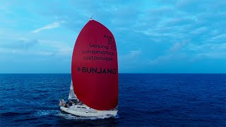

Slide 2


Stress-Free
C2C Platform for Secondhand Marketplaces

Slide 3

[beon gae zang teo]
Market,
Marketplace
Beyond Market
Sense of community & warmth
Lightning
Happening now
Happening fast
We are the Lightning Strike in the Recommerce Revolution

Slide 4

The Recommerce Revolution
Secondhand ≠ Second Class
$200B+ global market by 2027 $32B+ Korea in 2025, up by approx. 80% compared to 2021 Sustainability meets style Gen Z’s go-to for individuality
Notes:
주요 포인트
국내 리커머스 시장 현황/규모 (빠르게 성장 중)
허나 이커머스 시장과 비교했을때 아직 시작 단계에 불과
앞으로의 리커머스 시장은 이커머스 시장 처럼 성장/발전할 것
리커머스 2.0 시대의 도래
리커머스 1.0은 플랫폼이 생겨나면서 오프라인 위주의 중고거래가 기술로 더 쉽고 빠르게 거래할 수 있게 되었던 시대라면
리커머스 2.0은 플랫폼 기술과 서비스 발달로 중고거래도 숨쉬듯 자연스럽게 이루어지면서 시장과 생태계가 확대되는 시대가 도래

Slide 5
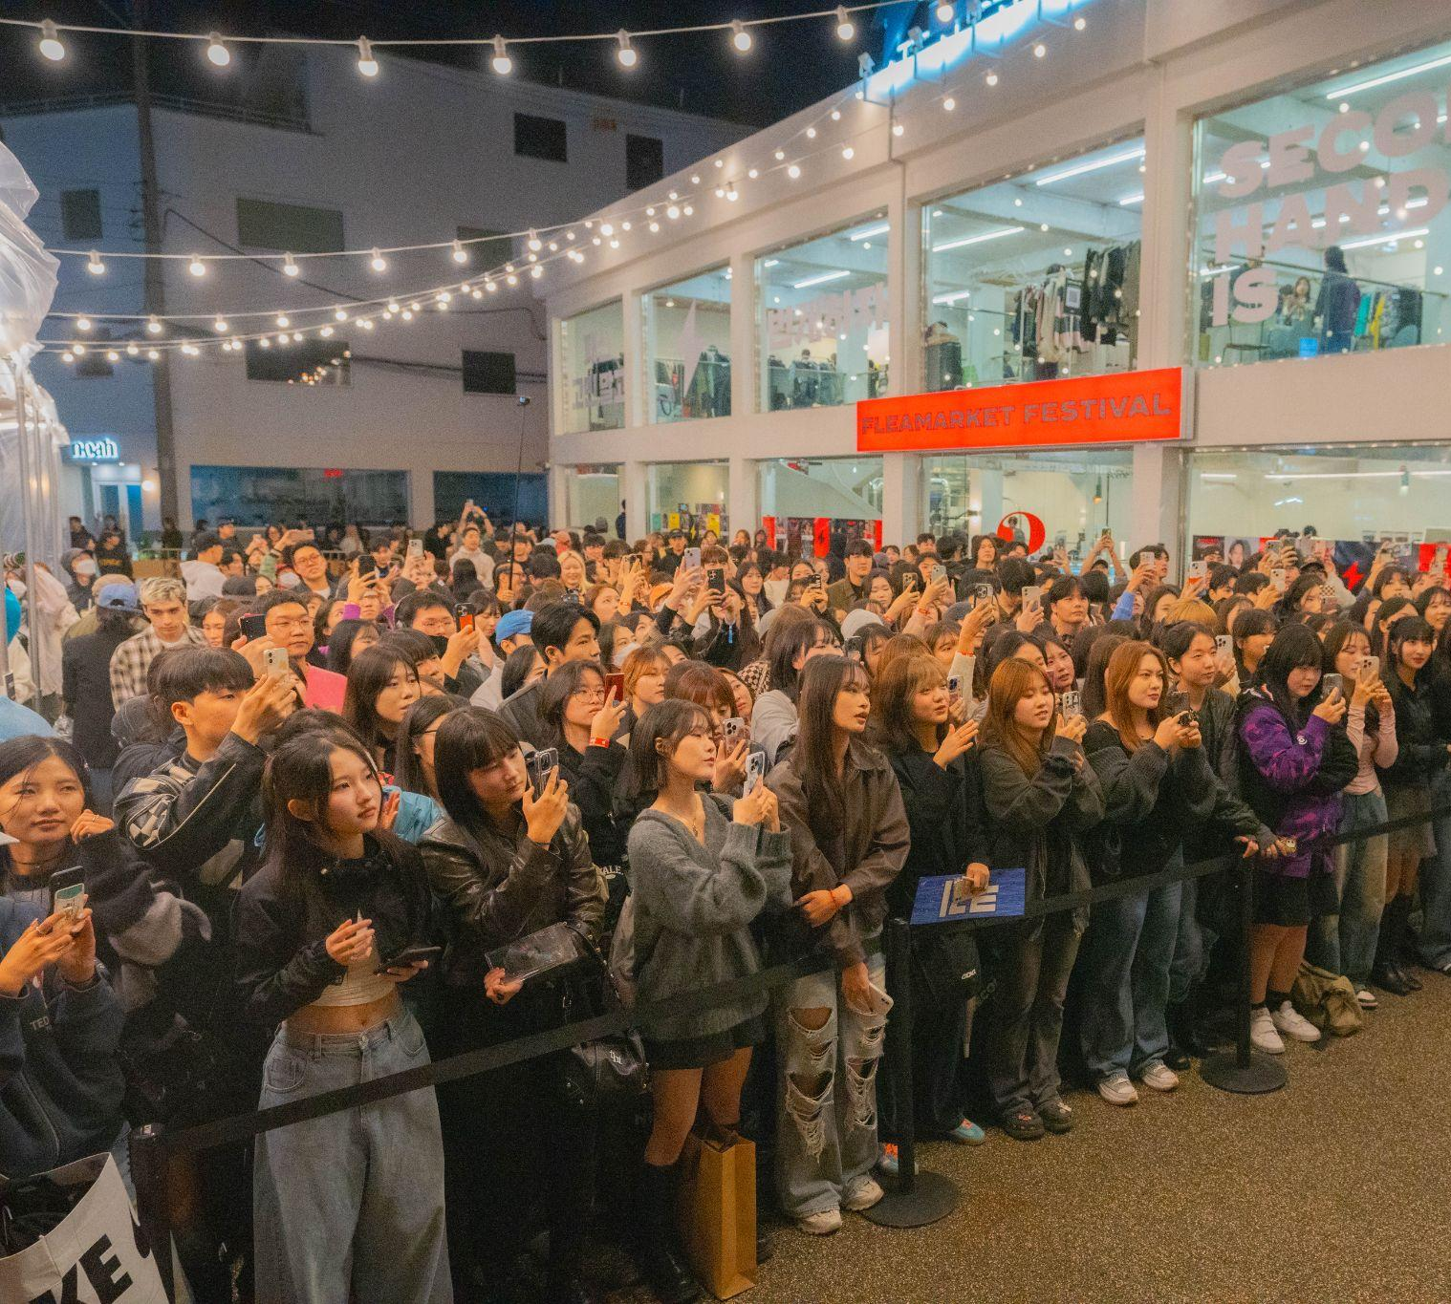
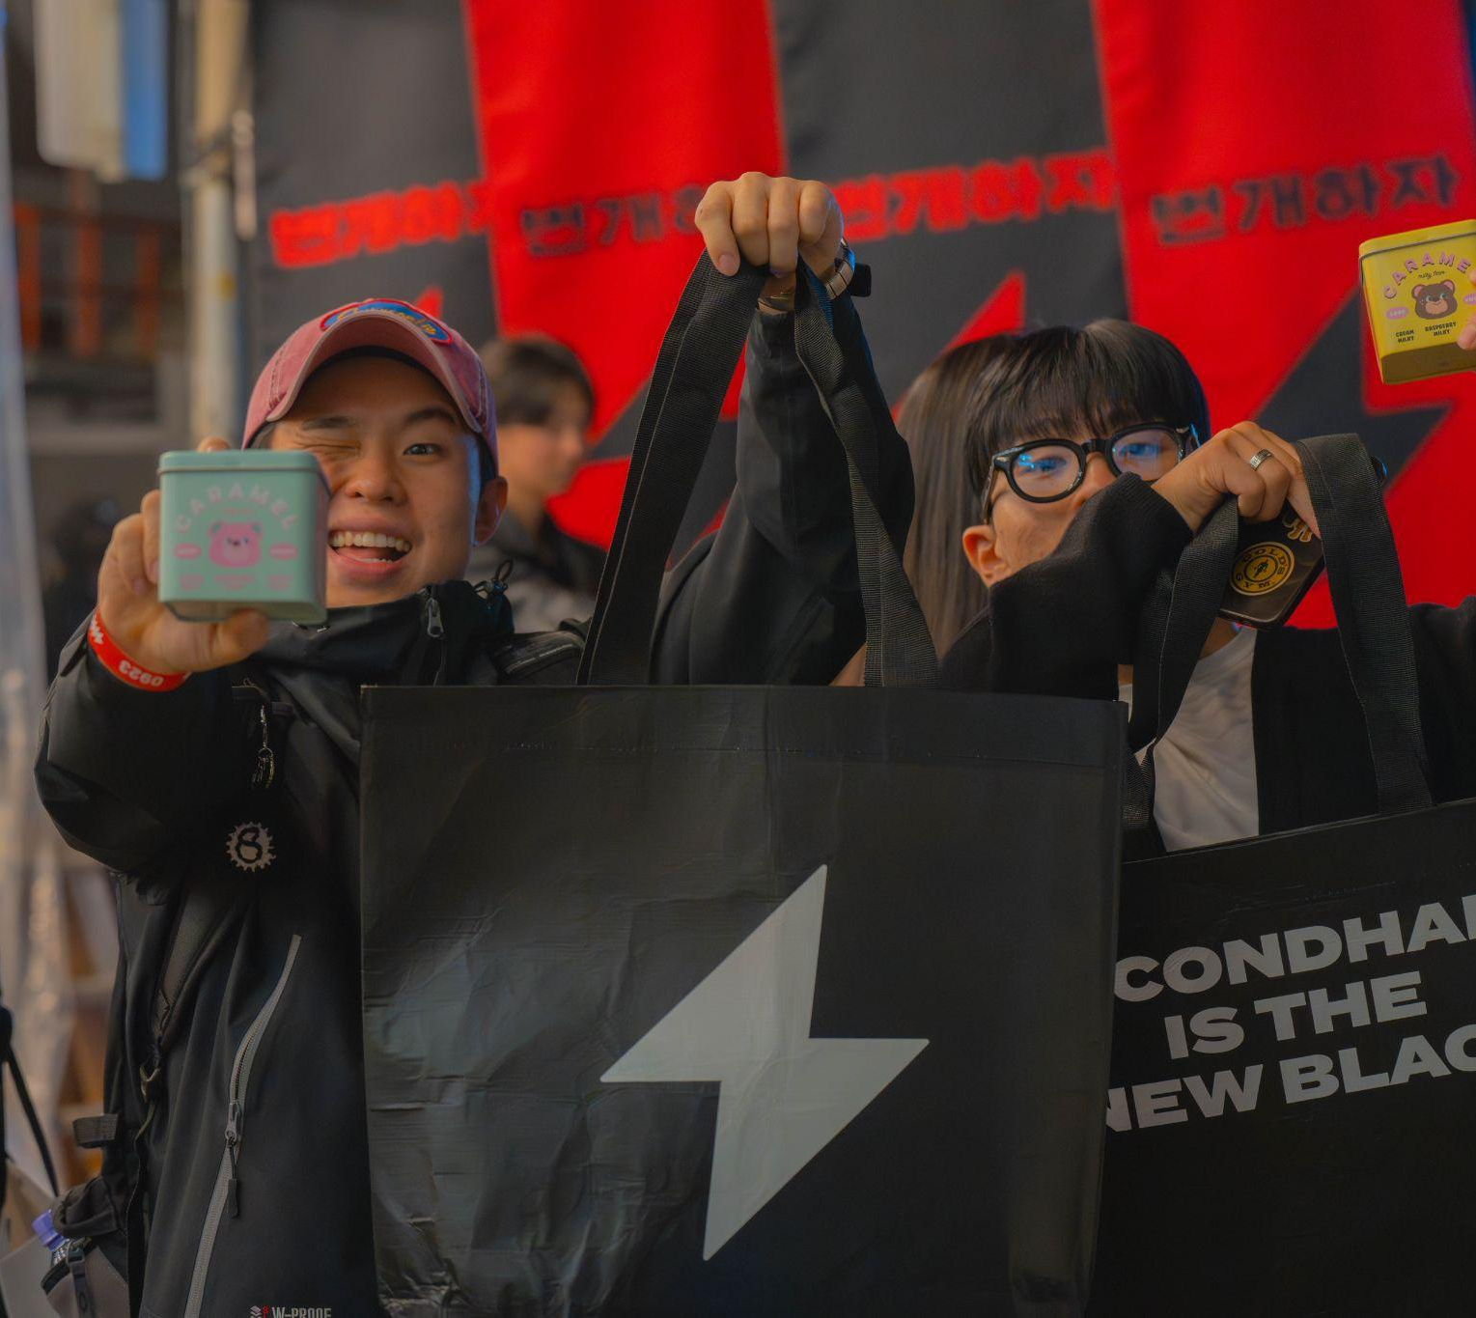
Bunjang is where community meets commerce

Slide 6
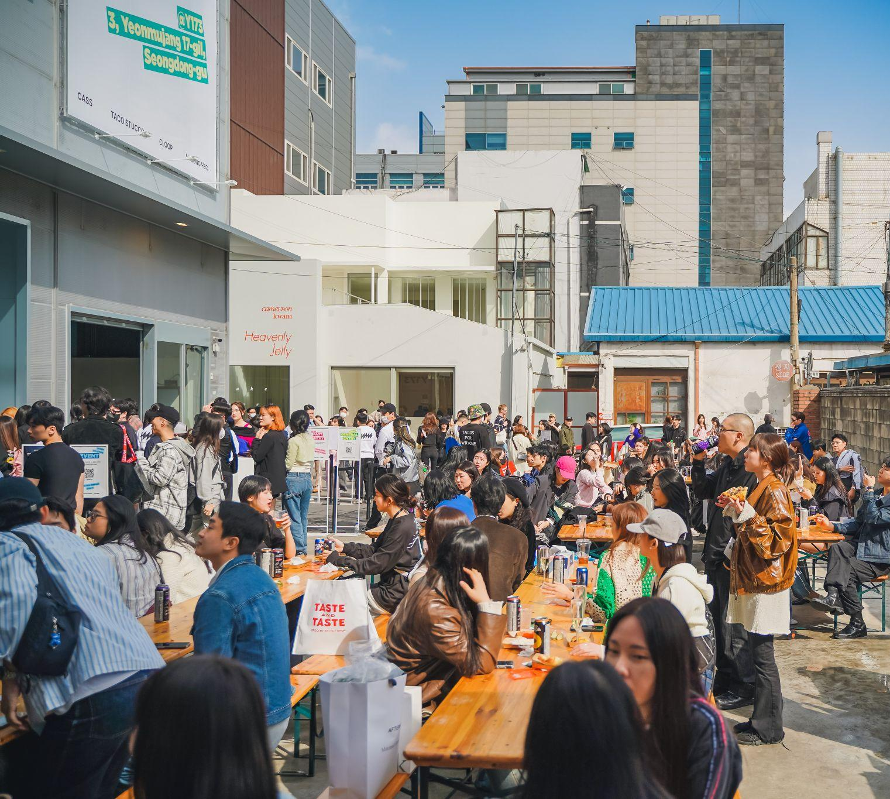
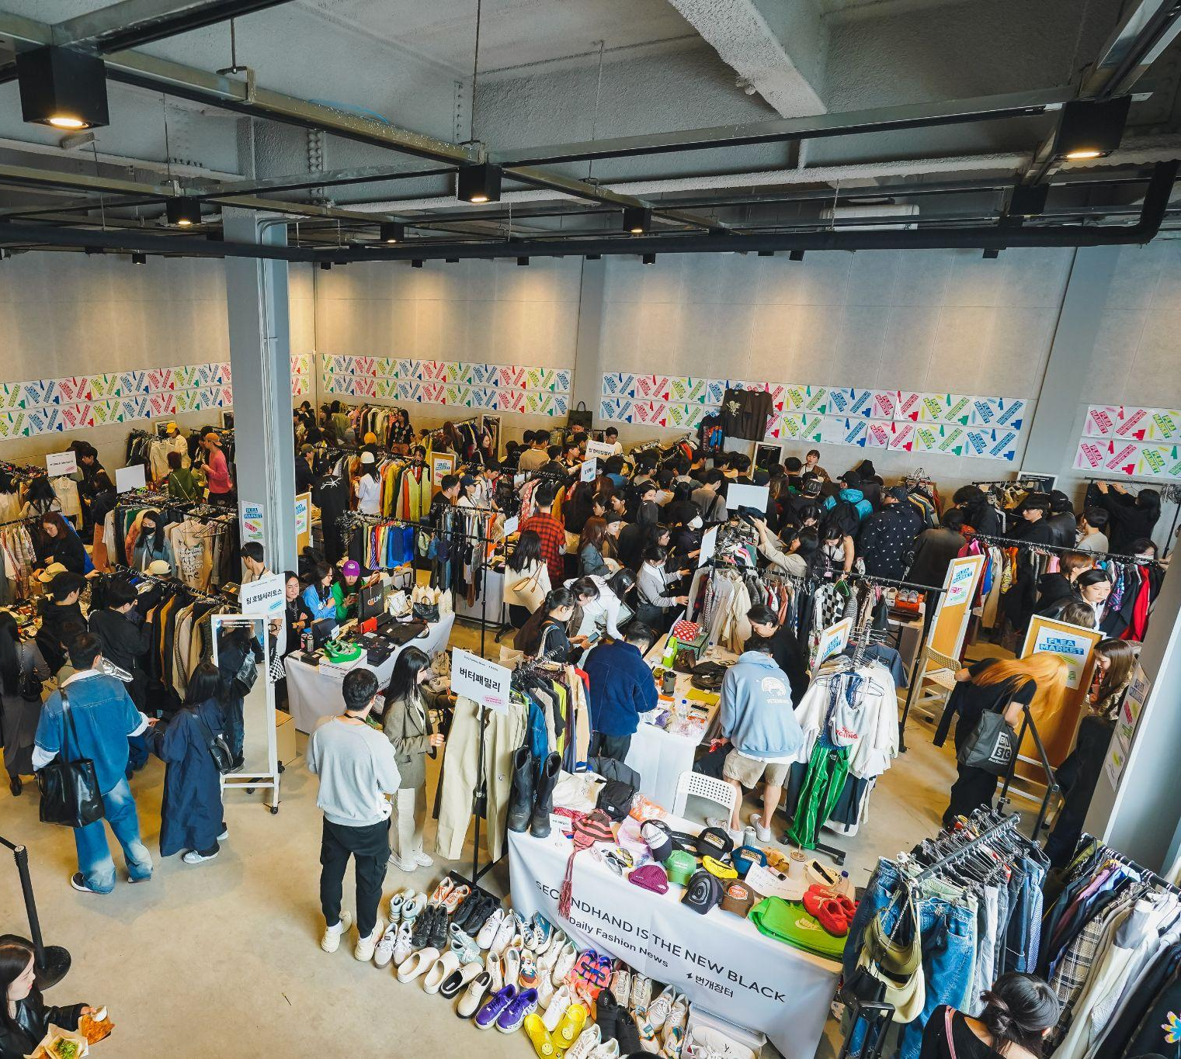
Secondhand is no longer second best.

Slide 7
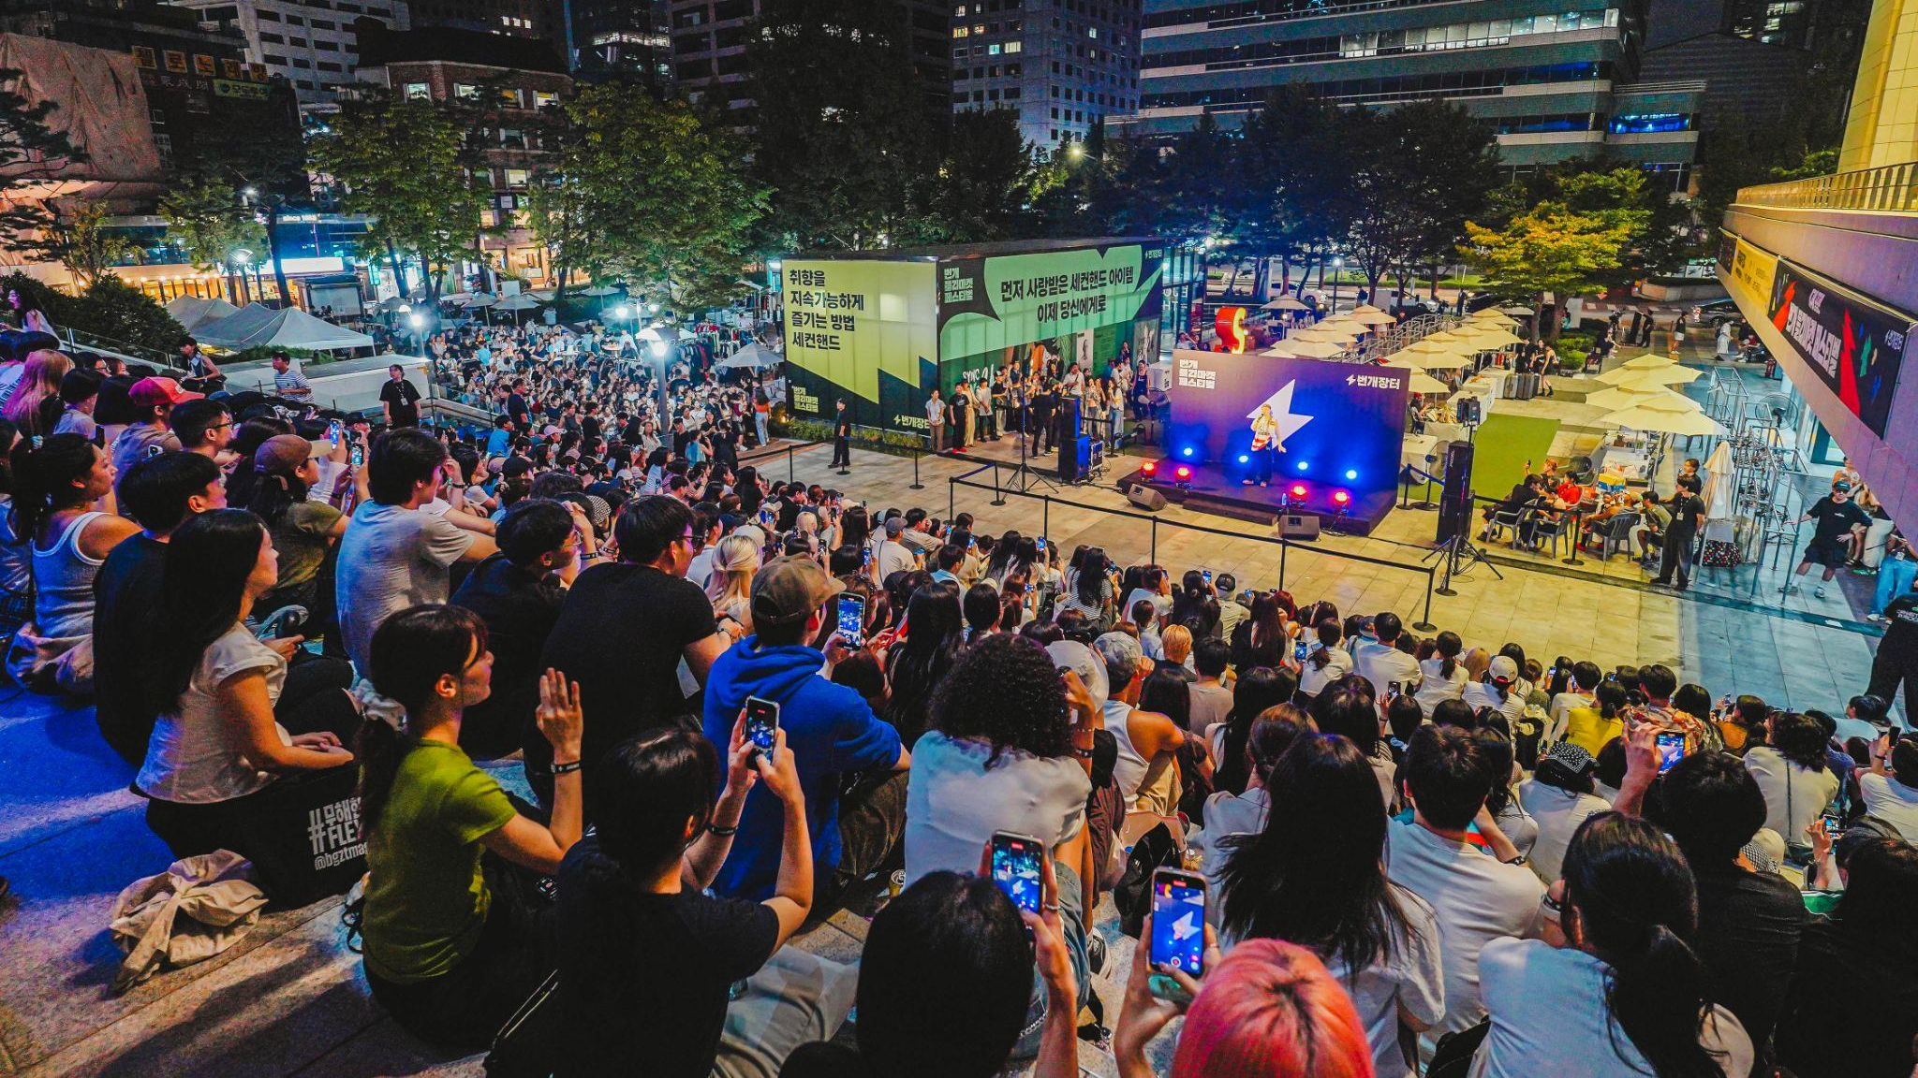

Slide 8
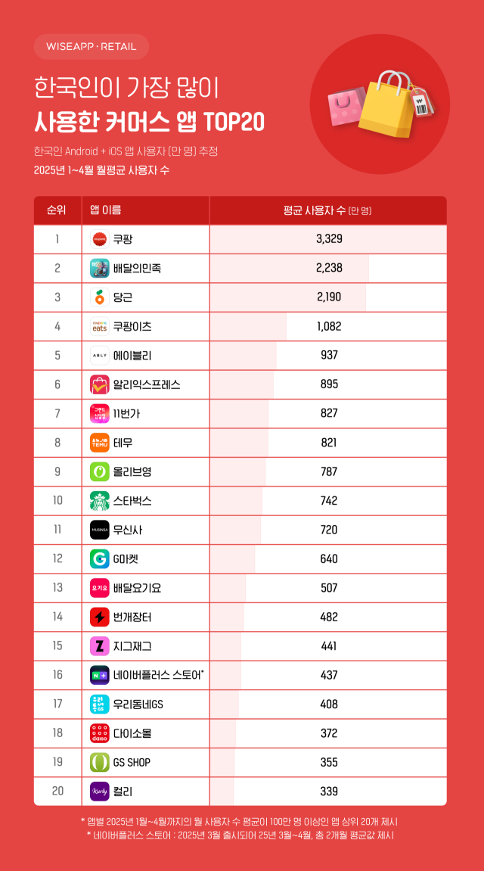
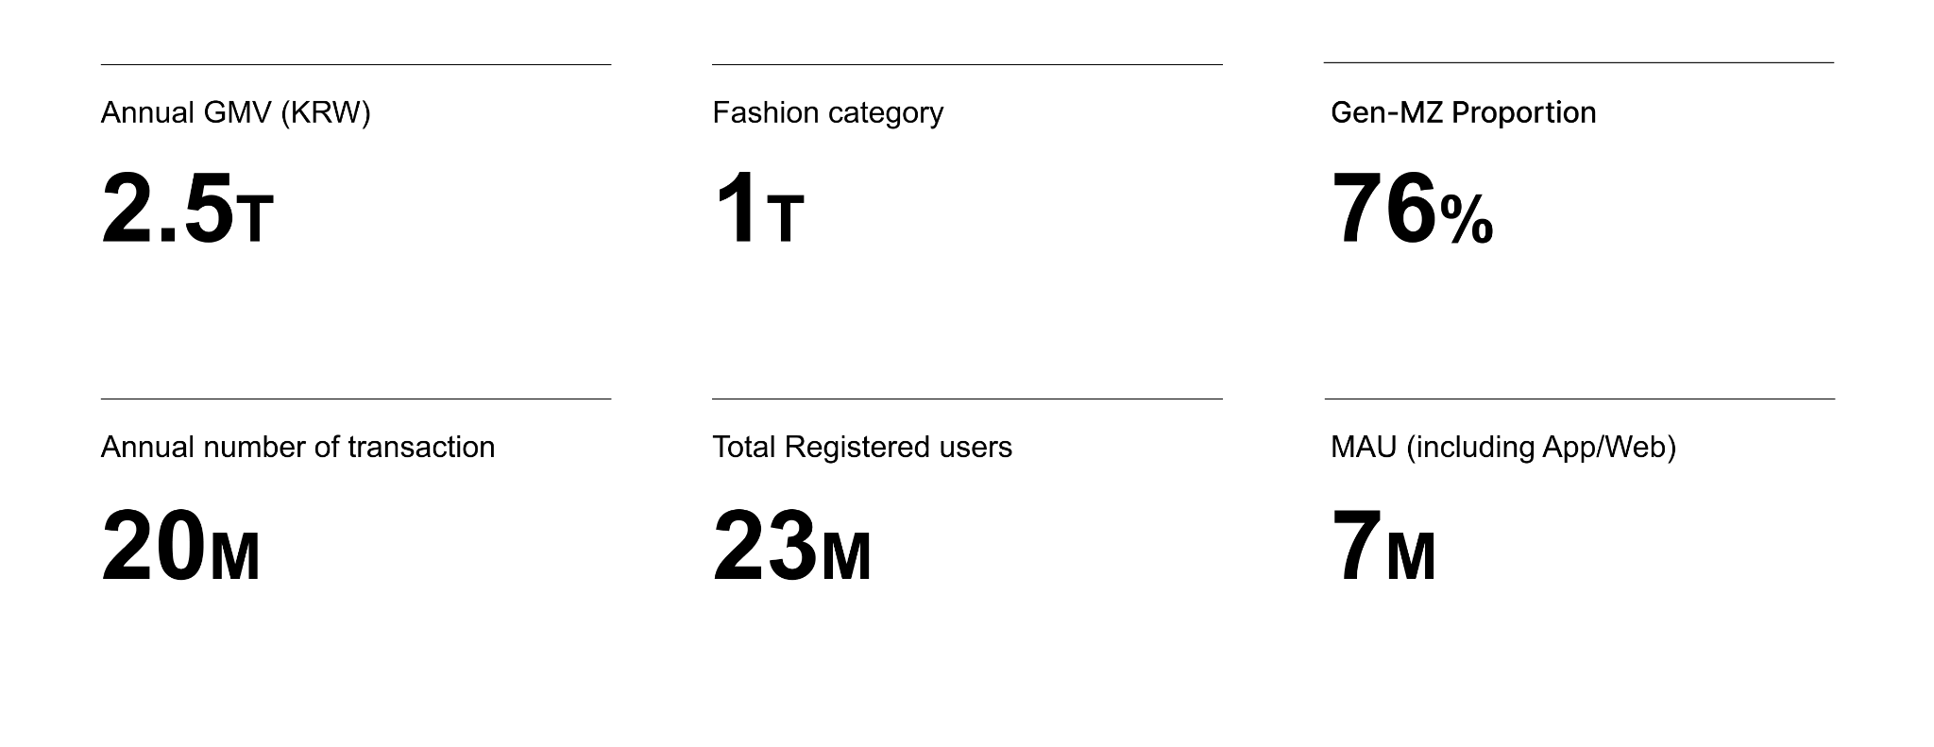
Lightning Strikes So Far
Making secondhand first-rate
Notes:
주요포인트
번개장터 이용자 76% MZ 세대
비대면, 효율성, 안전성에 대한 니즈 더욱 높아

Slide 9
Why We Exist
Reinventing the Recommerce with Trust Baked in
Most platforms either focus on peer-to-peer chaos or luxury resale niches
Still Driven by In-Person Deals and Cash Transactions
Rising Fraud in Secondhand Transactions
Year | Number of Cases | Fraud Losses(Approx. USD)
2013 | ~27,000 | ~$20 million
2024 | ~302,330 | ~$215 million
*Source: Korean National Police Agency
Notes:
주요포인트
국내 중고거래 아직 직거래, 현금거래 기반
중고거래 사기 건수와 피해액 모두 10년전 대비 10배 넘게 증가
안전하지 못한 중고거래 환경 부각

Slide 10

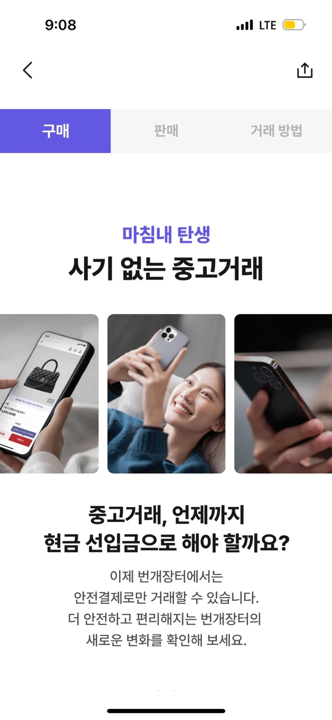
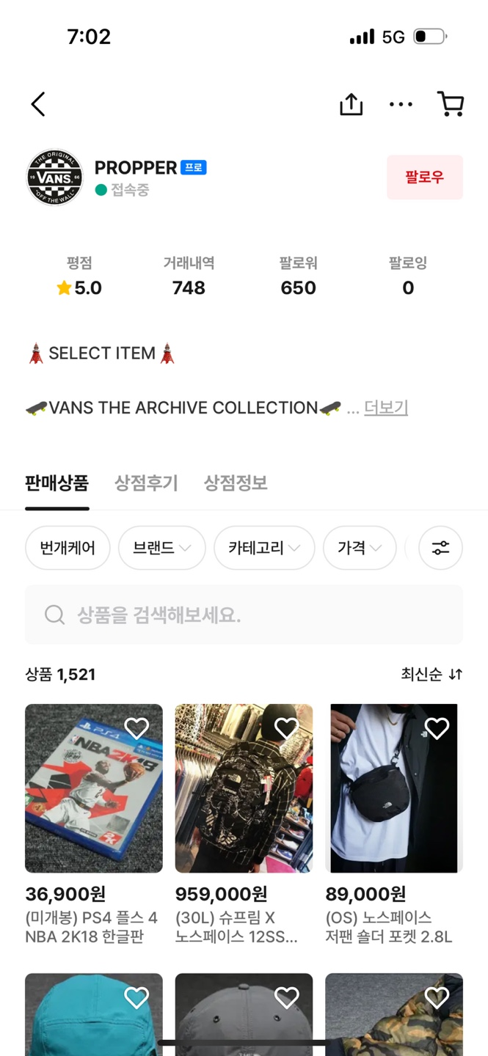
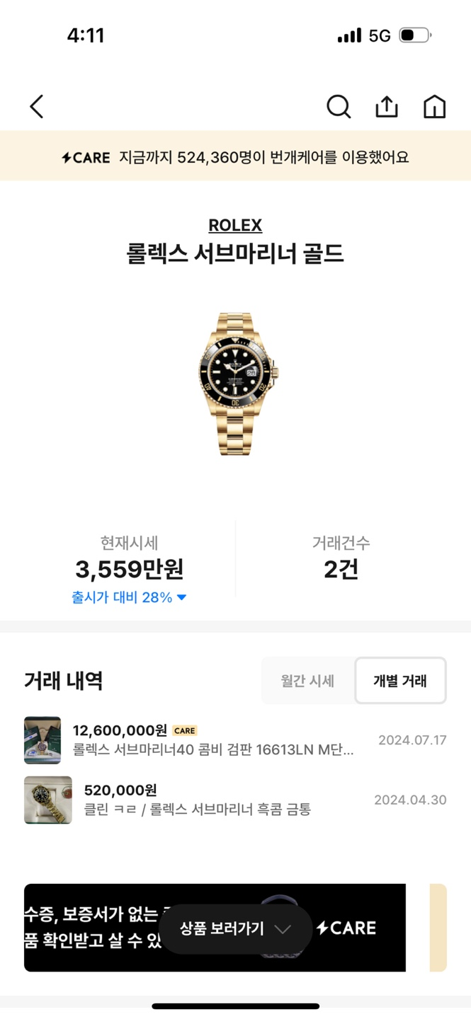
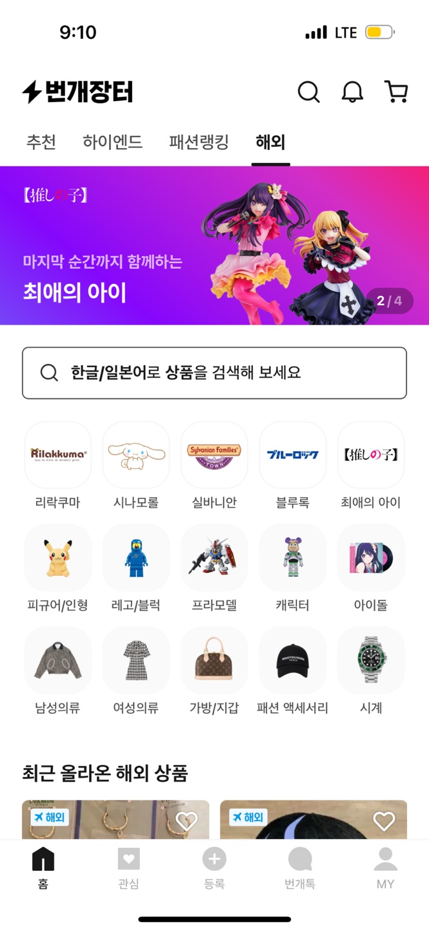
How We Change the Game
Trusted second-hand marketplace, powering secure commerce
Escrow (C2C)
Care
Global
Pro-Seller (B2C)
Notes:
주요포인트
우리의 비즈니스 모델

Slide 11
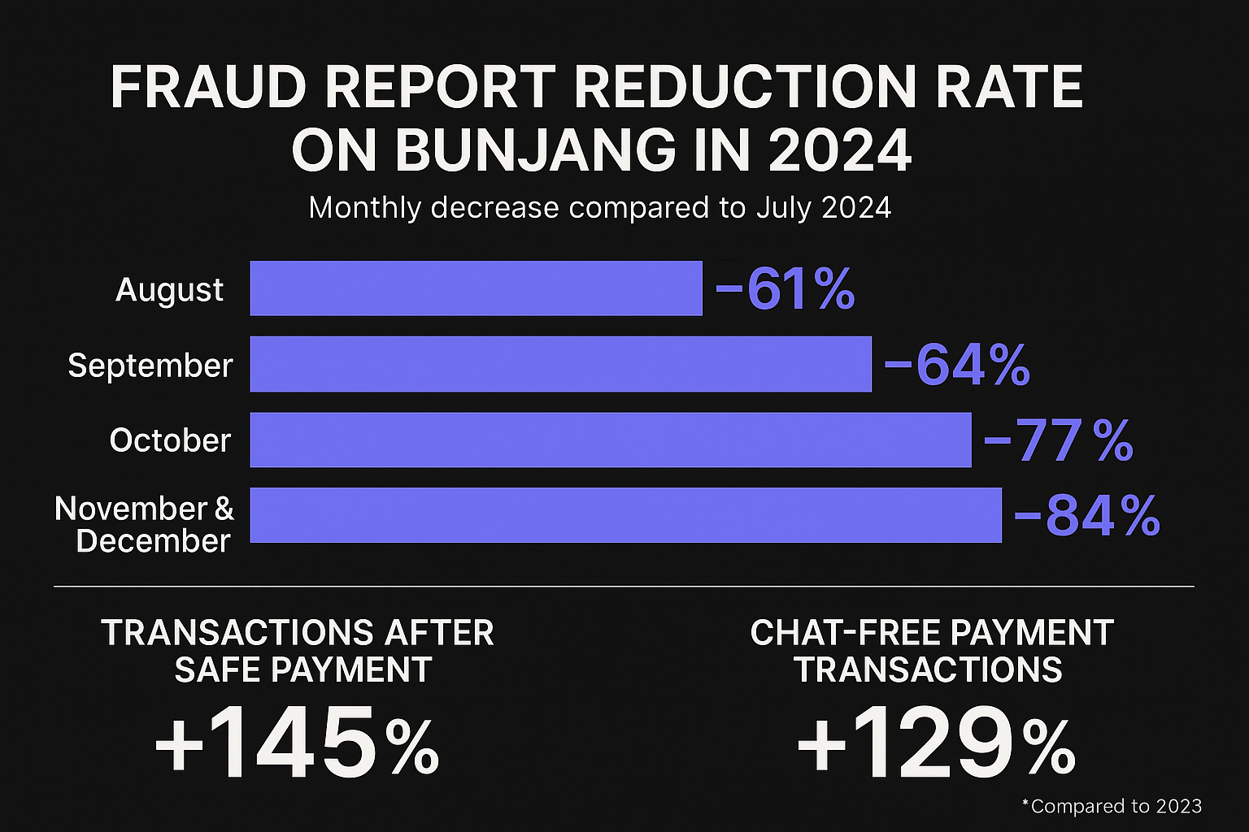
Escrow (C2C):
Builds Trust for Sellers and Peace of Mind for Buyers
Bunjang Sets New Standard
As of August 1, 2024, Safe Payment became the default method for all transactions - an industry first
Building a Safer Marketplace
Fraud reports dropped by over 80% after Safe Payment became the default
Examples of collaboration with the Government
Korea Fair Trade Commission
Notes:
주요포인트
안전결제 소개
업계 최초 안전결제 도입.
안전결제 도입 이후 사기 신고 건수 80% 넘게 감소

Slide 12
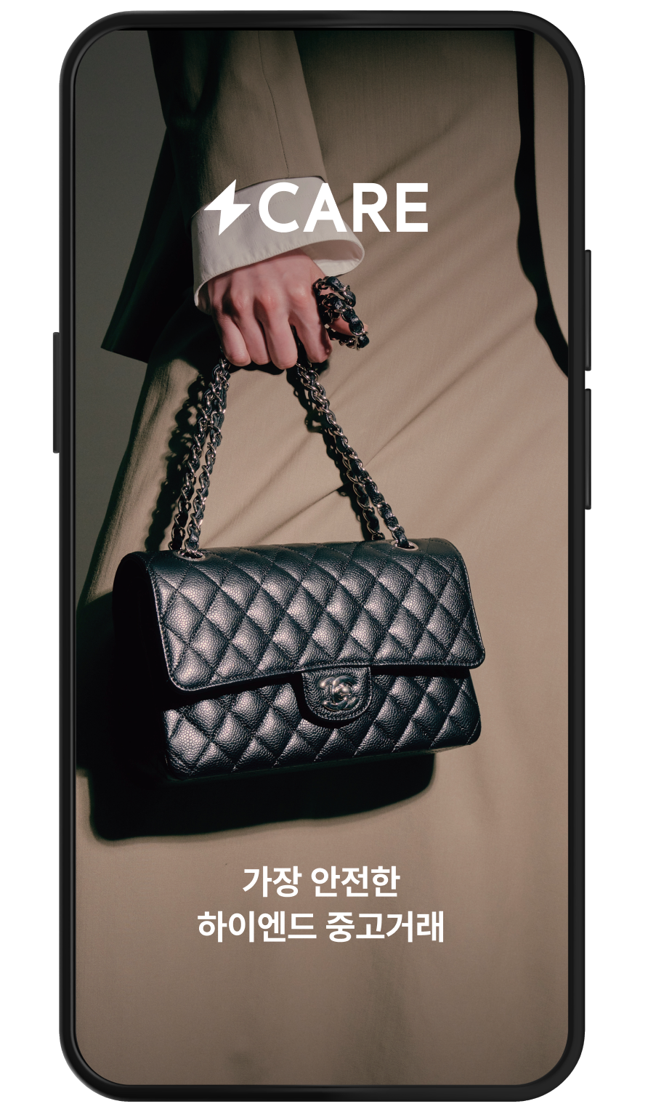
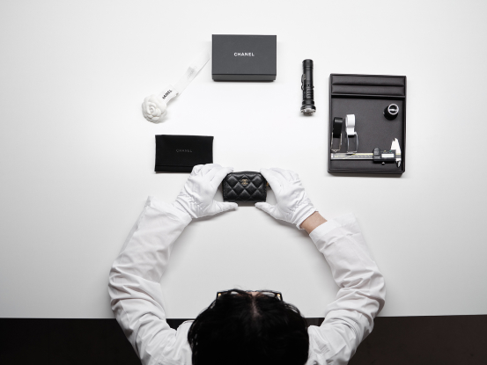
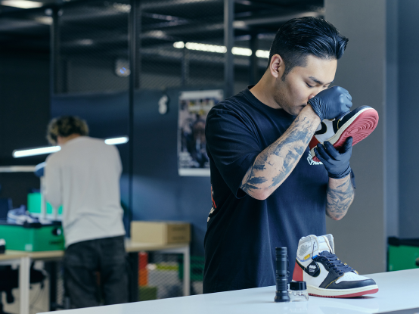
Bungae Care:
Making Secondhand First-Rate
Bungae Care
APT (Authenticity Proof Technology) is a non-destructive material analysis system that identifies unique patterns in metals and other materials to verify authenticity.
Seongsu Inspection Centers
Opened a second Inspection Center last year
Examples of collaboration with the Government
Korean Intellectual Property Office
Notes:
주요포인트
번개케어 소개
과학검수 기반의 서비스 제공
작년 제2 검수센터 오픈 (사업 확장)
정부와의 협력 사례 (특허청 사례, 공정위 소비자원 분쟁)

Slide 13
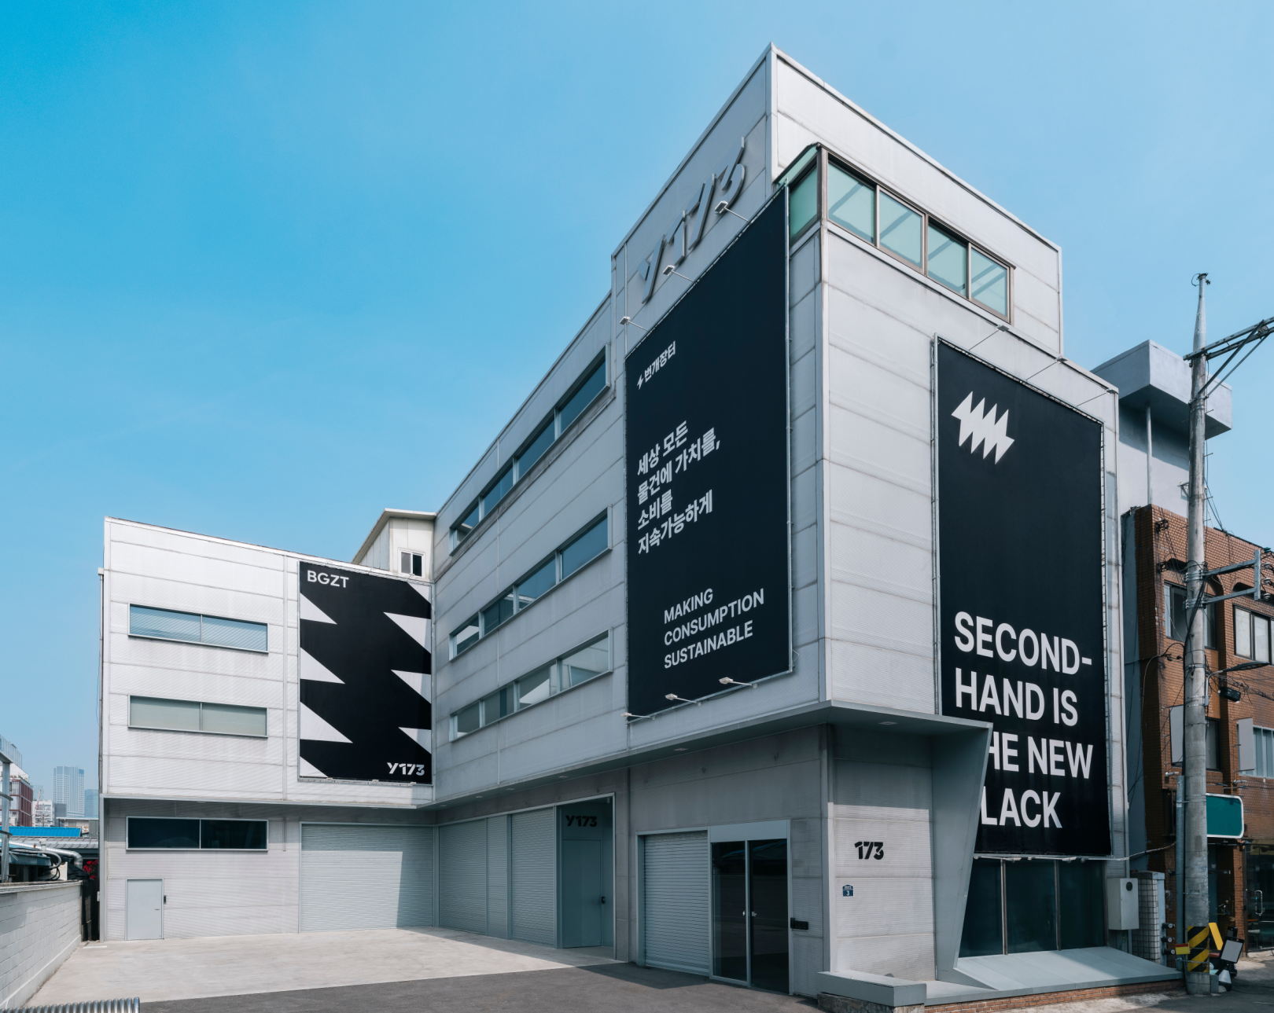
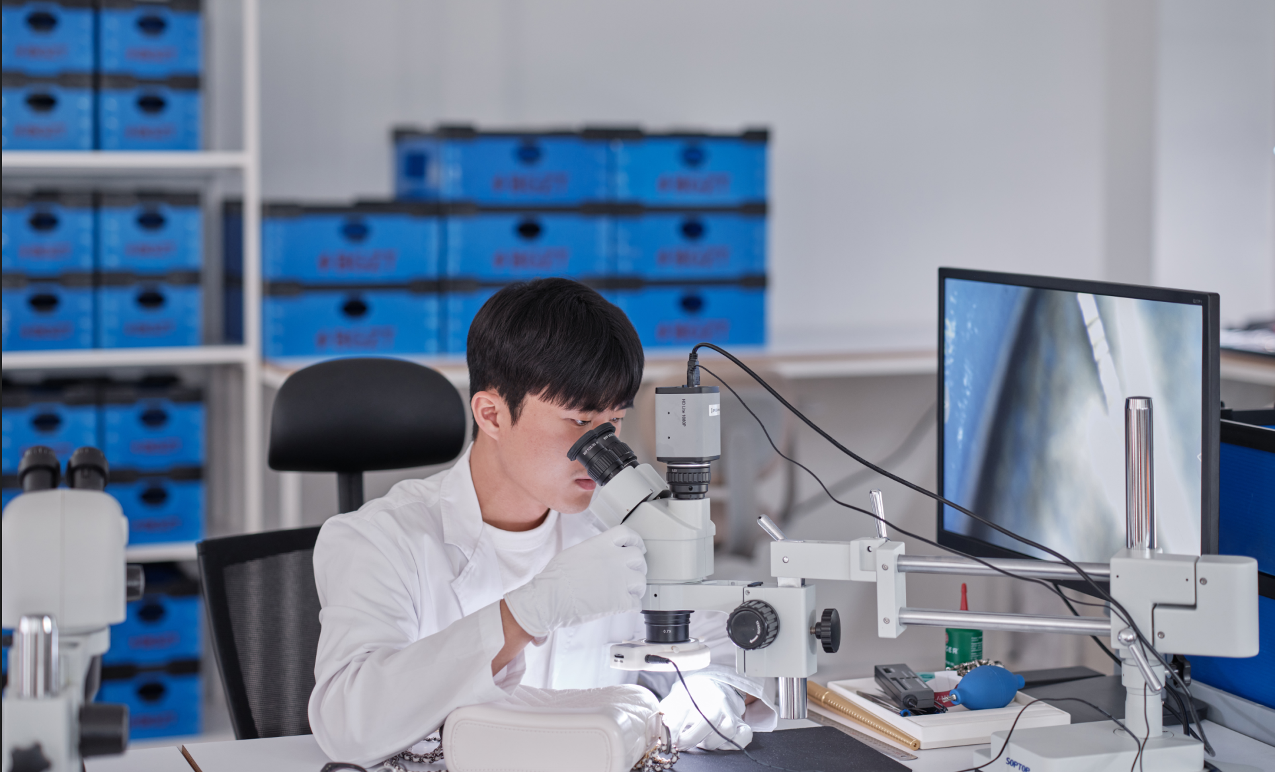
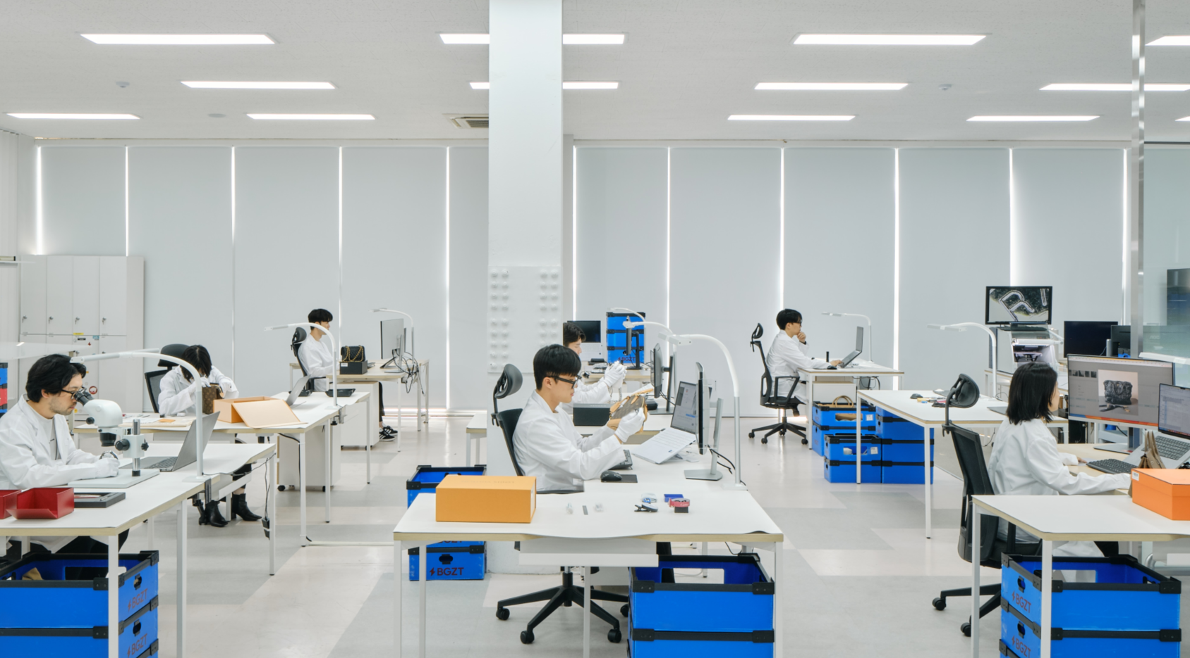
Inspection Centers in Seoungsu

Slide 14
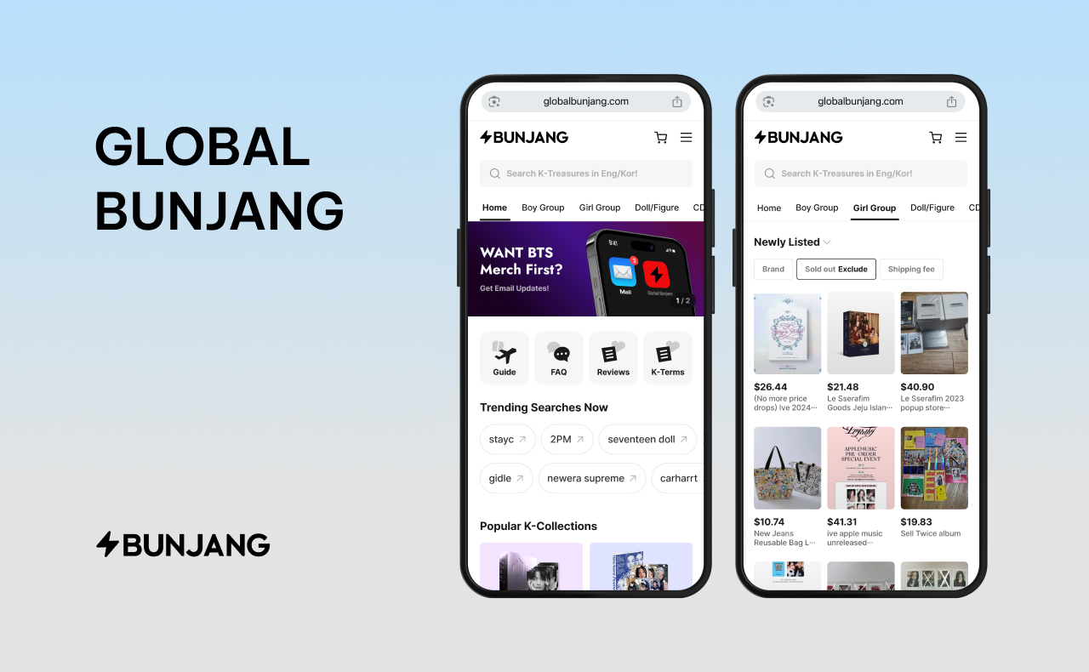
From Local to Global:
Creating a Borderless Recommerce Experience
Global Bunjang - A dedicated service for international users
Real-Time Synced Item Listings from Bunjang
Mercari Partnership
Cross-Platform Trading Enabled
Smarter Search with AI: Find Global Products in Korean
Notes:
주요포인트
글로벌 기반의 국경없는 중고거래 플랫폼
메루카리 파트너십
글로벌 번장

Slide 15
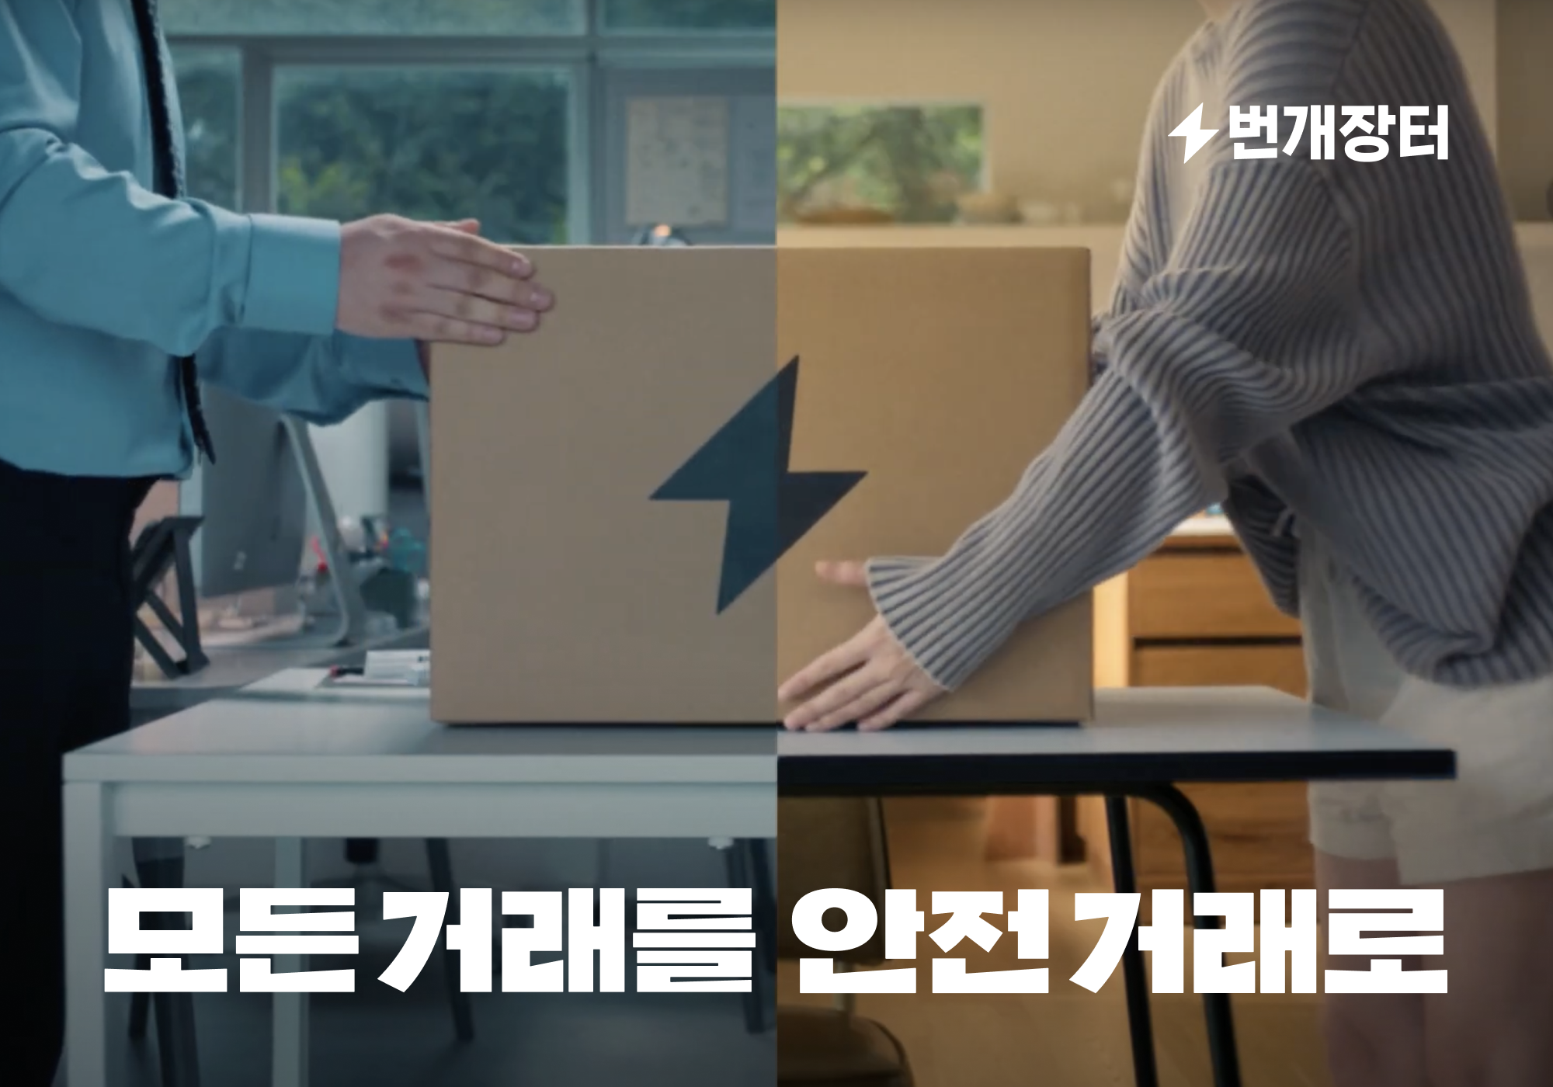
Recommerce, Recharged
Thank you

Slide 16
Appendix.

Slide 17
AI Innovations
Taking Retail Technology to the Next Level
AI Short-Form Video
Bunjang’s AI analyzes product images and descriptions to automatically generate short-form videos, accelerating sales through increased exposure.
AI Language Translation
AI-powered translation enables a borderless recommerce experience, allowing users to search and browse overseas listings in Korean.
AI-Powered Recommendations
Enhanced UI and machine learning-based recommendations increased product views by 234%, improving the buyer’s discovery experience.
Real-time AI fraud detection
AI continuously monitors chat activity, triggering alerts and blocking suspicious conversations to protect users in real time.

Slide 18
Bunjang is where community meets commerce

Slide 20
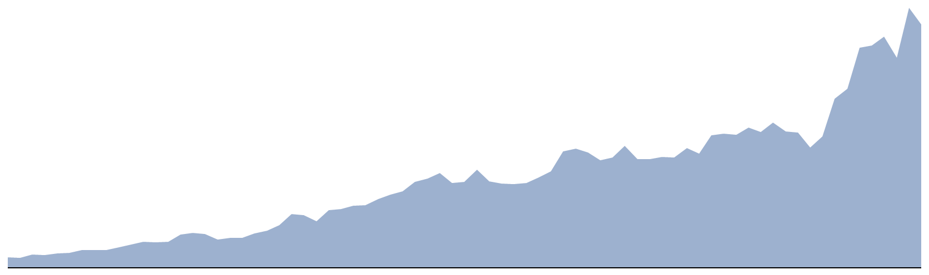
Escrow (C2C):
Escrow GMV(Gross Merchandise Volume) has achieved 58% of CAGR(Compound Annual Growth Rate)
CAGR
+58%
Jan
Apr
Jul
Oct
Jan
Apr
Jul
Oct
Jan
Apr
Jul
Oct
Jan
Apr
Jul
Oct
Jan
Jul
Apr
Oct
Jan
Apr
Jul
Oct
Jan
Mar
2019
2020
2021
2022
2023
2024
2025

Slide 21
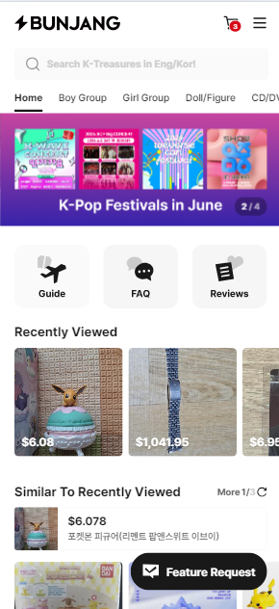
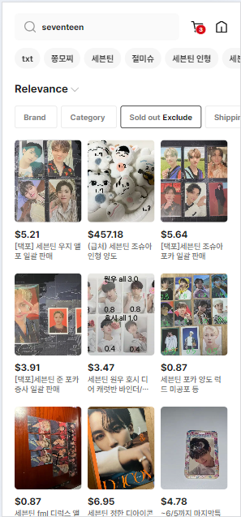
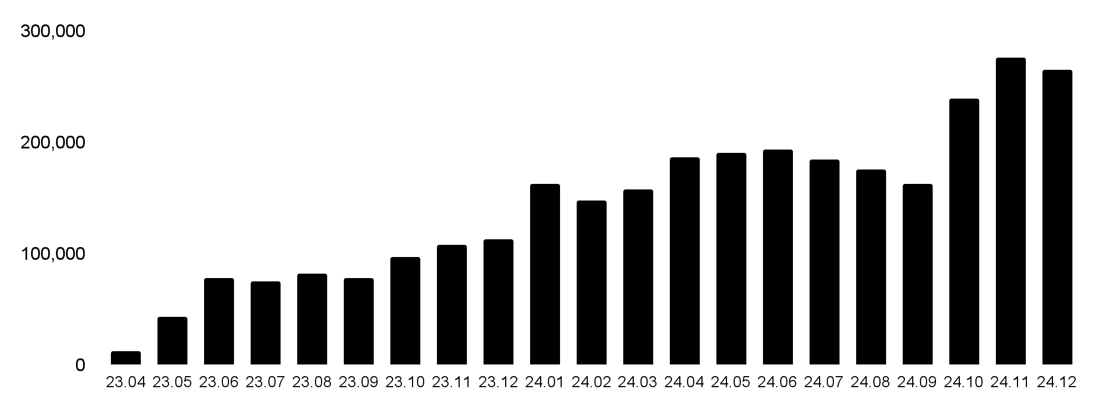
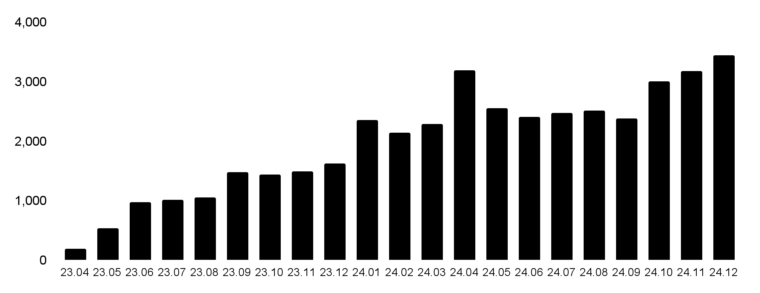
From Local to Global:
Creating a Borderless Recommerce experience
[GMV Trend]
CMGR
+16%
[Number of transaction Trend]
Notes:
For example, limited-edition items like those only available to attendees of special events or signed Polaroids can often only be found in Korea, and Bunjang is where most of these unique items are traded. In response to this growing global interest, we launched a dedicated website for our international users, and we've been thrilled with the rapid growth we've seen. Our global web platform has experienced significant growth, with a remarkable annual growth rate in GMV of 2577%.

Slide 22
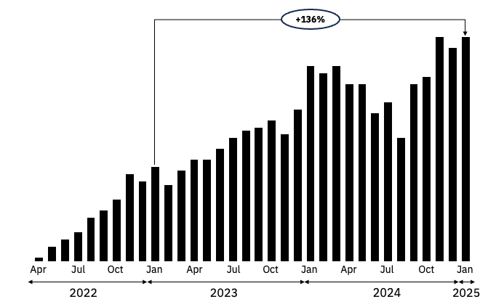









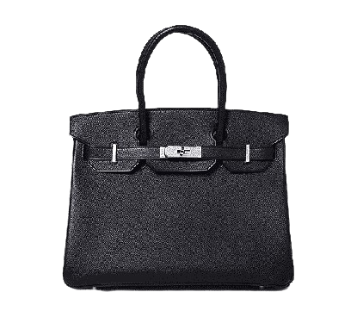
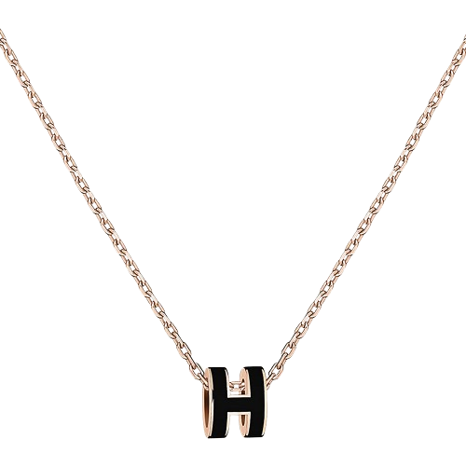
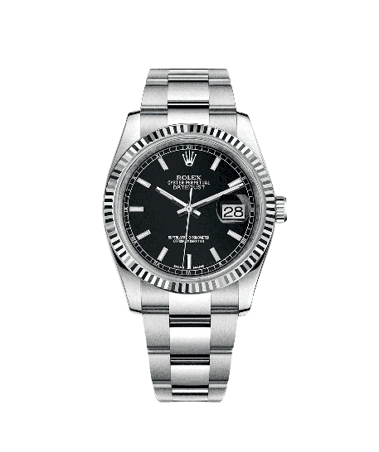
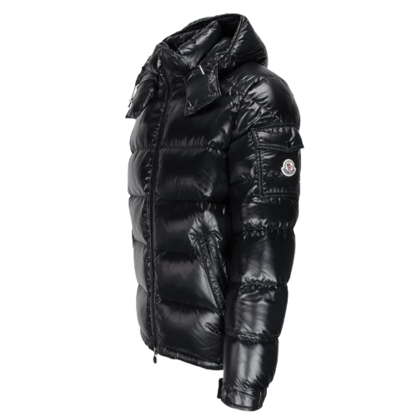
Bungae Care:
Reliable purchases, guaranteed authenticity
Luxury GMV by month
Luxury Brand & Category coverage
(Unit: Bil)
80+
Luxury / Street Brands
…
Grand Launching
+4 Categories
…
Bag/Wallet
Jewelry
Watch
Apparel

Slide 23
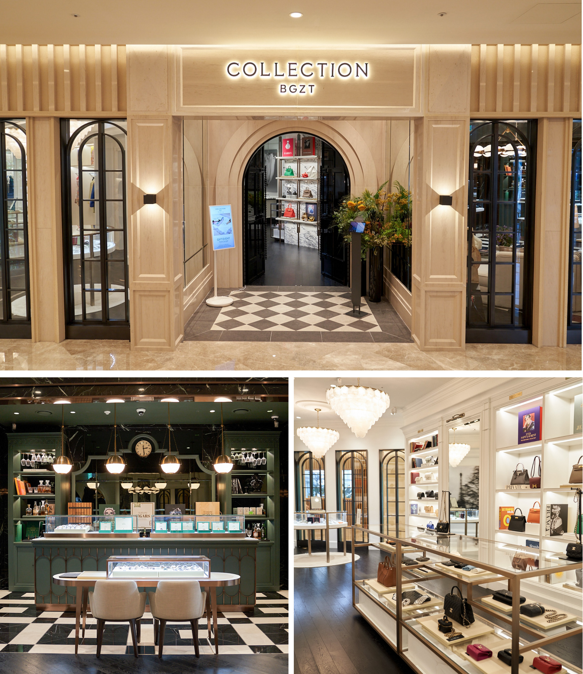
BGZT COLLECTION (2022~present)
An offline outlet specializing in high-end brands, serving as a flagship store for consignment, buyback, and sales, while also showcasing online consignment products

