Slide 1
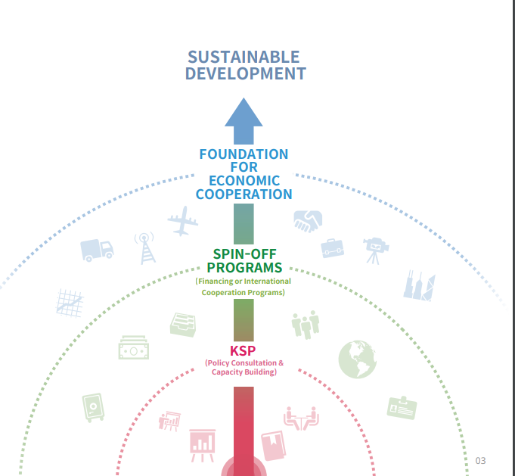




The Progress of
our 2024/25 KSP journey with Poland

Slide 2

Introduction to Knowledge Sharing Program (KSP)
KSP is a joint policy research program that shares Korea’s development experience and derive tailored policy recommendations with partner countries, while also providing capacity-building opportunities to support their effective policy development & implementation.
High level dialogues for Economic Cooperation & follow-up Partnership
04
Policy diagnosis through mutual learning
02
01
Demand-driven
policy Research
03
Comprehensive capacity building

Slide 3
Project Overview: 2024/25 KSP with Poland
Objective
Providing policy implications and recommendations to effectively support the development and implementation of MRiT's Digital Transformation Programme for Enterprise.
Partner Country | Poland
Project Period | July 2024 ~ August 2025
Partner Ministry | Ministry of Economic Development and Technology (MRiT)
Coordinating Institution | Korea Development Institute (KDI)
Project Topic | Strengthening the national supporting system for the digital transformation of SMEs - Topic 1: Development of Mid to long-term strategy and action plans for SME Digitalization - Topic 2: Advancement of AI Innovation Ecosystem and Regulatory reform for SME Digitalization - Topic 3: Advancement of Cyber Security Ecosystem and Regulatory Reform for SME Digitalization

Slide 4

Project Overview: 2024/25 KSP with Poland
KSP project mainly consists of four activities :
Launching Seminar & High-level Meeting
Policy Seminar & In-depth Studies
Interim Reporting & Policy Practitioners’ Workshop
Senior Policy Dialogue & Final Reporting Workshop.
After the final reporting, a policy consultation report will be published and delivered to the MRiT
(Held in Poland)
(Held in Poland)
(Held in Korea)
(Held in Poland)
Final Report Publication
Project Completion
Policy Consultation Report
(KSP Policy Brief)
Senior Policy Dialogue & Final Reporting Workshop
Interim Reporting & Policy Practitioners’ Workshop
KSP Policy Seminar &
In-depth Studies
Launching Seminar &
High-level Meeting
’24 Oct. | Nov. | Dec | ’25 Jan | Feb. | Mar. | Apr. | May | Jun. | Jul. | Aug. | Sep. | Oct.
* The schedule is subject to change upon circumstances.

Slide 5
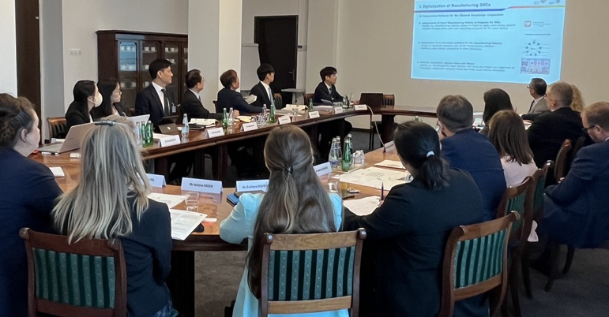
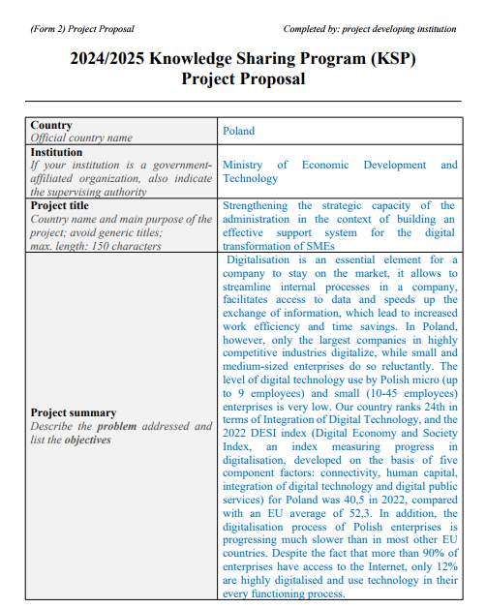
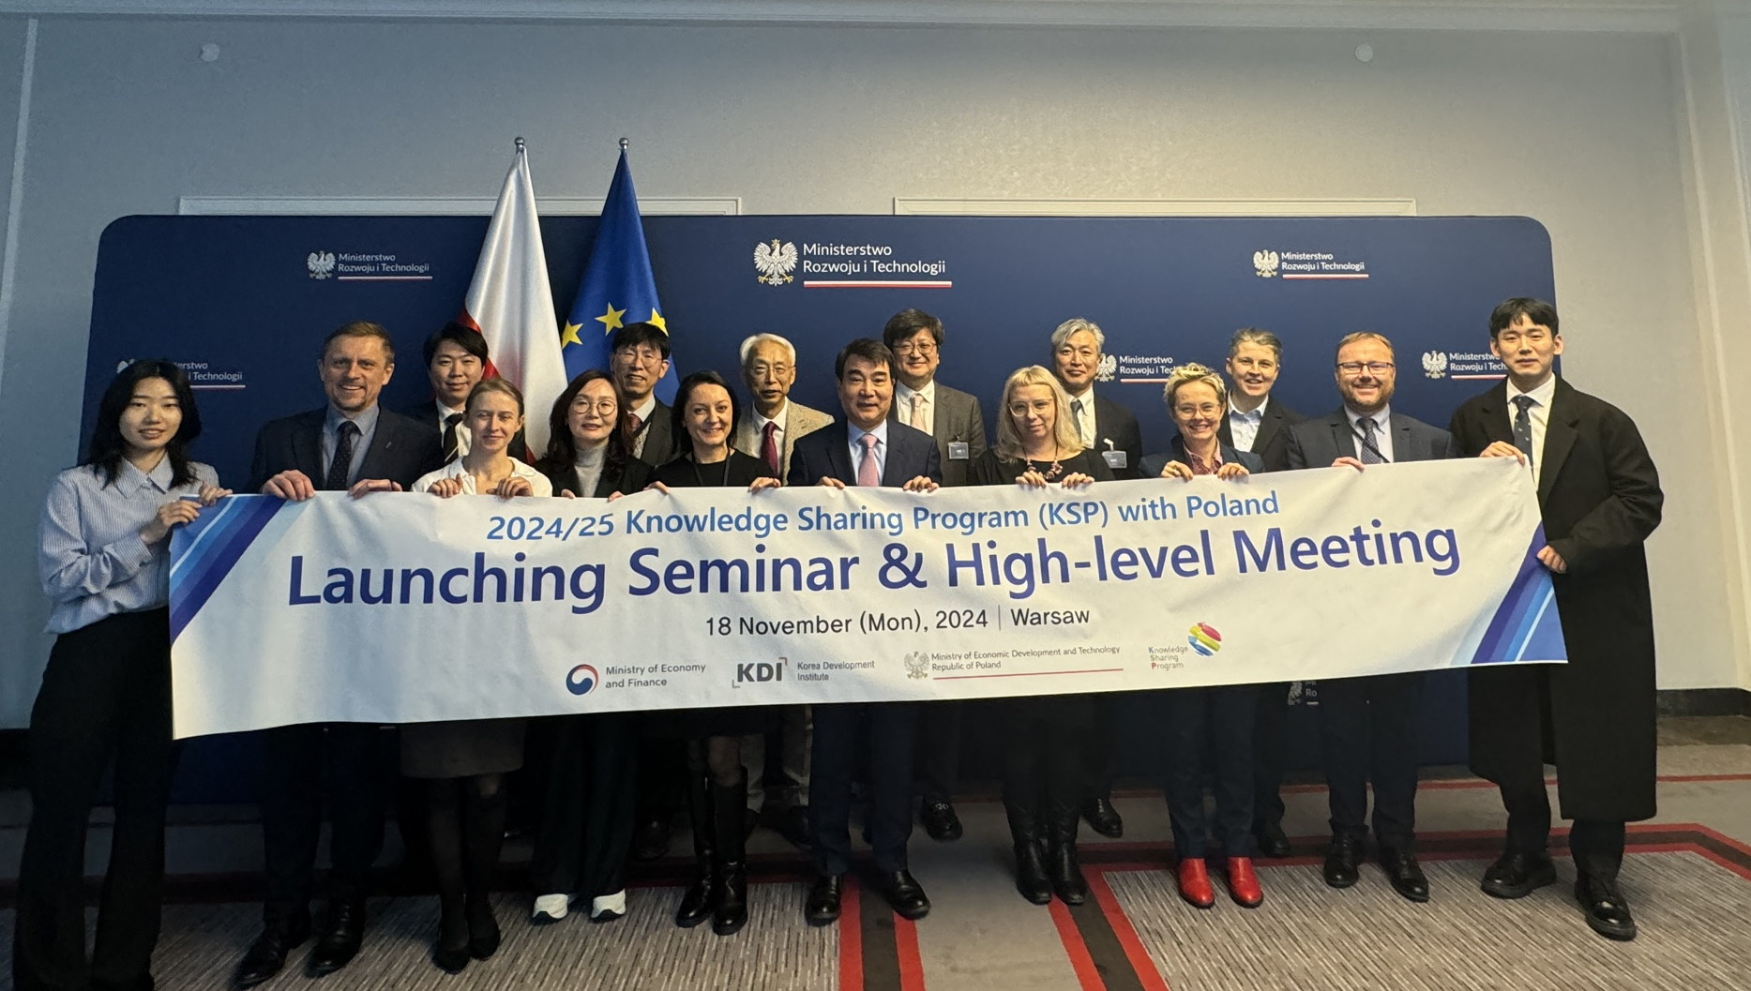
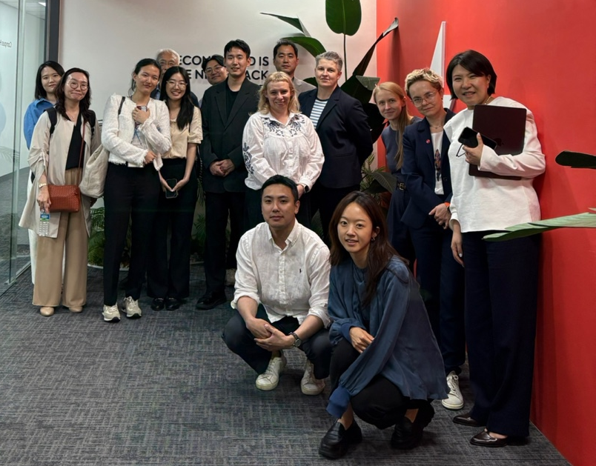

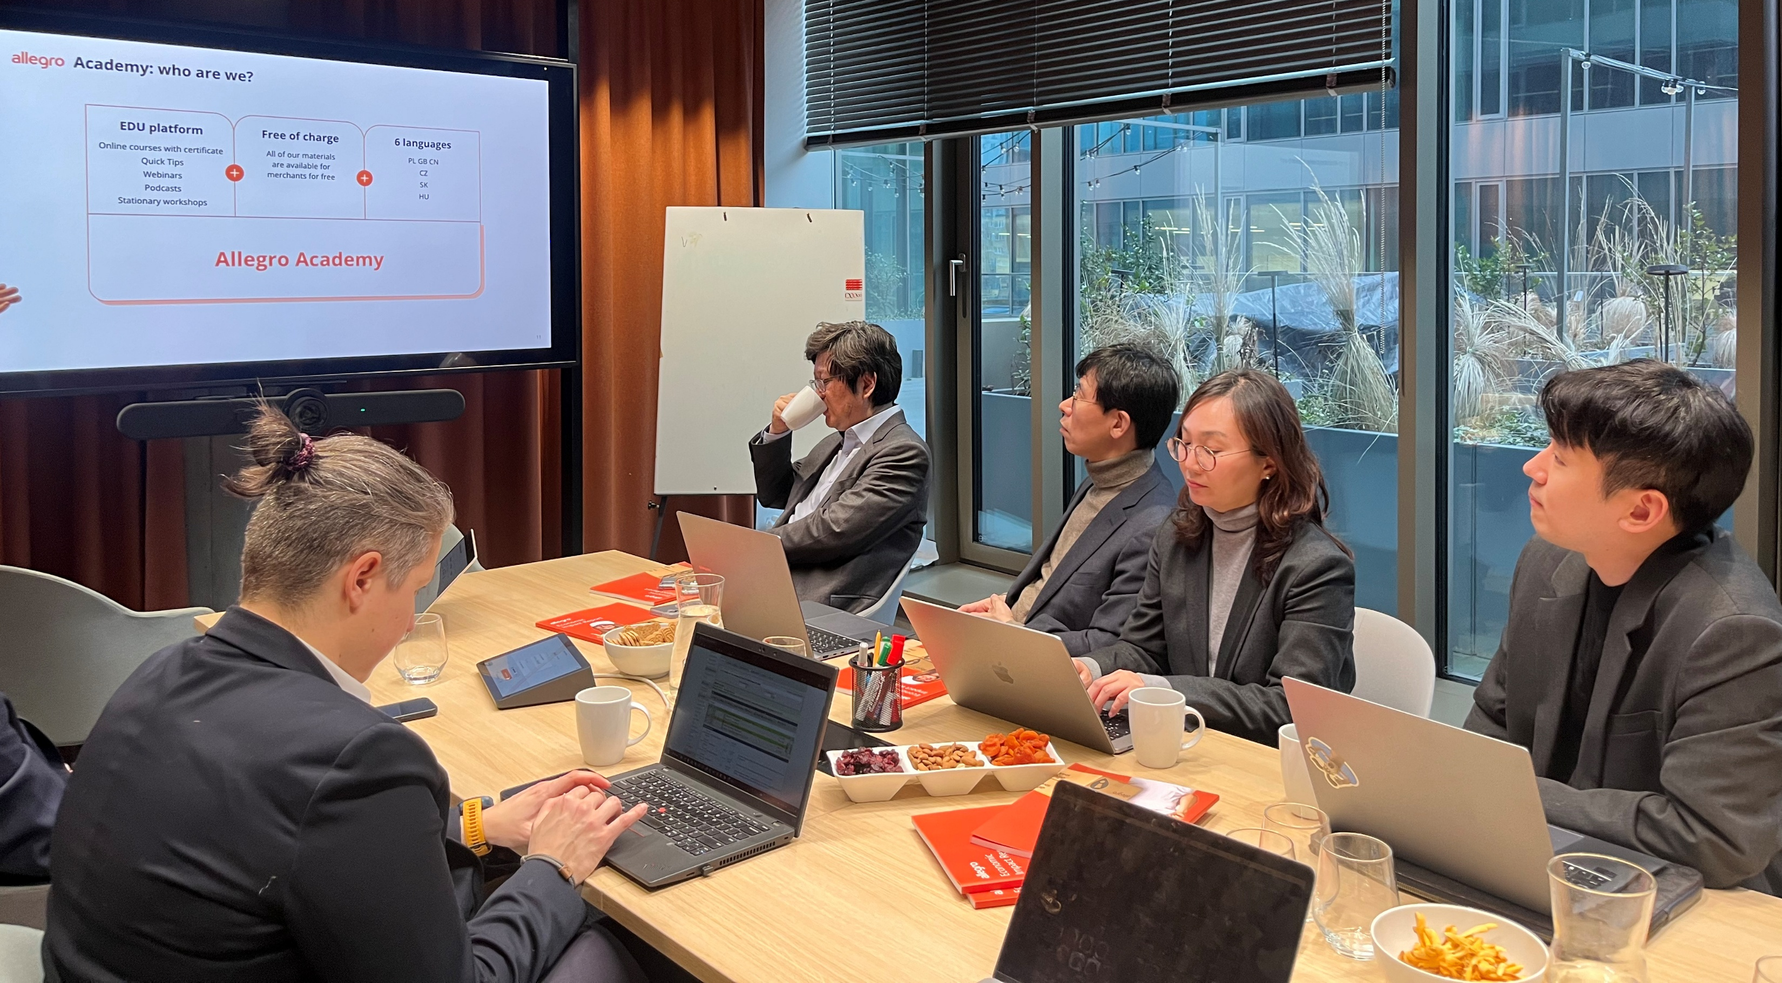
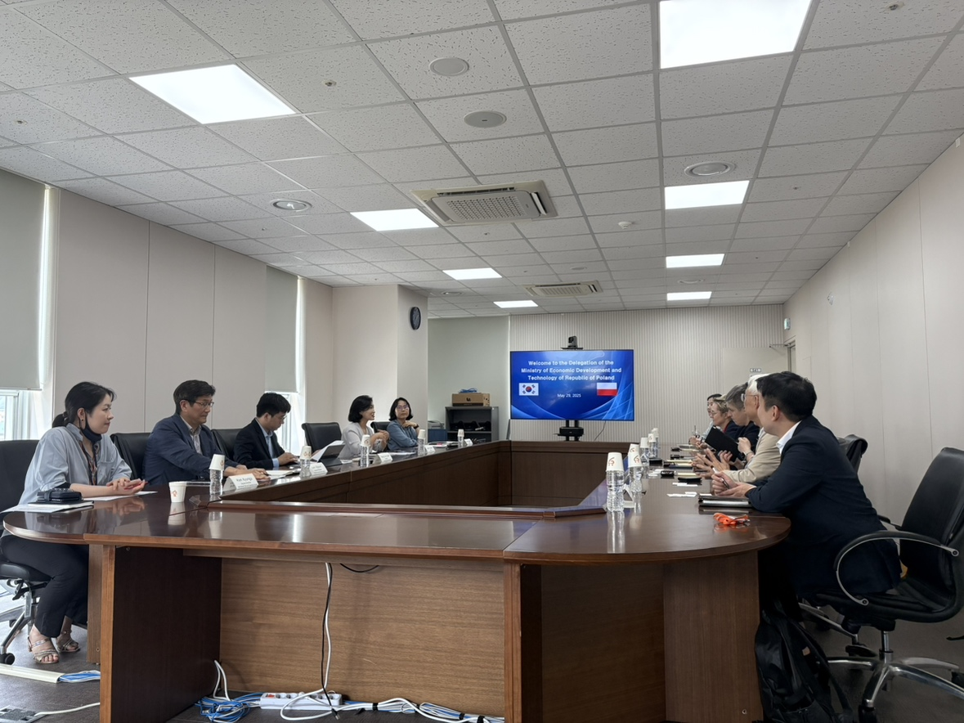
2024/25 KSP Journey with MRiT (2023-2025)
Preliminary Discussion (Sep.2023)
2. Received Project Proposal
(Nov. 2023)
3. Launching Seminar
(Nov. 2024)
4. In-depth Studies
(Feb.2025)
5. Policy Practitioners’ Workshop (Korea)
(May. 2025)
6. Final Reporting Seminar
(July. 2025)

Slide 6




Exploring opportunities for 2026/27 KSP with Polish Government
Final Reporting Seminar
(July. 2025)
Proposal Submission Procedure (2026/27 KSP)
AI Regulation
Government
Institution
Korean Embassy
MOEF
(Korea)
Industrial Cluster
Project Proposal
Cybersecurity
Priority List
Start-ups
E-government
Submission by
Oct, 2025
Strategic Industries
Project Approval Procedure
Oct, 2025 (Tentative)
Feasibility Study and
Expert Review
Project Approval
Project Planning
Project Launching
Dec. 2025
1st Half of 2026
1st Half of 2026
2nd Half of 2026

