Slide 1
Environment, Energy and Climate Change Programme (PL-CLIMATE) supported by the EEA Grants
Vsó Consulting
25. june 2020

Slide 2








Established 1958
100% Employee owned
Incorporated since 1972
Outpost in Norway since 2010

Slide 3
Employee composition
Over 90 employees
Median age is app. 44 years old – Over 30 employees have over 10 years experience

Slide 4
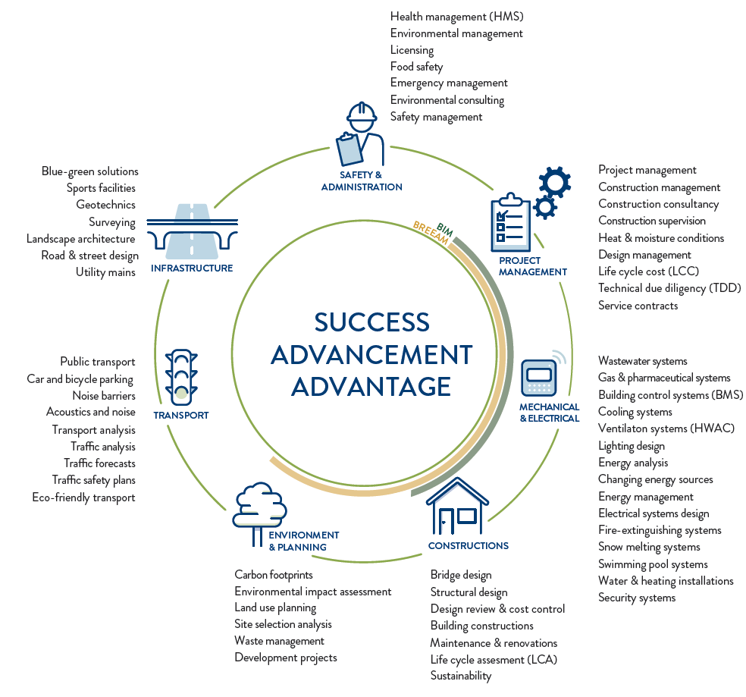

Slide 5
Major Projects
Meðferðarkjarni (new national hospital)
ISAVIA (international airport)
Eimskip (shipping company)
Extensive project experience from Norway

Slide 6
Contact:
Sigriður Osk Bjarnadottir
sigridur@vso.is

