Slide 1


2024/25 KSP with Poland
Final Reporting Workshop
July 2025
TOPIC 3.
Cybersecurity Innovation Ecosystem & Regulatory Reform: Supporting SME Digital Transformation
Hyung-Jong Kim
Professor, School of Information Security
Seoul Women’s University
Notes:
I am Professor Hyung-jong Kim from Seoul Women's University.
Thank you for having me again. During my last visit, I received such positive energy.
I've been looking forward to this meeting. I'm delighted to see you all again. I sincerely hope this project progresses successfully and becomes an opportunity to enlarge mutual understanding and build valuable knowledge-sharing between Poland and Korea.
Today, I'll be presenting Topic 3 of our KSP project: 'Cybersecurity Innovation Echo-system and Regulation Reform Supporting SMEs Digital Transformation.'

Slide 2

CONTENTS
01
POLAND & KOREA CURRENT STATUS
02
FINAL POLICY RECOMMENDATIONS
Notes:
For today's presentation, I'll cover three main topics. First, I'll present KISA's programs. As our national agency responsible for private sector cybersecurity, KISA plays a crucial role in supporting SMEs' security initiatives.
Second, I'll introduce KISIA, a private organization for the information security industry, and present an overview of Korean cybersecurity SMEs through statistical data. This data will help us understand the current landscape and significance of SMEs in Korea's cybersecurity sector.
Finally, I'll explain how the Ministry of SMEs and Startups operates systems to protect technology from SMEs.

Slide 3
01
POLAND & KOREA CURRENT STATUS
Notes:
Let's start with KISA's SME support programs.

Slide 4


Introduction & Common Challenges
Shared Background: Both countries face similar cybersecurity challenges with neighboring countries
Both Countries are
geopolitical buffer zone
ANCS (EU NIS)
PDPA (GDPR)
Network Law
PIPL
Enigma Codebreaking
Vulnerability Discovery
Cybersecurity for
SMEs
Defcon Winners
SMEs in Cybersecurity Area
NASK
KISA/NSRI
SME Vulnerability: Poland (99.8% SMEs) & Korea (84.4% of cyber incidents target SMEs)
Implementation Gap: Strong legal frameworks but weak SME adoption

Slide 5
SME Cybersecurity Vulnerabilities and Implementation Challenges
Poland's SME Cybersecurity Landscape
Low Risk Awareness: 84% perceive themselves as "safe" despite minimal investment
Resource Constraints: 84% lack dedicated staff, <50% have security policies
Basic Protection Only: Focus on low-cost measures (password management 86%, software updates 83%)
Korea's SME Cybersecurity Status
High Threat Recognition: 79% recognize security importance
Budget Challenges: 64.5% lack formal security budget
Government Dependency: Security investment virtually non-existent without government support
Progress: Policy adoption approaching 60% with government assistance

Slide 6
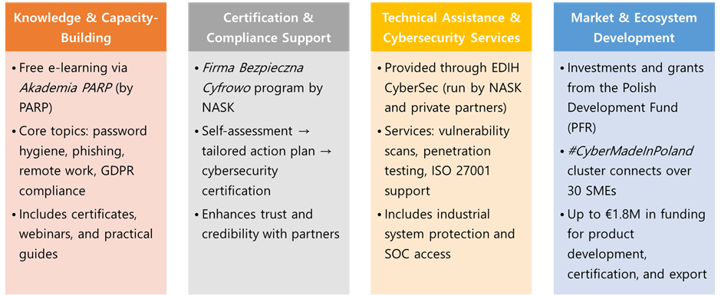
SME Cybersecurity Support Programs Categories in Poland
4 Categories of SME supporting program are recognized
Notes:
The first program is Information Protection Consulting and Security Solution Support.
Since SMEs typically lack fundamental knowledge about information security, the government connects them with consulting firms to build this essential knowledge base. Beyond consulting, they also recommend and support implementing specific security solutions these companies need.
The process begins with application screening, followed by consulting, with current emphasis on ransomware concerns. Based on identified threats and vulnerabilities during consultation, appropriate security solutions are proposed. As with all government programs, we conduct performance reviews and satisfaction surveys to evaluate effectiveness.

Slide 7
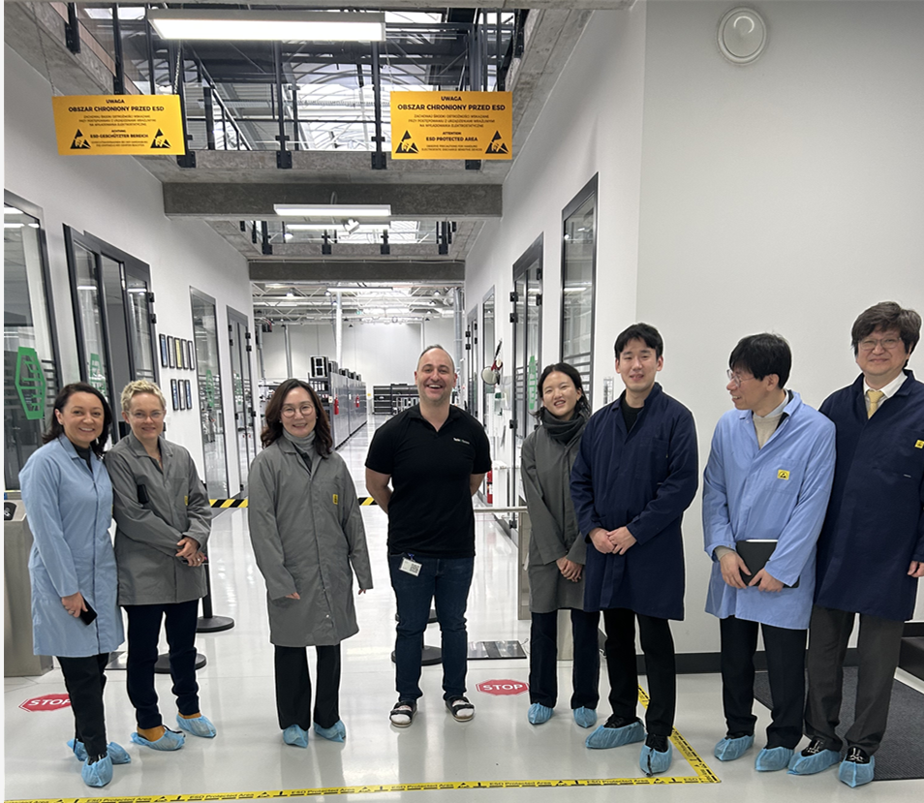

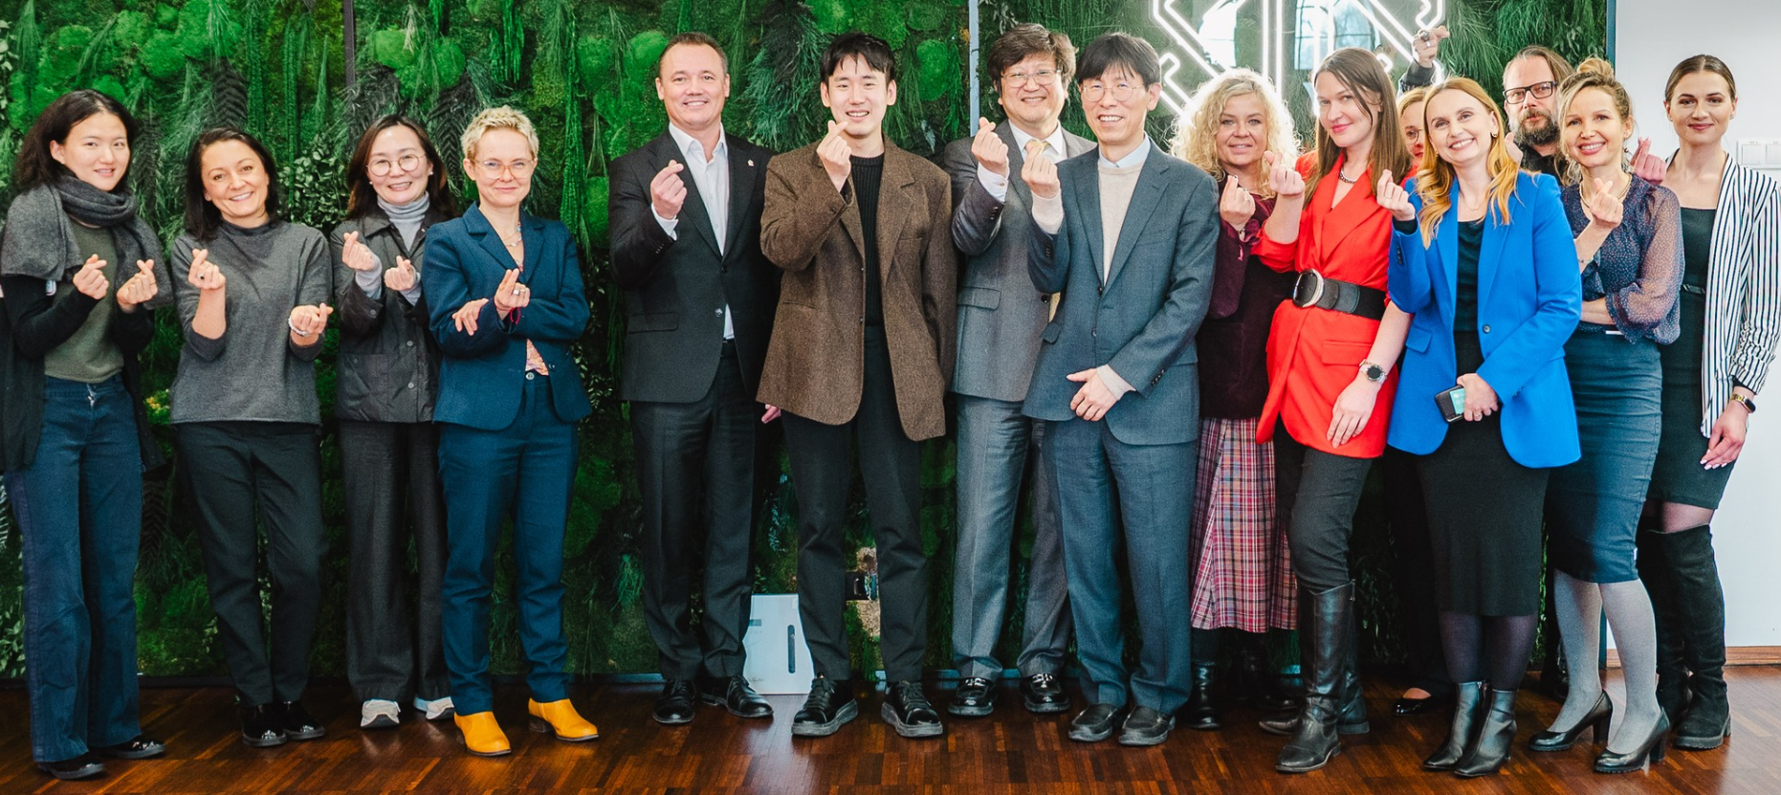
Field Interview Insights and Strategic Directions for SME Cybersecurity
Direct Field Interview Findings (Manufacturing facility & Special Economic Zone):
Turnkey Solution Preference: SMEs expressed strong demand for pre-configured, ready-to-use cybersecurity tools requiring minimal technical interpretation
Awareness Gap Reality: Significant cybersecurity knowledge deficits observed, particularly in traditional industries within the special economic zone
Industry Pattern Analysis (Based on interviews and comparative understanding):
Digital sectors generally demonstrate better preparedness
Traditional sectors show concerning awareness gaps even at management level
Notes:
A key aspect of solution delivery is the transition to cloud-based Security as a Service. For SMEs, managing on-premise solutions can be challenging. Since this program requires annual support, it operates on a one-year subscription model for specific Security as a Service.
This approach helps SMEs become more familiar with security solutions and recognize their value. The goal is for them to view security solutions as essential as standard business software like Microsoft Office, encouraging future security investments.

Slide 8
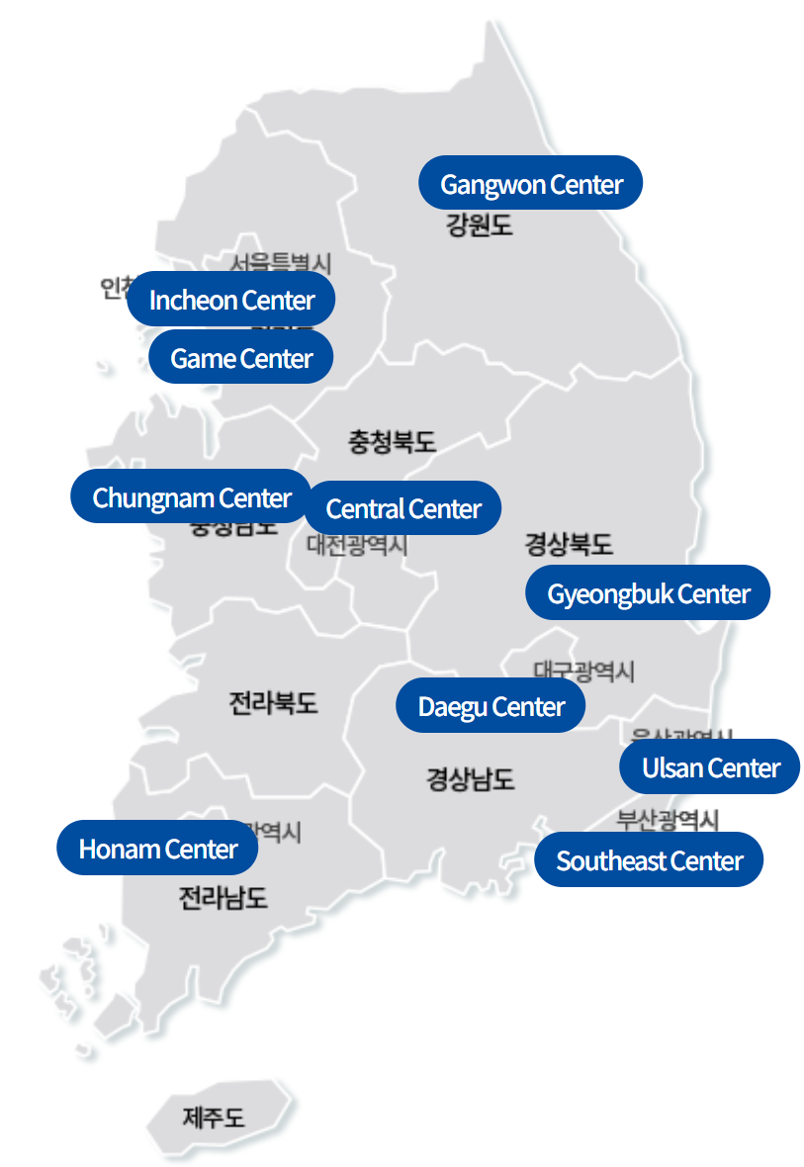
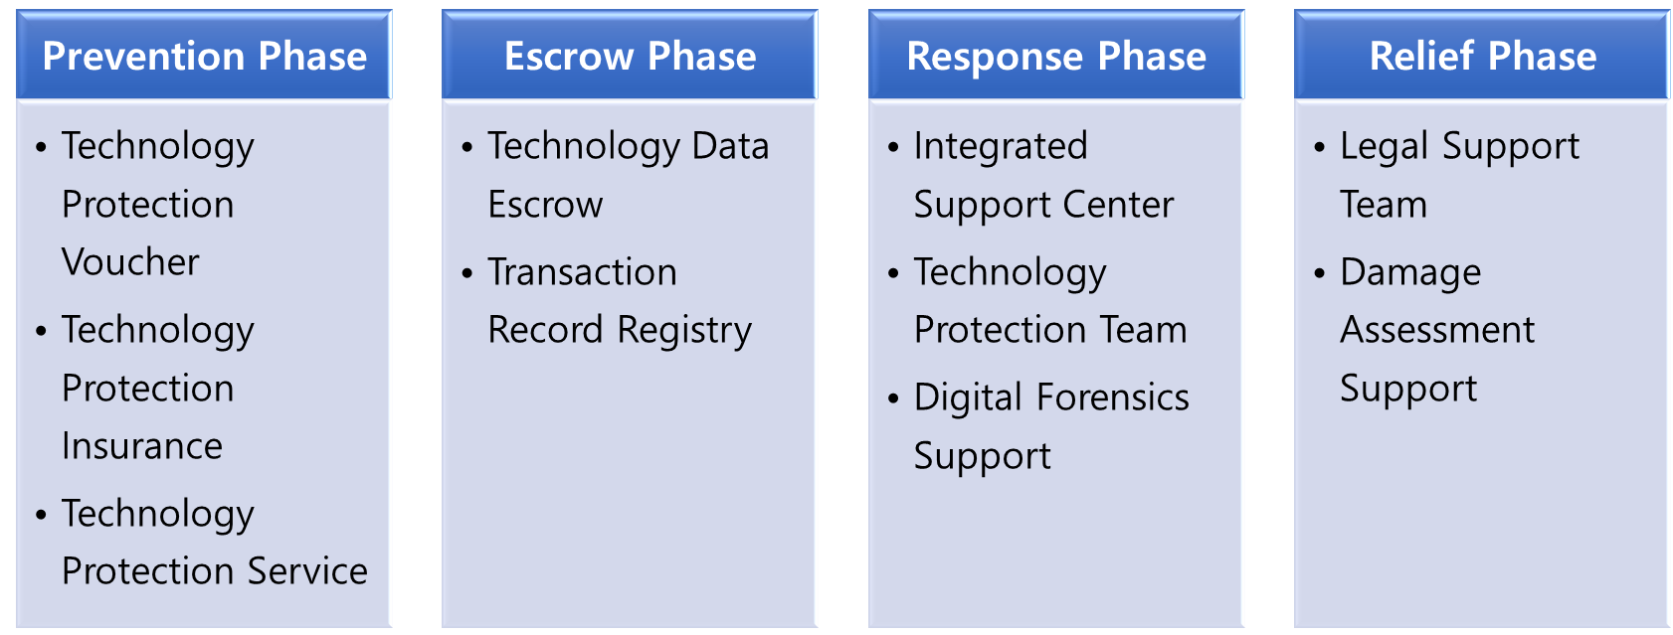
Korea's SME Cybersecurity Support Programs
Regional Support Infrastructure: 10 Regional Information Protection Centers with industry-specific expertise
Simplified Certification Framework
ISMS Simplification: 50% reduction in requirements, timeline, and cost
CSAP Streamlining: Simplified cloud service certification for SMEs
Technical Services & Solutions:
Security-as-a-Service (SecaaS): 190 cloud-based solutions portfolio
Information Protection Consulting: 4-step process with ransomware focus
Comprehensive Technology Protection: “4-Phase Lifecycle Protection”
Market Access & Procurement: “Technology Market Platform” Direct government contracting without bidding, List Price Sales for 3 years
Industry Association Support: KISIA Coordination - Centralized SME representation and advocacy

Slide 9
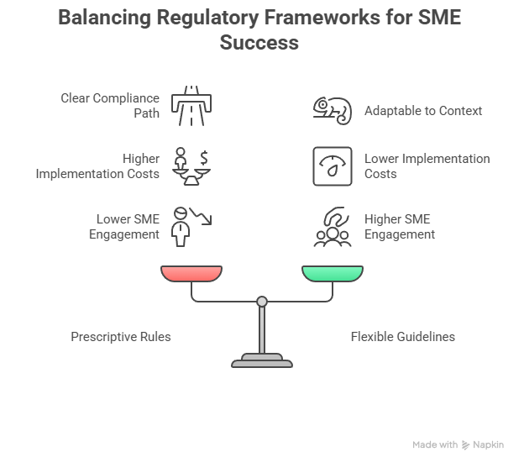
Field Interview Insights and Strategic Directions for SME Cybersecurity
Policy Analysis and Reflections:
Financial Constraint Implications: Implementation costs remain significant barriers despite basic digital operations
Regulatory Framework Considerations: Need to balance prescriptive rules vs flexible guidelines based on diverse SME contexts → Needs of turn-key solution
Participation Gap Analysis: Disconnect between available programs and actual SME engagement rates
Notes:
"Finally, I want to acknowledge that the strategic directions I've presented today represent ideal goals that may face significant practical implementation challenges in reality.
Rather than viewing these as perfect solutions, I hope you'll consider them as strategic guidelines for long-term bilateral learning and gradual improvement between Korea and Poland.
While there's certainly a gap between policy aspirations and operational realities, I believe that by presenting these directions, we can explore cooperation approaches that will benefit both countries in our shared journey toward better SME cybersecurity support."
"마지막으로 말씀드리고 싶은 것은, 오늘 제시한 이러한 전략적 방향들이 매우 이상적인 목표라는 점입니다. 실제 구현 과정에서는 다양한 현실적 어려움에 직면할 수 있습니다.
이러한 제안들을 완벽한 해결책이라기보다는, 한국과 폴란드 양국이 장기적으로 함께 학습하고 점진적으로 개선해 나갈 수 있는 전략적 가이드라인으로 이해해 주시기 바랍니다.
정책적 이상과 운영상의 현실 사이에는 분명 격차가 존재하지만, 이러한 방향성을 제시함으로써 양국 모두에게 도움이 되는 협력 방안을 모색할 수 있을 것이라고 생각합니다."

Slide 10
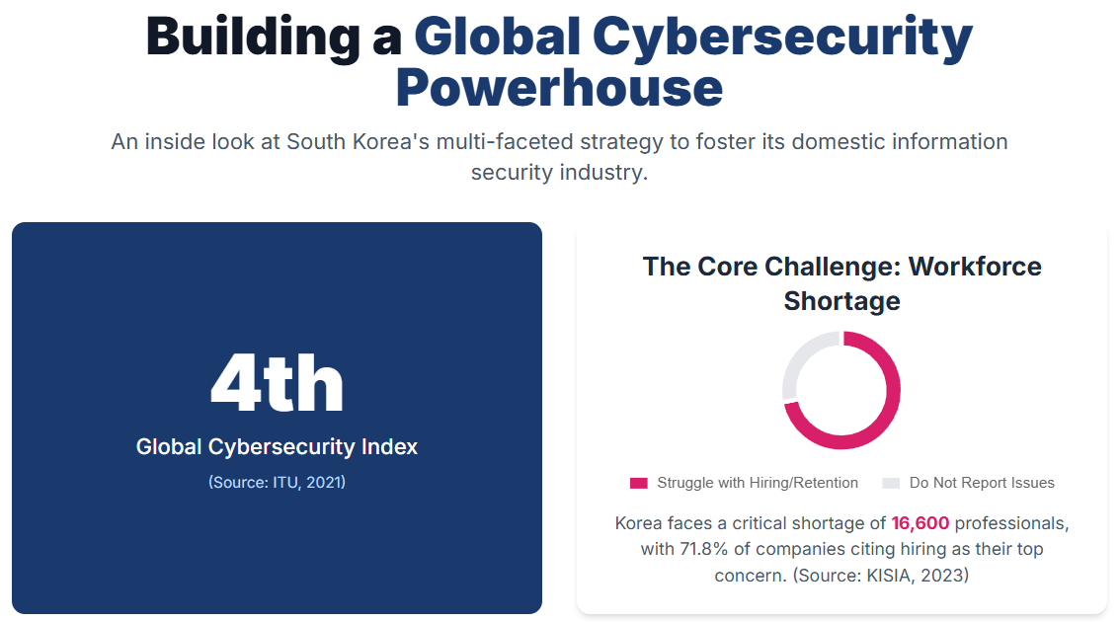
Promoting Information Security Industry
Notes:
"Finally, I want to acknowledge that the strategic directions I've presented today represent ideal goals that may face significant practical implementation challenges in reality.
Rather than viewing these as perfect solutions, I hope you'll consider them as strategic guidelines for long-term bilateral learning and gradual improvement between Korea and Poland.
While there's certainly a gap between policy aspirations and operational realities, I believe that by presenting these directions, we can explore cooperation approaches that will benefit both countries in our shared journey toward better SME cybersecurity support."
"마지막으로 말씀드리고 싶은 것은, 오늘 제시한 이러한 전략적 방향들이 매우 이상적인 목표라는 점입니다. 실제 구현 과정에서는 다양한 현실적 어려움에 직면할 수 있습니다.
이러한 제안들을 완벽한 해결책이라기보다는, 한국과 폴란드 양국이 장기적으로 함께 학습하고 점진적으로 개선해 나갈 수 있는 전략적 가이드라인으로 이해해 주시기 바랍니다.
정책적 이상과 운영상의 현실 사이에는 분명 격차가 존재하지만, 이러한 방향성을 제시함으로써 양국 모두에게 도움이 되는 협력 방안을 모색할 수 있을 것이라고 생각합니다."

Slide 11
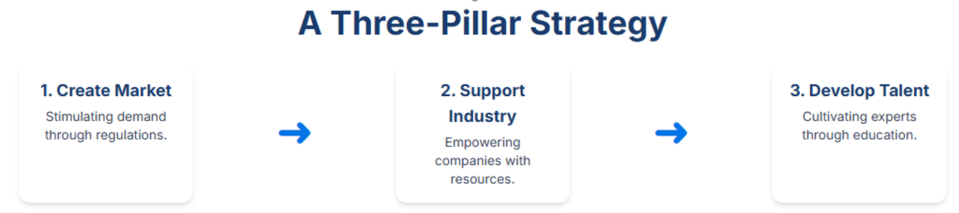
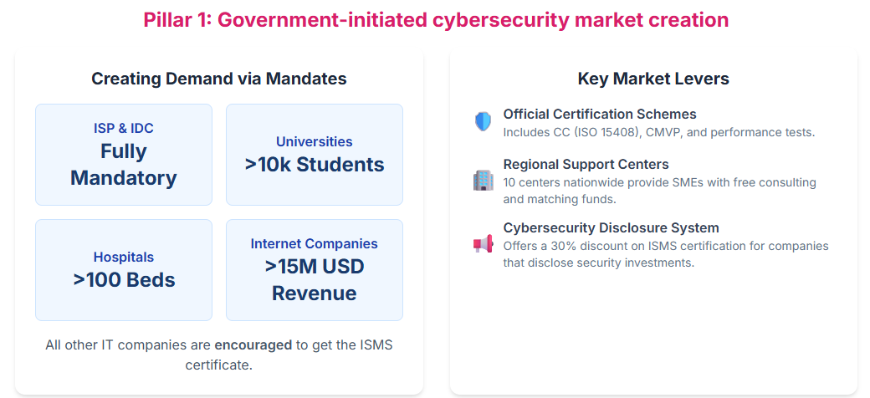
Promoting Information Security Industry
Notes:
"Finally, I want to acknowledge that the strategic directions I've presented today represent ideal goals that may face significant practical implementation challenges in reality.
Rather than viewing these as perfect solutions, I hope you'll consider them as strategic guidelines for long-term bilateral learning and gradual improvement between Korea and Poland.
While there's certainly a gap between policy aspirations and operational realities, I believe that by presenting these directions, we can explore cooperation approaches that will benefit both countries in our shared journey toward better SME cybersecurity support."
"마지막으로 말씀드리고 싶은 것은, 오늘 제시한 이러한 전략적 방향들이 매우 이상적인 목표라는 점입니다. 실제 구현 과정에서는 다양한 현실적 어려움에 직면할 수 있습니다.
이러한 제안들을 완벽한 해결책이라기보다는, 한국과 폴란드 양국이 장기적으로 함께 학습하고 점진적으로 개선해 나갈 수 있는 전략적 가이드라인으로 이해해 주시기 바랍니다.
정책적 이상과 운영상의 현실 사이에는 분명 격차가 존재하지만, 이러한 방향성을 제시함으로써 양국 모두에게 도움이 되는 협력 방안을 모색할 수 있을 것이라고 생각합니다."

Slide 12
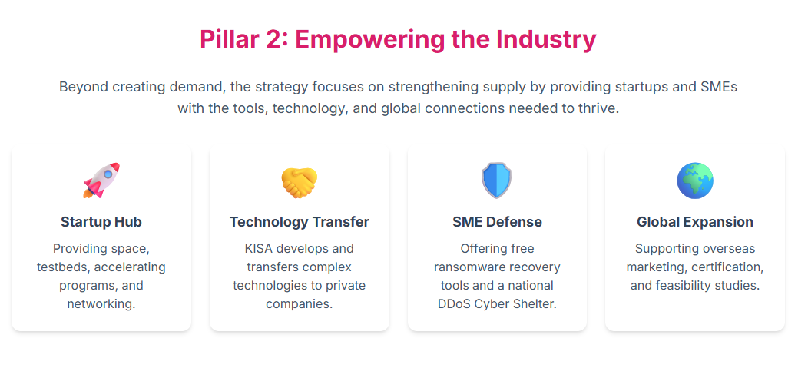
Promoting Information Security Industry
Notes:
"Finally, I want to acknowledge that the strategic directions I've presented today represent ideal goals that may face significant practical implementation challenges in reality.
Rather than viewing these as perfect solutions, I hope you'll consider them as strategic guidelines for long-term bilateral learning and gradual improvement between Korea and Poland.
While there's certainly a gap between policy aspirations and operational realities, I believe that by presenting these directions, we can explore cooperation approaches that will benefit both countries in our shared journey toward better SME cybersecurity support."
"마지막으로 말씀드리고 싶은 것은, 오늘 제시한 이러한 전략적 방향들이 매우 이상적인 목표라는 점입니다. 실제 구현 과정에서는 다양한 현실적 어려움에 직면할 수 있습니다.
이러한 제안들을 완벽한 해결책이라기보다는, 한국과 폴란드 양국이 장기적으로 함께 학습하고 점진적으로 개선해 나갈 수 있는 전략적 가이드라인으로 이해해 주시기 바랍니다.
정책적 이상과 운영상의 현실 사이에는 분명 격차가 존재하지만, 이러한 방향성을 제시함으로써 양국 모두에게 도움이 되는 협력 방안을 모색할 수 있을 것이라고 생각합니다."

Slide 13
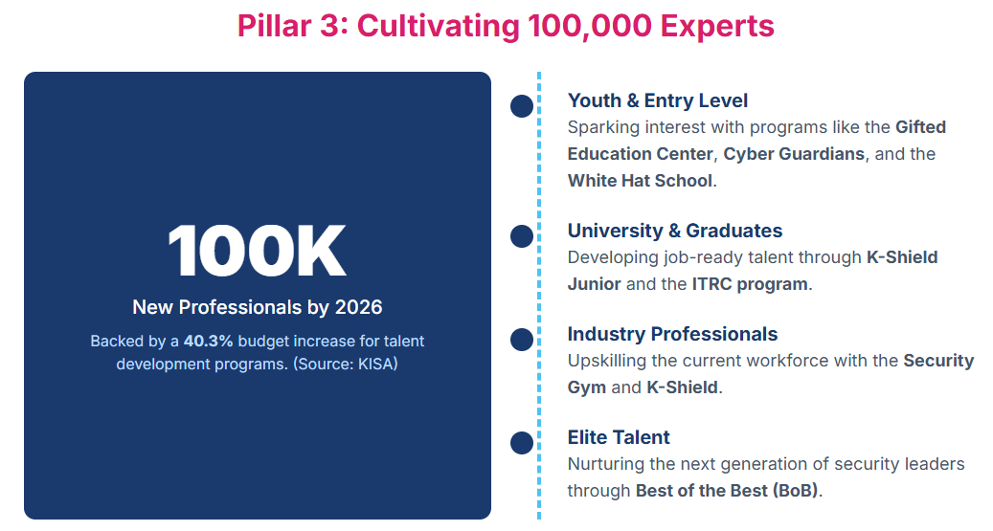
Promoting Information Security Industry
Notes:
"Finally, I want to acknowledge that the strategic directions I've presented today represent ideal goals that may face significant practical implementation challenges in reality.
Rather than viewing these as perfect solutions, I hope you'll consider them as strategic guidelines for long-term bilateral learning and gradual improvement between Korea and Poland.
While there's certainly a gap between policy aspirations and operational realities, I believe that by presenting these directions, we can explore cooperation approaches that will benefit both countries in our shared journey toward better SME cybersecurity support."
"마지막으로 말씀드리고 싶은 것은, 오늘 제시한 이러한 전략적 방향들이 매우 이상적인 목표라는 점입니다. 실제 구현 과정에서는 다양한 현실적 어려움에 직면할 수 있습니다.
이러한 제안들을 완벽한 해결책이라기보다는, 한국과 폴란드 양국이 장기적으로 함께 학습하고 점진적으로 개선해 나갈 수 있는 전략적 가이드라인으로 이해해 주시기 바랍니다.
정책적 이상과 운영상의 현실 사이에는 분명 격차가 존재하지만, 이러한 방향성을 제시함으로써 양국 모두에게 도움이 되는 협력 방안을 모색할 수 있을 것이라고 생각합니다."

Slide 14
02
FINAL POLICY RECOMMENDATIONS
Notes:
Let's start with KISA's SME support programs.

Slide 15
Comparative Analysis: Poland and Korea
Comparative Analysis of Key Program Elements
Program Element | Poland | Korea
Regional Support Infrastructure | • SME support programs active through special economic zone • Efforts underway to develop cybersecurity-specific measures for SMEs | • Network of 10 regional information protection centers • Region-specific industry focus with local personnel deployment
Certification Processes | • NASK's "Firma Bezpieczna Cyfrowo" certification program | • Simplified ISMS (50% reduction in requirements) • Streamlined CSAP for cloud services
Technology Protection | • EDIH technical services including vulnerability assessments and penetration testing | • Comprehensive four-phase protection system • Technology escrow service with specialized legal support and insurance subsidies
Procurement Access | • [Information not available] | • Technology Market Platform with direct contracting mechanisms • List price allowances for evaluated technologies
Technical Services | • EDIH CyberSec providing comprehensive technical support • Free/subsidized professional services through EU Digital Europe Programme | • Cloud-based Security-as-a-Service model • Portfolio of 190 security solutions
Industry Association Role | • #CyberMadeInPoland cluster connecting 30+ SMEs • Substantial funding support (€1.8M grants) | • KISIA as centralized industry representative • Comprehensive advocacy and support functions
Educational Programs | • PARP's Akademia PARP: free e-learning, certifications, webinars | • Regional center training programs • SME-focused ransomware defense training
Notes:
KISIA is a private organization focused on industry promotion and development, operating through member companies' fees. While the fees aren't substantial, they receive various government support. Currently, they're running educational programs to develop talent needed in the information security industry.
Additionally, they assist companies in the information security subcontracting sector. Since public procurement requirements in the information security field are complex, KISIA acts on behalf of the government to review and correct any inappropriate procurement requirements.
They also provide ransomware solution education and related training for SMEs.
KISIA serves as a unified voice for Korean cybersecurity SMEs, representing their interests and concerns to the government.

Slide 16
Comparative Analysis: Poland and Korea
Poland's Key Characteristics:
EU Integration Excellence: Strong alignment with European cybersecurity frameworks enabling cross-border cooperation
Technical Service Quality: EDIH CyberSec provides professional-grade vulnerability assessments and penetration testing
Cluster Development: #CyberMadeInPoland demonstrates effective industry networking with substantial funding support
International Standards: Maintains European compliance standards ensuring global compatibility
Korea's Key Characteristics:
Regional Accessibility: Distributed center model addresses geographic disparities in cybersecurity support
Administrative Simplification: Systematic reduction of certification barriers while maintaining security effectiveness
Lifecycle Protection: Comprehensive four-phase technology protection from prevention to damage relief
Market Integration: Direct procurement pathways creating business incentives for cybersecurity investment
Notes:
Next is our Local Information Protection Center program. As shown here, we address what we call 'blind spots' in national operations. Like many countries, Korea faces various gaps - generational, economic, gender, and particularly notable disparities between the Seoul/Gyeonggi metropolitan area and other regions. This extends to information security capabilities, with some regions facing geographical and resource limitations.
The Local Information Protection Center operates across ten regions, including Gangwon Province, Incheon-Gyeonggi, Chungnam, Central region, Gyeongbuk, Daegu, Ulsan Southeast, and Honam.
These centers operate core programs that include training for regional information security personnel to enhance capabilities. Importantly, they provide on-site incident response support for security breaches and implement the security consulting and solution provision programs mentioned earlier.
In terms of resource allocation, the Local Information Protection Centers address this by stationing KISA personnel in each region. These staff members utilize government funding to provide three types of services to regional businesses.

Slide 17
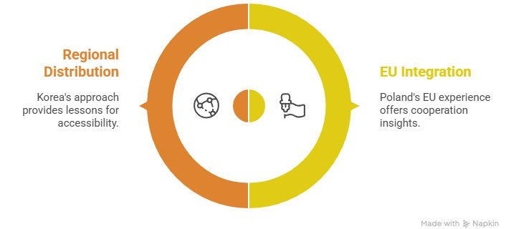
Comparative Analysis: Poland and Korea
Differences in Foundational Frameworks for SME Support
EU Integration Models: Poland's experience with European frameworks provides valuable insights for international cooperation models
Regional Distribution: Korea's regional center-based approach offers lessons for improving geographic accessibility
Areas for Continuous Mutual Reference and Learning
Security Service Delivery to SMEs: Both countries employ different approaches while actively working to address multiple barriers—financial, technical, and organizational—that hinder SME cybersecurity investment
Cybersecurity Industry Development: Each system represents distinct approaches shaped by national contexts and strategic priorities
Notes:
Next is our Local Information Protection Center program. As shown here, we address what we call 'blind spots' in national operations. Like many countries, Korea faces various gaps - generational, economic, gender, and particularly notable disparities between the Seoul/Gyeonggi metropolitan area and other regions. This extends to information security capabilities, with some regions facing geographical and resource limitations.
The Local Information Protection Center operates across ten regions, including Gangwon Province, Incheon-Gyeonggi, Chungnam, Central region, Gyeongbuk, Daegu, Ulsan Southeast, and Honam.
These centers operate core programs that include training for regional information security personnel to enhance capabilities. Importantly, they provide on-site incident response support for security breaches and implement the security consulting and solution provision programs mentioned earlier.
In terms of resource allocation, the Local Information Protection Centers address this by stationing KISA personnel in each region. These staff members utilize government funding to provide three types of services to regional businesses.

Slide 18
Comparative Analysis: Poland and Korea
Poland's Strengths Korea Could Learn From:
EU Integration Model: Poland's experience with European cybersecurity frameworks offers insights for international cooperation and standardization
Technical Service Excellence: EDIH CyberSec's professional-grade services demonstrate effective public-private collaboration models
Cluster Development: #CyberMadeInPoland shows successful industry networking with substantial funding support
Korea's Approaches Poland Might Consider:
Regional Distribution Model: Korea's network of specialized regional centers addresses geographic accessibility challenges
Administrative Simplification: Korea's certification streamlining demonstrates ways to reduce SME barriers while maintaining standards
Comprehensive Technology Protection: Korea's four-phase lifecycle approach offers a systematic framework for IP protection
Notes:
Next is our Local Information Protection Center program. As shown here, we address what we call 'blind spots' in national operations. Like many countries, Korea faces various gaps - generational, economic, gender, and particularly notable disparities between the Seoul/Gyeonggi metropolitan area and other regions. This extends to information security capabilities, with some regions facing geographical and resource limitations.
The Local Information Protection Center operates across ten regions, including Gangwon Province, Incheon-Gyeonggi, Chungnam, Central region, Gyeongbuk, Daegu, Ulsan Southeast, and Honam.
These centers operate core programs that include training for regional information security personnel to enhance capabilities. Importantly, they provide on-site incident response support for security breaches and implement the security consulting and solution provision programs mentioned earlier.
In terms of resource allocation, the Local Information Protection Centers address this by stationing KISA personnel in each region. These staff members utilize government funding to provide three types of services to regional businesses.

Slide 19
Joint Research & Knowledge Exchange Opportunities
Translation of available cybersecurity support into actual SME implementation remains a shared challenge, presenting opportunities for joint research and mutual learning to strengthen both nations' approaches
Joint Research Opportunities:
Implementation Gap Solutions: Both countries face challenges in translating available programs into actual SME adoption
Turnkey Solution Development: Shared interest in simplified, ready-to-implement security solutions
Regional vs. Centralized Models: Comparative study of different geographic distribution approaches
Knowledge Exchange Programs:
Best Practice Sharing: Regular exchanges on effective SME support mechanisms
Policy Innovation: Collaborative development of SME-friendly cybersecurity frameworks
Industry Development: Joint approaches to building robust domestic cybersecurity ecosystems
Notes:
Next is our Local Information Protection Center program. As shown here, we address what we call 'blind spots' in national operations. Like many countries, Korea faces various gaps - generational, economic, gender, and particularly notable disparities between the Seoul/Gyeonggi metropolitan area and other regions. This extends to information security capabilities, with some regions facing geographical and resource limitations.
The Local Information Protection Center operates across ten regions, including Gangwon Province, Incheon-Gyeonggi, Chungnam, Central region, Gyeongbuk, Daegu, Ulsan Southeast, and Honam.
These centers operate core programs that include training for regional information security personnel to enhance capabilities. Importantly, they provide on-site incident response support for security breaches and implement the security consulting and solution provision programs mentioned earlier.
In terms of resource allocation, the Local Information Protection Centers address this by stationing KISA personnel in each region. These staff members utilize government funding to provide three types of services to regional businesses.

Slide 20
Korea-Poland SME Cybersecurity Cooperation Framework
Korea-Poland SME Cybersecurity Cooperation Framework
Three-Pillar Approach for Adaptive Learning & Bilateral Cooperation
PILLAR 1
Policy Discussion &
Knowledge Sharing
KEY ACTIONS:
KDI-hosted Policy Development Workshops
Joint Policy Effectiveness Research
Bi-annual Meetings & Cooperation Sessions
PILLAR 2
Joint Research &
Technology Transfer
KEY ACTIONS:
SecaaS Model Localization Studies
Technology Exchange Programs
Inter-Ministry Cooperation Framework
PILLAR 3
Public-Private Partnership
for SME Protection
KEY ACTIONS:
Joint SME Cybersecurity Assessment
Comparative Technology Protection Studies
KDI-KISA-NASK Research Framework
MSIP/MSS/KDI
COOPERATION BENEFITS
MRiT/NASK
Effective Policy Making
KISA Regional Centers (10)
ISMS Simplification (80→40 items)
SecaaS Portfolio (190 solutions)
SME Technology Protection Act
Technology Escrow Service
Cybersecurity Technology Exchange
PARP Academy Online Education
EU NIS2 Directive Implementation
EDIH CyberSec Services
PFR R&D Funding
#CyberMadeInPoland Cluster
Joint Research on CyberSec for SMEs
SMEs Intellectual Property Protection
Capacity Building Program Sharing

Slide 21
CONTENTS
01
POLAND & KOREA CURRENT STATUS
02
FINAL POLICY RECOMMENDATIONS
Notes:
These three topics I've presented today were carefully selected based on our previous discussions. I hope this has been helpful, and I'm happy to provide additional information or data as needed.

Slide 22

2024/25 KSP with Poland
Final Reporting Workshop
July 2025
Thank you
Notes:
Thank you for your attention.

