Slide 1

  Medycyna obliczeniowa: Program Digital Health
  Zdrowie psychiczne: Program WHO mhGAP
Posiedzenie plenarne
Rady Naukowej przy Ministrze Zdrowia
29 listopada 2018
Kazimierz Murzyn, Lifescience Kraków

Slide 2
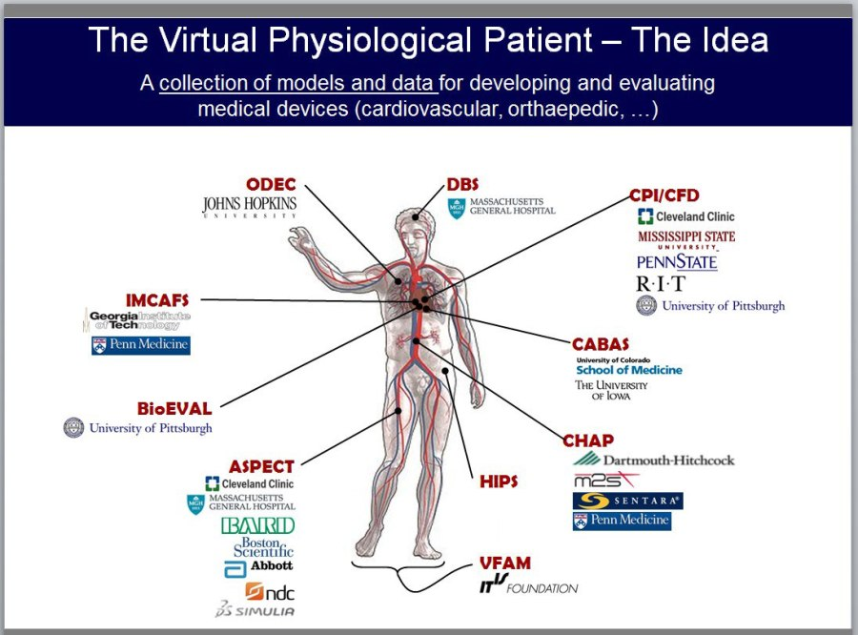
In Silico Medicine: the concept
The direct use of computer simulation
in the diagnosis, treatment and prevention of disease
The framework to enable investigation of the human body as a single complex system:
Personalised healthcare
Preventative approach to combatting disease
Holistic multi-morbidity medical treatments
Reduced need for animal experiments
Industrial partnerships: New products & systems
The Digital Twin – Philips: virtual representation of health status

Slide 3
In Silico Medicine: the concept
The direct use of computer simulation
in the diagnosis, treatment and prevention of disease
Digital Health: the use of information and communication technologies IT for health
The Human Factor in Digital Health: it is not just about the technologies, but also about the people
Challenges:
Engage more people with the “digital healthcare wave”
User-centred designed solutions and reduce complexity
Training healthcare workforce
Protect the data
Research translation to the clinic and in business
More engagement with business and evaluation of risks
Greenhalgh et al, J Med Internet Research

Slide 4
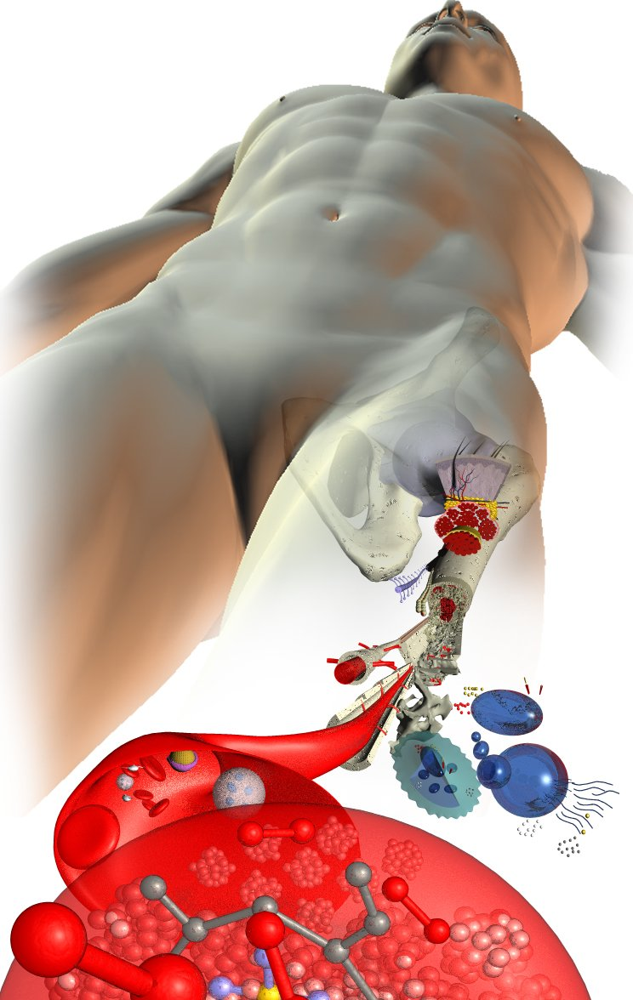







SANO - The Centre for New Methods
in Computational Diagnostics and Personalised Therapy
The applied research centre and the collaboration platform for…
the identification, development and implementation of new techniques for in Silico Medicine;
sustained industrial success through constant innovation, intellectual property, practical healthcare developments, higher education programmes and professional training.
Centre will be established as a Foundation in Krakow, Poland by:

Slide 5

SANO objectives
the development of new technologies for prevention, diagnosis and therapy;
integration of existing and novel preventive, diagnostic and therapeutic solutions to increase clinical objectivity and improve outcomes for patient benefit;
acceleration of regulatory and certification processes for clinical usage of computational technologies;
Clinical Decision Support Systems (CDSS)
Clinical Trial Simulation (CTS)
Automated Clinical Data Analysis
In silico device development
In silico drug development
Computational models of human physiology
Conceived in response to clinical need
Built in the context of related diseases
Intended to provide medical (analytical, preventive, diagnostic, and therapeutic) solutions.

Slide 6
SANO stakeholders and value proposition
Public and private organisations can closely collaborate in development and implementation of advanced programs aimed at solving specific clinical problems through computational methods
Health science
Health industry
SMEs and StartUps
Health industry
medtech and pharma
Healthcare
services
Publically-funded projects
Dissemination in academic contexts
Shared links with industry partners
Shared PhD programs
Fast product development
Access to curated data
Validation and testing tools and methods
Business up-scaling & access to markets
Biomarker development
Co-development of medical technologies
Access to HPC capability and expertise
Early access to IP
Industrial PhD programs
Training
Exploitation of advanced simulation models and CDSS
Workflow integration
Computational optimisation
inSilico clinical trials
Education
Business development
& regulatory
Translation management
Business incubation and acceleration
Support in legal and regulatory issues
IP and patents
Individual market studies

Slide 7
Program Digital Health Poland
Proponujemy utworzenie programu i strategii Digital Health dla Polski (DHP), których celem byłoby wsparcie rozwoju tej dziedziny, jako podstawowego paradygmatu nowoczesnego leczenia – powstałego jako konwergencja nauki, technologii i praktyki klinicznej.
Zdefiniowanie programu DHP z założeniem wpisania go do strategii sektorowych otwierałoby możliwość dalszego integrowania działań w formie projektów, wydarzeń i innych czynników, które wspólnie pozwoliłyby uzyskać w perspektywie dekady wymierne korzyści:
  wzrost aktywności w zakresie badań i rozwoju mierzony ilością i wartością projektów B&R wdrażanych do praktyki klinicznej
  wzrost skali wykorzystania w sektorze opieki zdrowotnej nowoczesnych technologii -> wzrost efektywności leczenia, wypełnienie luk kadrowych i kompetencyjnych , obniżenie kosztów leczenia
  rozwój innowacyjność i przedsiębiorczości, mierzone liczbą startupów, liczbą produktów oraz liczbą osób zatrudnionych w tym obszarze
  silna pozycja pośród liderów Digital Health dziedziny w Europie

Slide 8


Slide 9

The mental health Gap Action Programme
Mental, neurological, and substance use (MNS) disorders contribute approximately 10 percent of the global burden of disease.
They often run a chronic course, are highly disabling, and are associated with significant premature mortality.
Moreover, beyond their health consequences, the impact of these disorders on the social and economic well-being of individuals, families, and societies is enormous.
Despite this burden, MNS disorders have been systematically neglected in most of the world, particularly in low- and middle-income countries (LMICs), with pitifully small contributions to prevention and treatment by governments and development agencies.

Slide 10
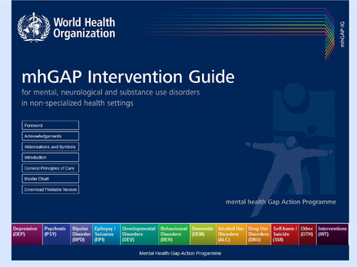
The mental health Gap Action Programme
The WHO programme seeks to address the lack of care for people suffering from mental, neurological and substance use (MNS) conditions.
As part of this programme, the mhGAP Intervention Guide (mhGAPIG) was issued in 2010.
mhGAP-IG is a clinical guide on mental, neurological and substance use disorders for general health-care providers who work in nonspecialized health-care set

Slide 11
Mental Health Gap Action Programme
MNS are common in all regions of the world, affecting every community and age group across all income countries.
While 14% of the global burden of disease is attributed to these disorders, most of the people affected - 75% in many low-income countries - do not have access to the treatment they need.
The WHO Mental Health Gap Action Programme aims at scaling up services for MNS for countries especially with low- and middle-income.
The programme asserts that with proper care, psychosocial assistance and medication, tens of millions could be treated for depression, schizophrenia, and epilepsy, prevented from suicide and begin to lead normal lives– even where resources are scarce.

Slide 12
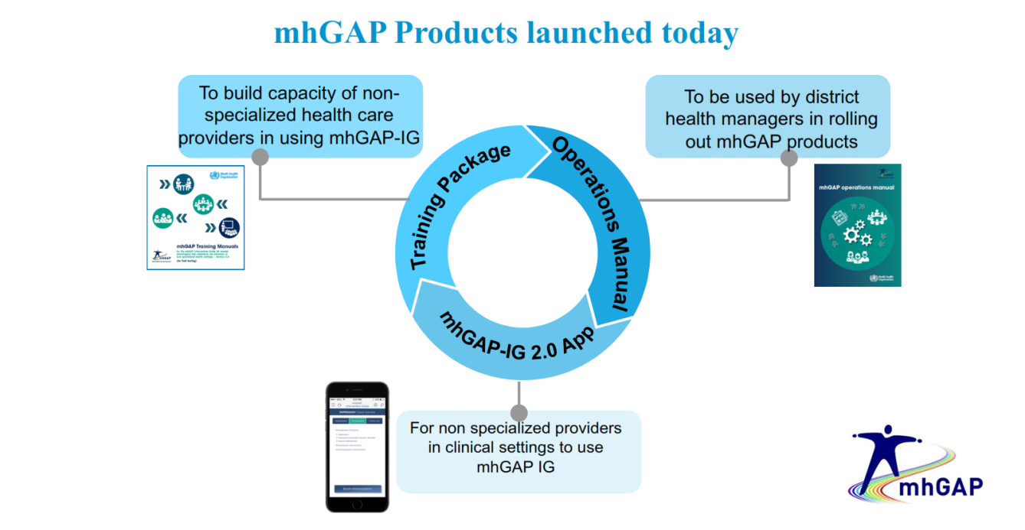
Mental Health Gap Action Programme – pilot in Poland
W oparciu o narzędzia WHO proponujemy opracowanie i przeprowadzenie pilotażowego programu profilaktycznego obejmującego:
podnoszenie kompetencji na trzech poziomach profesjonalistów: zawodów pomocowych, profesjonalistów opieki zdrowotnej oraz specjalistów z zakresu zdrowia psychicznego
edukację społeczną w zakresie profilaktyki zdrowia psychicznego i samobójstw w zakresie pierwszych interwencji oraz udzielanego wsparcia
kampanie promocyjne adresowane do społeczeństwa mające na celu podniesienie świadomości i destygmatyzowanie problemu
inne działania koplementarne
Rezultatem programu będzie:
zmniejszenie wskaźnika liczby samobójstw
zmniejszenie kosztów społecznych i ekonomicznych związanych z nieleczonymi MNS

Slide 13

Kazimierz MURZYN
Managing Director
LifeScience Kraków
For more information,
please contact…
LifeScience Kraków Foundation
30-387 Kraków
ul. Bobrzyńskiego 14
tel. +48 12 297 4 605
mob. +48 504 106 466
klaster@lifescience.pl
http://www.lifescience.pl/

