Slide 1
Overview of the call
2019 CEF Transport call
Information Day – 19 February 2019
Morten JENSEN
Head of Unit C1 –INEA – Innovation and Networks Executive Agency

Slide 2
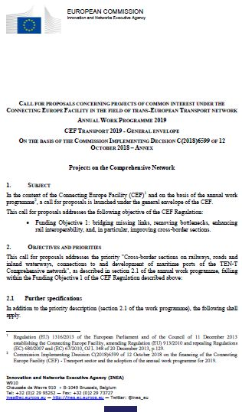
Reference documents
Content of the call text
Highlights of the call
Timeline

Slide 3
Reference documents
2019 Annual Work Programme
CEF Regulation & TEN-T Guidelines
Call text
Application forms (Parts A, B, C and D)
Guide for Applicants
Application checklist & CBA checklist
FAQs published on the call page
Model grant agreement
Cohesion Policy CBA methodology & CBA cash flow template
https://ec.europa.eu/inea/en/connecting-europe-facility/cef-transport/apply-funding/2019-cef-transport-call-proposals
Notes:
Let's start with the basics: these are the reference documents to which you should refer all the time when preparing your proposal. All these documents can be found on the call webpage.
CEF Regulation & TEN-T guidelines. When preparing a proposal, you should always bear in mind the legal framework of CEF. For this, we advise applicants to also revert to the CEF regulation and the TEN-T guidelines, given that these documents are frequently referred to in both the work programme and call texts.
The 2019 Annual Work Programme sets the scene for each call and should be taken as the basis when preparing the proposals. However, this document should always be read together with the call text, which specifies in further detail the priorities covered by the call, how to submit applications and how your application will be evaluated.
If applicants decide to give it a go and start preparing a proposals, it is essential to get acquainted with the type of information that will be requested in the application as well as the process for preparing and submitting a proposal. For this, the application forms and in particular the Guide for Applicants will be precious tools.
In order to reply to any doubts of the applicants, be it of general (process) or priority specific, the Agency has set up a helpdesk. Any question asked is replied in the form of FAQs that are updated frequently. Reading these upfront will certainly clarify many aspects of the call, so we encourage all applicants to consult these form the early stages, together with the other reference documents.
INEA also receives many questions on the next steps, notably aspects of legal and financial nature should a proposal be selected for funding. Many of these questions can be replied by the Model Grant Agreement and the FAQs on implementation of CEF Actions, which are also published in the call page. We advise applicants to also consult these documents when considering submitting a proposal.
In order to increase consistency and ensure that the certain elements are present, the work programme and call text suggest that when preparing a CBA accompanying the proposal, the Cohesion Policy methodology for Cost-Benefit Analysis is recommended. This methodology is also available for consultation in the call page.

Slide 4
Content of the call text
Priority Description
Budget
Timetable
Admissibility and eligibility criteria
Exclusion, selection and award criteria
Procedure for submission and evaluation of proposals
Legal and financial provisions
Information for Applicants
Notes:
As usual, soon after the adoption of the 2019 Annual Work Programme, the call for proposal was published and later opened on the INEA website. Call publishing happened on 05 December 2018 and call opening on 08 January 2019.
The main reference document for the call is the call text. The call text covers the points mentioned in this slide notably:
The priority description: the call texts make reference to the priorities as laid down in the work programme. It is therefore important to refer to both documents when preparing a proposal.
Budget: information on budget is also present in the call text, notably the indicative amount to be allocated on the basis of this call, which is €100 million. The call covers two priorities: Projects on the Comprehensive Network with the budget of €65 million and Reduction of rail freight noise with the budget of €35 million
Timetable: the call text refers to the indicative timetable for the call, from the moment of publication of the call up to the signature of the grant agreements.
The admissibility and eligibility criteria, as well as the exclusion, selection and award criteria can also be found in the call text. The procedure for the submission and evaluation of proposals is also explained in the call text. These elements will however be covered in the next presentations so there is no need to provide much detail at this stage.
The call text also refers to some legal provisions, notably the fact that actions shall only be financed if in conformity with EU law and which are in line with the relevant EU policies, in particular, in the areas of competition, protection of the environment, state aid and public procurement.
The text also referred to general financial provisions as well the funding forms. This includes information on co-funding rates, eligible costs, payment arrangements (notably info on pre-fianancing) and so on….
Finally, the text also makes reference other more practical aspects for applicants on how to submit a proposal and where to get additional information.

Slide 5
Highlights of the call text (Projects on Comprehensive Network)
Proposals for studies, works and mixed proposals are eligible under the call
Maximum co-funding rates (% of eligible costs):
Studies: 50%
Works: from 10% to 40%
Notes:
Some aspects of the call are worth highlighting:
A proposal submitted under this call must address either works or studies. In addition, proposals may combine studies and works as long as the respective activities and related budget are clearly defined and separated. Finally, studies may include pilot activities under certain conditions laid down in the call text.
Depending of the type of action, different co-funding rates will apply.

Slide 6
Highlights of the call text (Rail Freight Noise)
Only works retrofitting of rail freight wagons- are eligible under the call
Unit contributions apply:
Per S-type: EUR 250
Per SS-type: EUR 600

Slide 7
Highlights of the call text
Start of eligibility of costs: as from the date of submission of the application
End date of the Action: no later than 31 December 2023
Notes:
As was the case for past calls, costs are eligible as of the date of submissions. Of course this is at own risk of the applicants in the sense that if a proposal is not selected for funding and awarded a grant, any costs incurred will not be reimbursed. It is also important to keep in mind that only the last date of submission will be considered for the eligibility of costs. Therefore, if a proposal is submitted, reopened for editing and then submitted again, the date that stands for the eligibility of costs is the last.
Also similarly to past calls, the work programme sets an end date for the actions selected under this call, which should be at the latest 31 December 2023. Any costs incurred after will not be eligible.

Slide 8
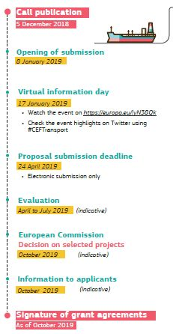
Reference documents
Content of the call text
Highlights of the call
Timeline

Slide 9
Indicative timeline
Call publication | 08 January 2019
Deadline for submission | 24 April 2019 (17:00:00 Brussels time)
Evaluation of proposals | April-July 2019
Consultation of CEF Coordination Committee Information of European Parliament | September 2019
Adoption of Selection Decision | October 2019
Information to applicants | October 2019
Time To Grant | As of October 2019
9

Slide 10
Contact INEA
INEA-CEF-Transport-calls@ec.europa.eu
http://ec.europa.eu/inea
@inea_eu
Look for INEA!

